Slide 1


Slide 2

Lecture #2 – Aesthetics of Soccer
Goals
Saves
Plays
The Beautiful Game - Documentary

Slide 3
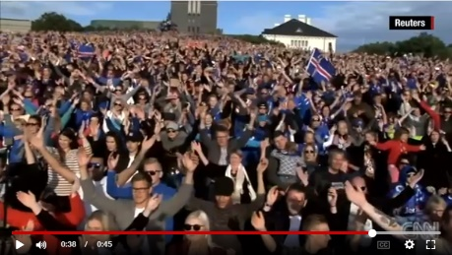
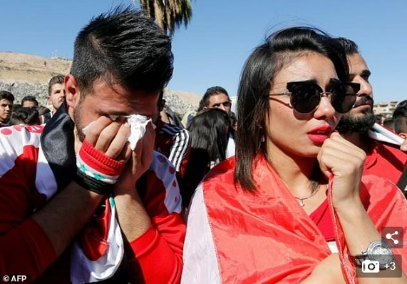
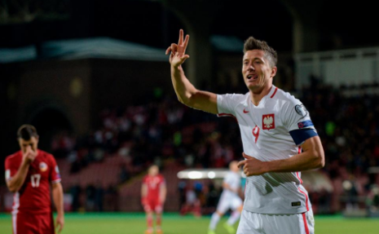


LAST WEEK TODAY…
With a population of just 335,000, Iceland became the smallest country ever to qualify for the World Cup
Tears in Damascus as Syria misses shot at World Cup
50 goals in 90 games . top European scorer with 16 goals. 33 goals in his last 31 appearances for Poland
Germany - Perfect 10 for 10 5:1 over Azerbaijan
Argentina – Likely miss!!! 0:0 with Peru

Slide 4
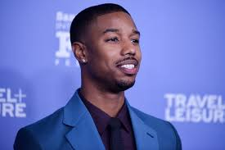
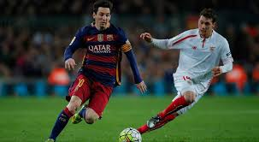
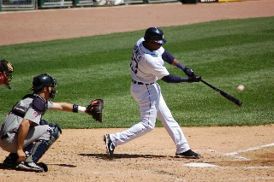
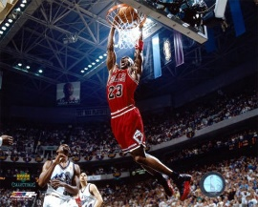
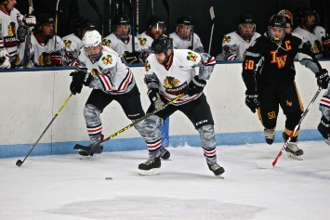
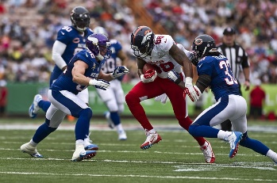
Attributes and Aesthetics
Attributes | Soccer | Baseball | Basketball | Hockey | Football
FITNESS | Non-Stop, 7-9.5 M, Stop-Start, F/B/S RUN, JUMP | Specialized Skill | Breaks, Time-Outs, Substitutes | Short Spurts. High intensity Shift | Offense/Defense Rest, Breaks, Time-Outs
CREATIVITY | Randomicity , Strategy, Individual decision making | Programmed with limited improv. | Strategy, with improvisation | Randomicity, Similar to Soccer | Diagrammed w/ Audibles, Agility
SKILL | Generalist, Full Body | Specialist | Generalist/ Specialist | Generalist, Arms, Legs | Specialist
VERSATILITY | Very High | Very Low | Low | Medium | Low
PHYSICALITY | Not a key factor, Endurance | Varies by position | Height and Lift | Body Strength, Speed | Strength, Power, Endurance
INTUITION | Anticipation, Play w/o the ball, Spatial | Hitter, Runner | Rebounding, Passing, Magic | Similar to Soccer on smaller real-estate, much faster | Quarterback, Receiver

Slide 5
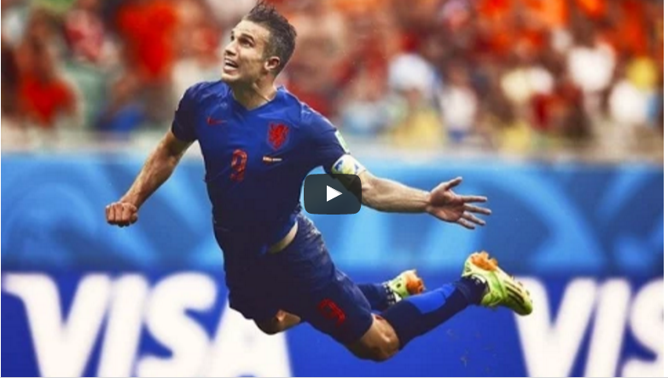
He shoots…He scores!!!

Slide 6
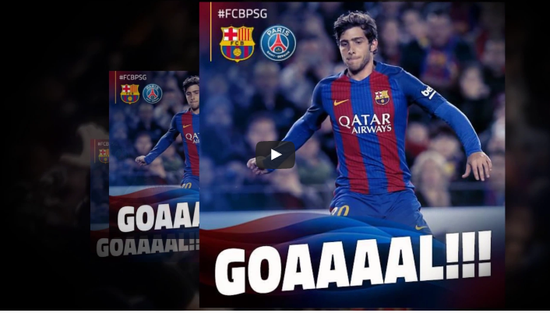
Who & How to Score?
1
2
3
4

Slide 7
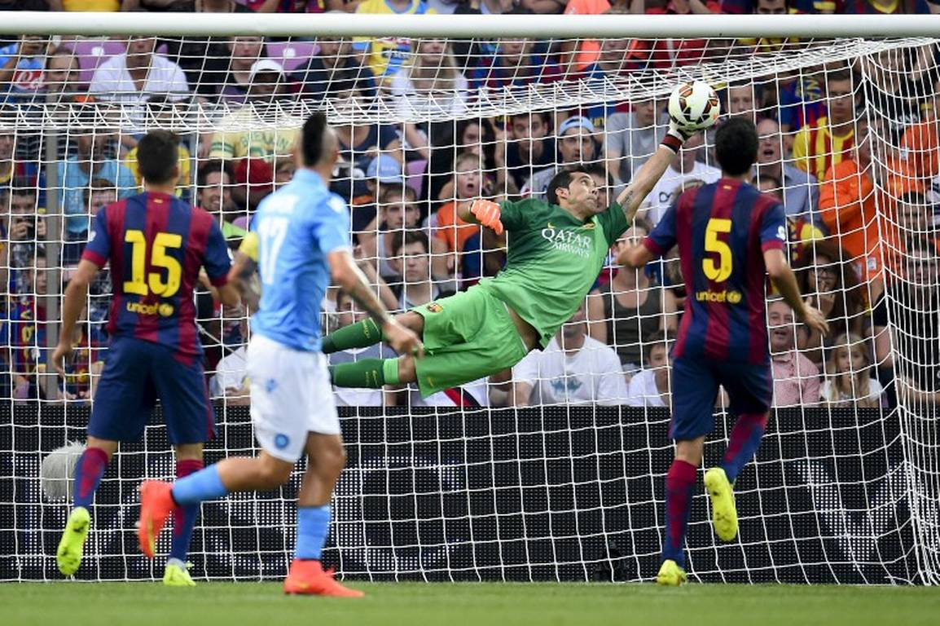

Slide 8
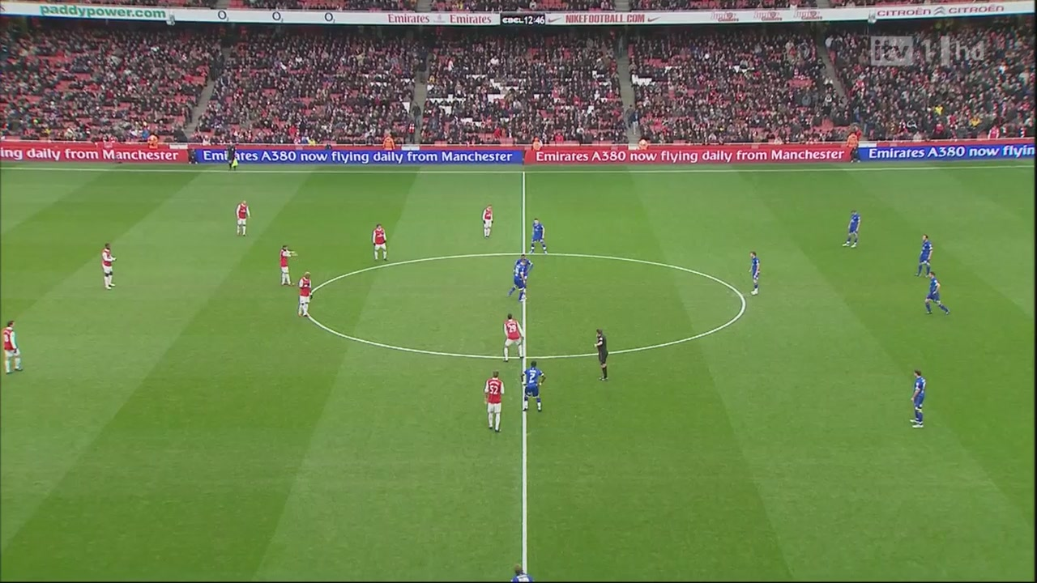
Defense is just as important
2

Slide 9

It’s not always that Beautiful!

Slide 10
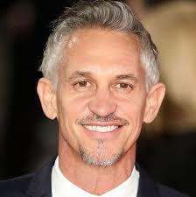
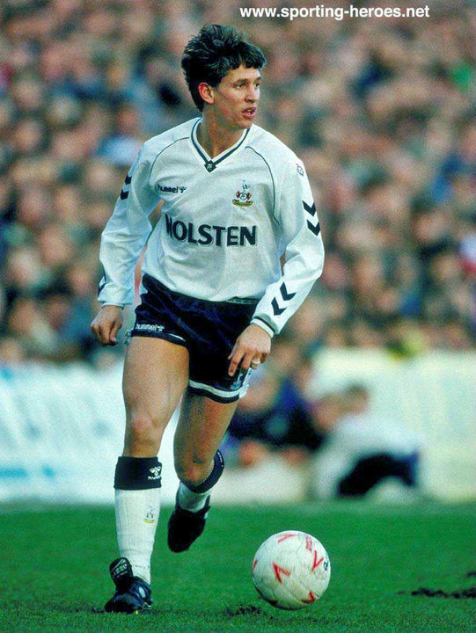
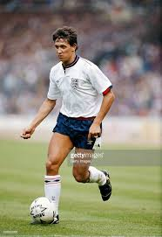
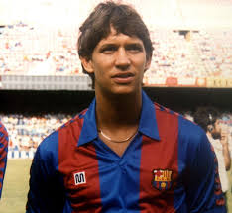
Gary Lineker – A Spurs & England Legend – Now BBC Commentator

Slide 11
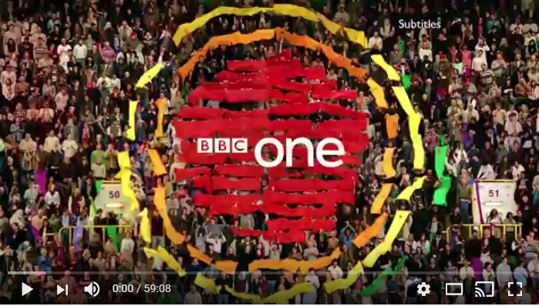
The Beautiful Game
Gary Linekar Biography
Gary Linekar is one England’s top scorers in international football, winning the golden boot at the 1986 World Cup final. Since retiring from the game, Linekar has become a celebrated media pundit, acting as anchorman for BBC’s match of the day.
https://www.youtube.com/watch?v=2uuKm7LgzZQ

Slide 12
Next Week
Soccer and Politics in Dictatorships and Democracies.
Major Historical & Political, Events ( Wars, Disasters, Dramas, Patriotism)

