Slide 1
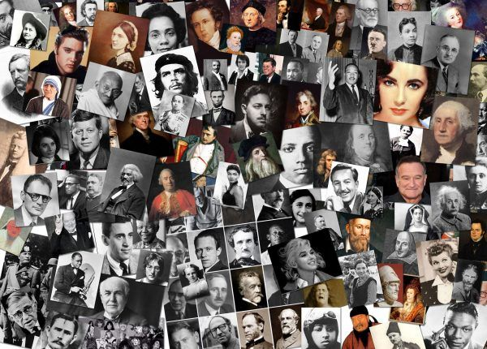
Leaders & Heroes
People who made a difference

Slide 2
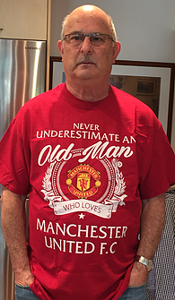
Amnon Zohar
  Born & Educated in Israel
  Corporate Executive
  Serial Entrepreneur
  Business Advisor
  Student York University
  Student Tel-Aviv university
  Student Harvard University
  Football Fanatic
  Best Sabba in The World

Slide 3
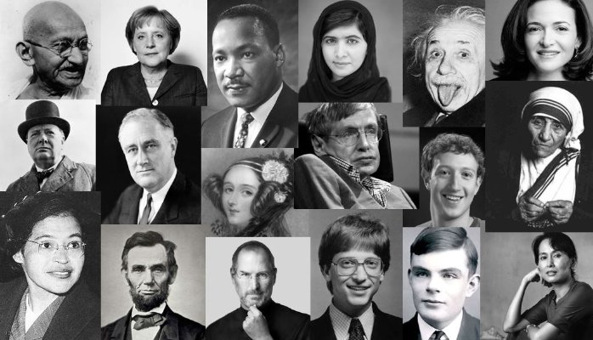
What is a Leader?
https://www.youtube.com/watch?v=Tj1JMylBS8w

Slide 4

Defining Leadership – Is There an Ideal Leadership Profile?
leadership is a unique idea because it encompasses so many elements of personality, skills, experience, drive, motivation and overall outlook.
Well, in our research and work, it isn’t about a profile, preference or personality, but has to do more with inherent qualities that are uniquely bolstered by each individual’s approach.
Successful leaders have an energy for learning. This energy extends beyond an understanding about their business and in to other areas of their life. In short, they are intellectually curious.
Successful leaders have generally faced adversity and often failed at some point in their careers. They persevered through this difficult experience, and learned important lessons that ultimately made them successful.
Successful leaders all employ a diverse repertoire of behaviors
Mark Miller | VP of Marketing, Emergenetics International

Slide 5
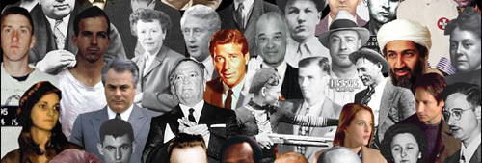
A Hero can be a Leader and a Leader can be a Hero… Or Not!!!
What is a Hero?
https://www.youtube.com/watch?v=BA41ulxeI40

Slide 6

Are Heroes born Heroes or become?
Warren Bennis once said, “The most dangerous leadership myth is that leaders are born-that there is a genetic factor to leadership. That’s nonsense; in fact, the opposite is true. Leaders are made rather than born.”
https://youtu.be/grMHzqtRm_8

Slide 7

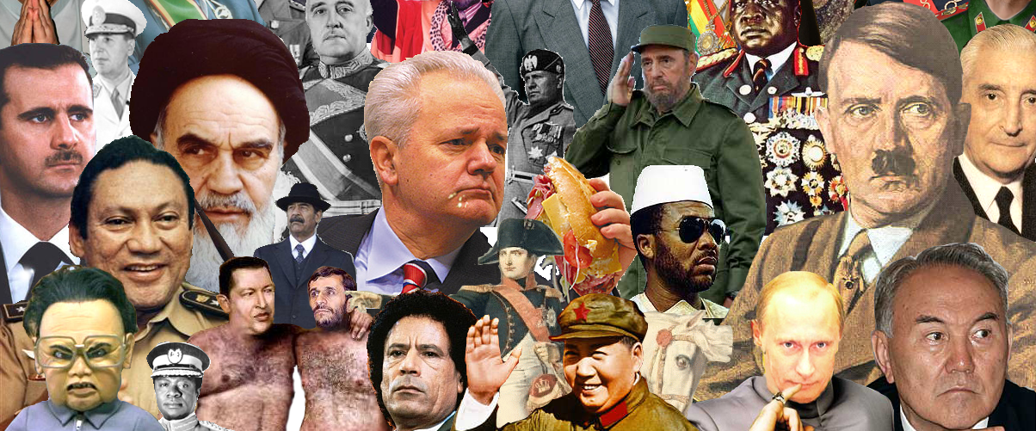
Are Heroes and Leaders a force for Good or a force for Evil?

Slide 8
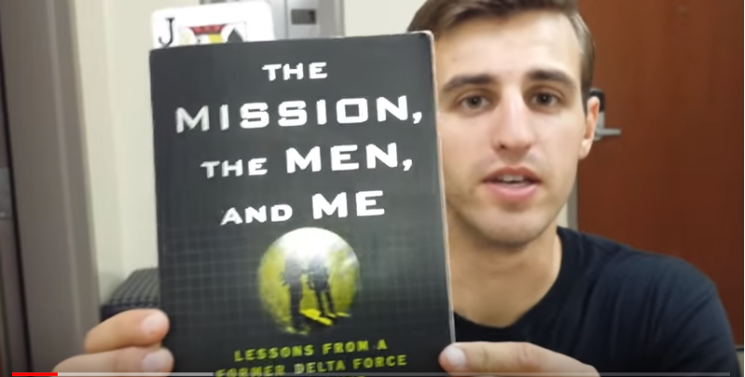
The MEN – MISSION – ME THEORY

Slide 9


PROFITEER CONSERVATIVE TRUE LEADER FOLLOWER MAGLOMANIAC INSECURE/NEEDY

Slide 10


The 7 Essential Qualities of Leadership
https://www.youtube.com/watch?v=th5A6ZQ28pE&t=69s

Slide 11
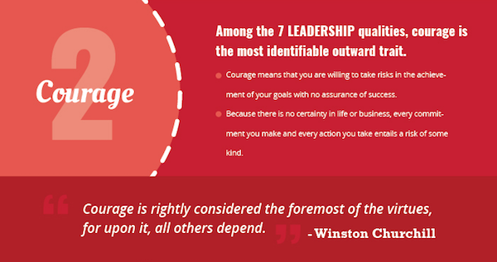

https://www.youtube.com/watch?v=gDZK09AUXT8

Slide 12

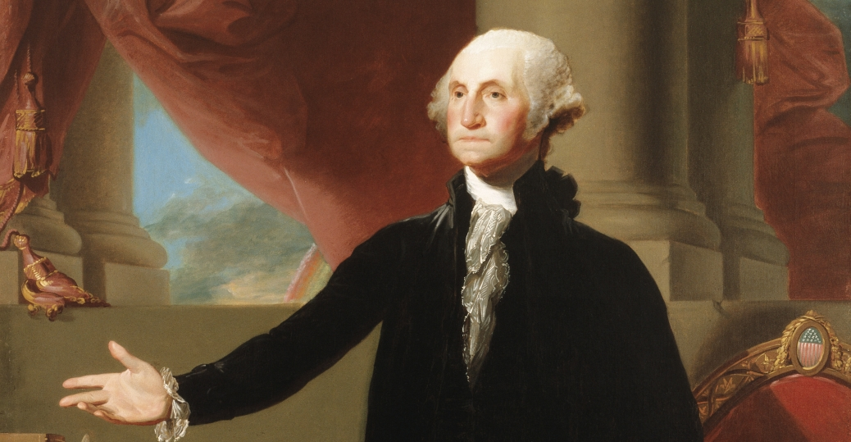
https://www.youtube.com/watch?v=DOi70sJ5cgo

Slide 13
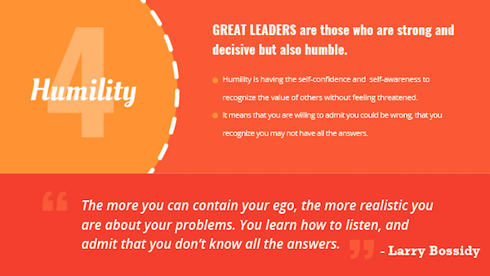
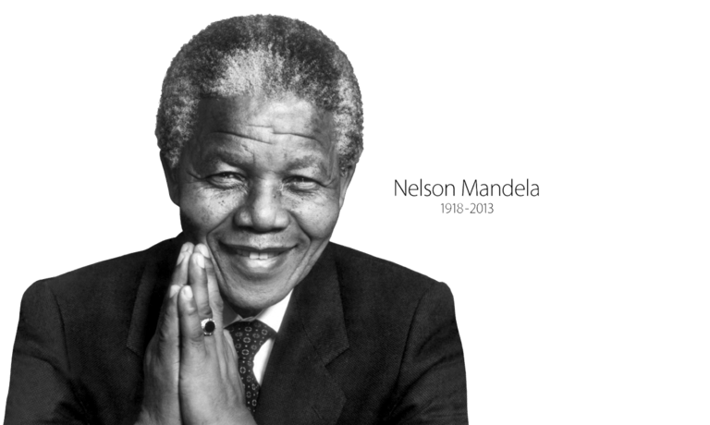
https://www.youtube.com/watch?v=lh7yZZN2oz0

Slide 14
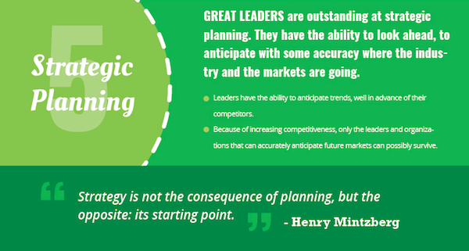

https://www.youtube.com/watch?v=Q5Djl9_Xc3w

Slide 15
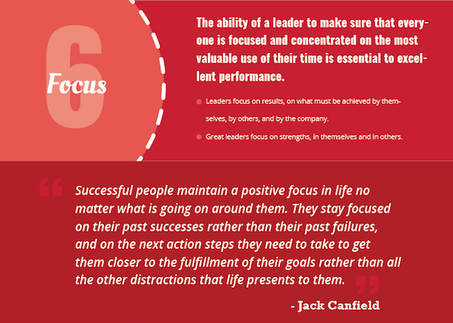
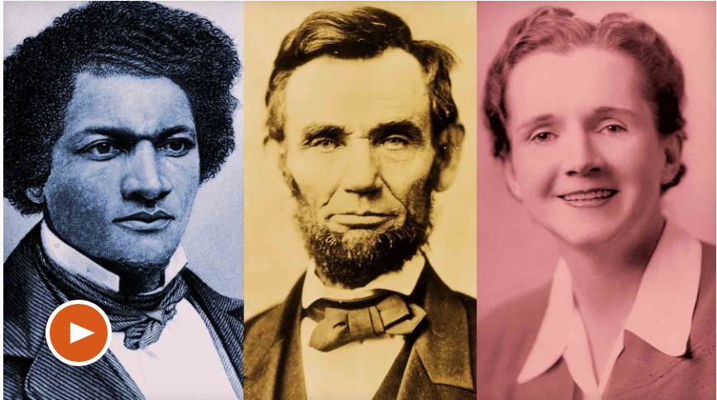
Learning how to say “No”

Slide 16
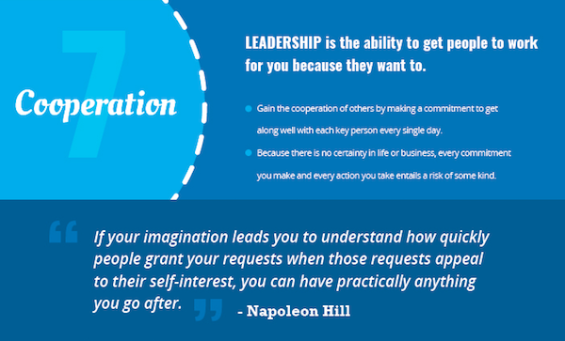
https://www.youtube.com/watch?v=-zPceXpqTRE

Slide 17
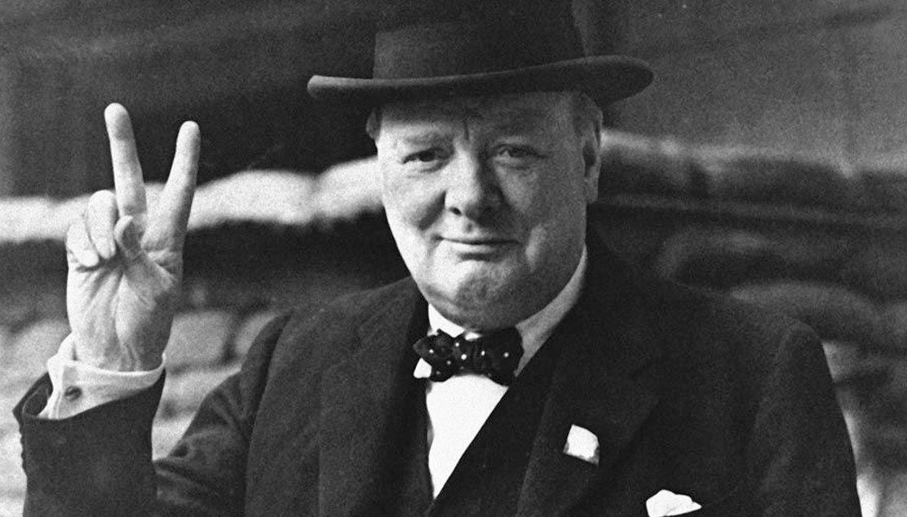
You don’t need to be a Hero to be a Leader
https://www.youtube.com/watch?v=paaghuk3rp8

Slide 18

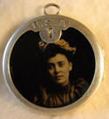
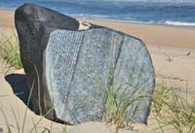
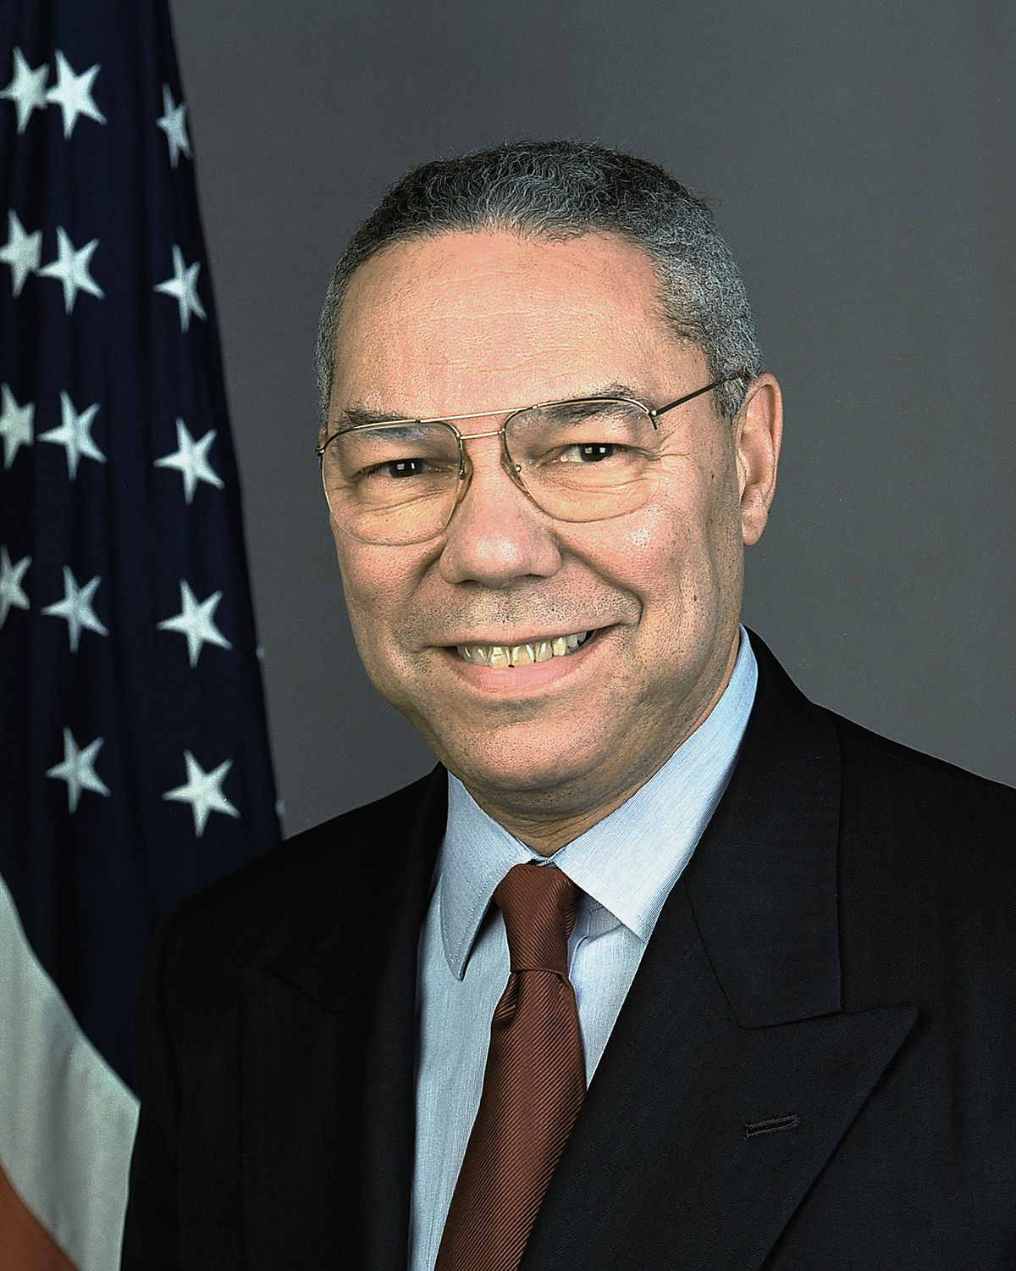
It Ain’t as Bad as You Think! It Will Look Better in the Morning!
Get Mad Then Get Over It!
Avoid Having Your Ego so Close to your Position that When Your Position Falls, Your Ego Goes With It!
It Can be Done!
Be Careful Whom You Choose!
Don’t Let Adverse Facts Stand in the Way of a Good Decision.
You Can’t Make Someone Else’s Decisions! You Shouldn’t Let Someone Else Make Yours!
Inspect Small Things!
Share Credit!
Remain calm! Be kind!
Have a Vision! Be Demanding!
Don’t take counsel of your fears or naysayers!
Perpetual optimism is a force multiplier!
https://www.youtube.com/watch?v=_4oZoUXiETs

Slide 19
