Slide 1
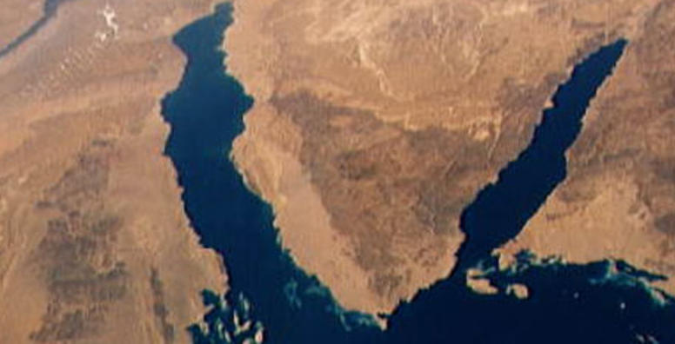
War & Peace
In The Middle East
Lecture #6

Slide 2
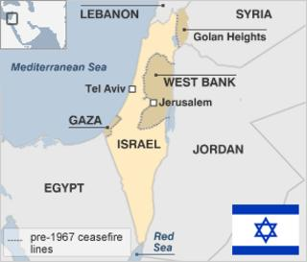
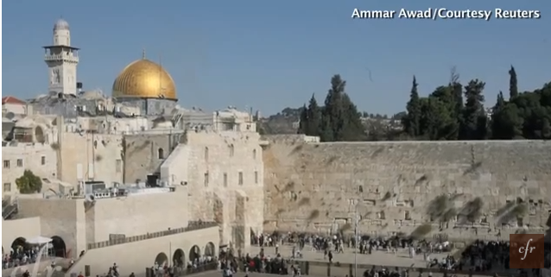
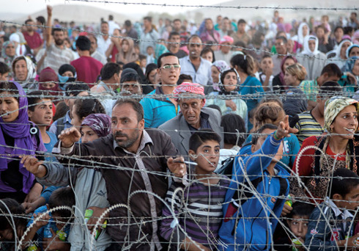
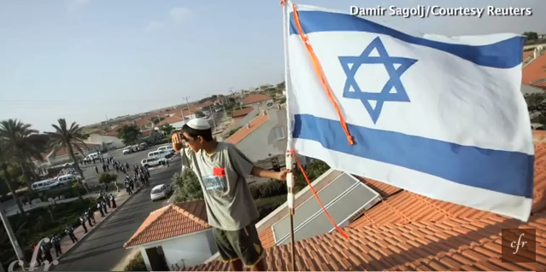
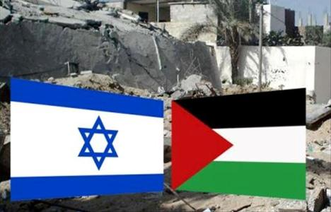

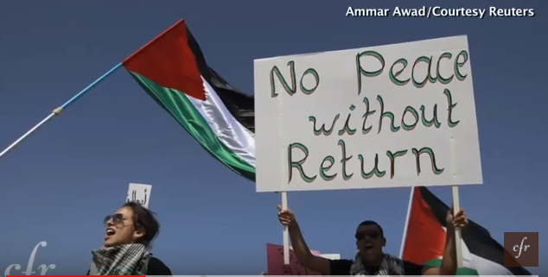
The Thorny Issues
6.3 % Settlement Block
6.3% Land Swap +Gaza Corridor
Divide Jerusalem? 5
Palestinian Citizenship
Compensation to UNRAW “Refugees”
4
Free two way Access
Israel control of Jewish Quarter
East Jerusalem Palestinian Capital?
Temple Mount up P down I
6
Borders
Settlement Block 6.3%
Jews Living in Palestine
Jews E.Jerusalem
Settlement Expansion
Freedom of Movement
Refugees
Jerusalem
8
De-Militarization
Transitional IDF
Presence – Jordan Valley
Border Control
Counter Terrorism co-op
9
Palestinian UN Membership
Formal Recognition of Israel
Diplomatic Relationships
Regional Developement co-op.
Foreign Investments
3
Settlements
100-200 Family Unification
Israeli Citizenship
Compensation
4
Security/De-militarization
Right of Return
Statehood/Recognition

Slide 3
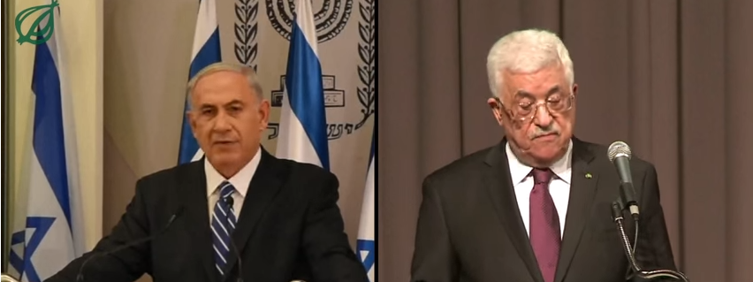
What seems to be the problem?
Status Quo Manageable if not Sustainable
Leadership Failure – No Political Courage
Present Regimes (Fatah, PLO, Hamas, Israeli Coalition)
Willingness to burry the Hatchet
Lack of Trust in written , oral, International guarantees
Stop incitement, victimhood, hatred education & attitudes

Slide 4
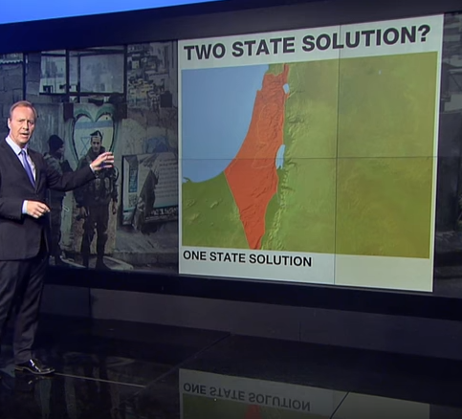
What needs to happen?
Top Down – Calamity
Bottom Up – Education 30Yr.
Rise of the young – New Leaders
Foreign Investment
Regional Development

Slide 5
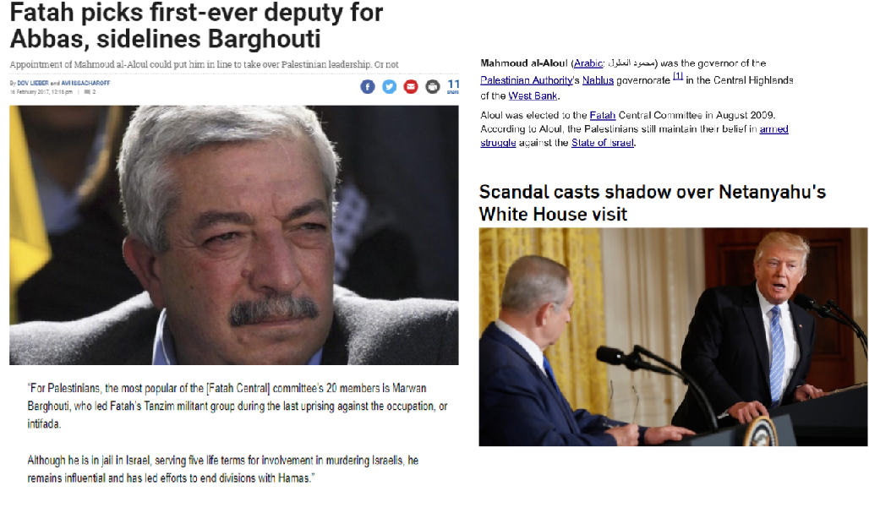

Slide 6
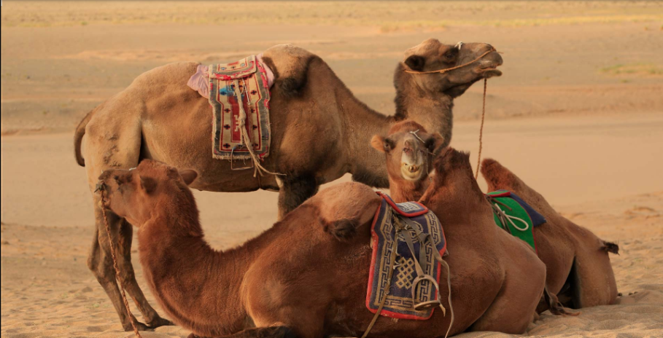
Last week today
The World & The Middle East
  USA
  RUSSIA
  CHINA
  EU
  TURKEY
  SAUDI ARABIA
  IRAN
  Discussion Q&A
https://www.youtube.com/watch?v=0JjpB6sQoVI&t=23s
https://www.youtube.com/watch?v=0JjpB6sQoVI&t=23s

Slide 7
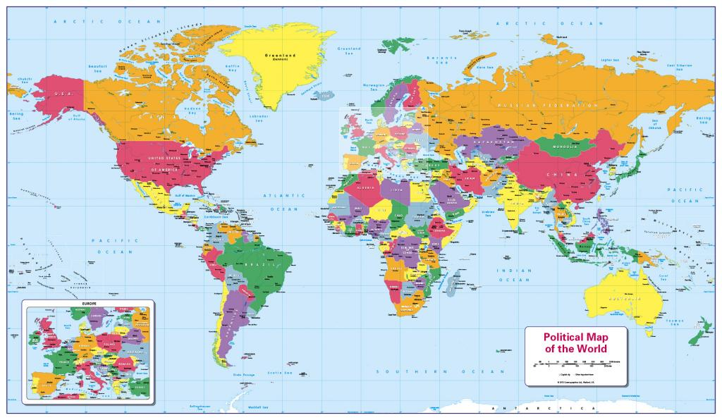

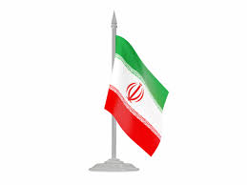
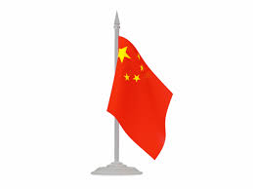



Slide 8
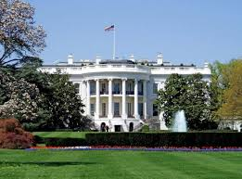

https://www.youtube.com/watch?v=qMQjx77iLyI
OIL STABILITY
DEMOCRATIZATION
COUNTERTERRORISM
ECONOMIC/TRADE
COUNTER BALANCE IRAN-RUSSIA

Slide 9

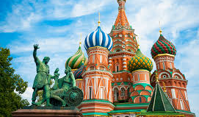
https://www.youtube.com/watch?v=jq9YQaKeiY0
https://www.youtube.com/watch?v=2ocB-AcqGEI
REMEMBER THE SOVIET UNION
COUNTER BALLACE US ALLIANCES
PHYSICAL BASE OF OPERATION
DEPENDENCY RELATIONS W/SHIA
SYRIAN CIVIL WAR
IRAN DEAL – UP/DOWN
PALESTINIAN PATRONSHIP
COUNTER BALANCE CHINA

Slide 10
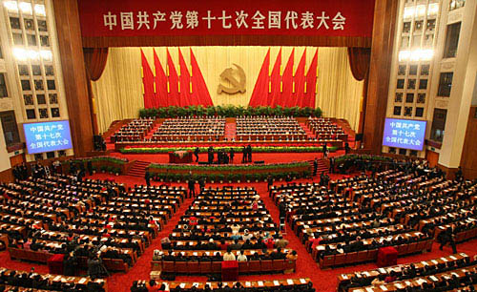
https://www.youtube.com/watch?v=icUDZ8eQTNs
CONTINUE MOVING EAST
MARKET DEVELOPMENT
COMMODITIES/EXPORT
ECONOMIC, POLITICAL POWER

Slide 11
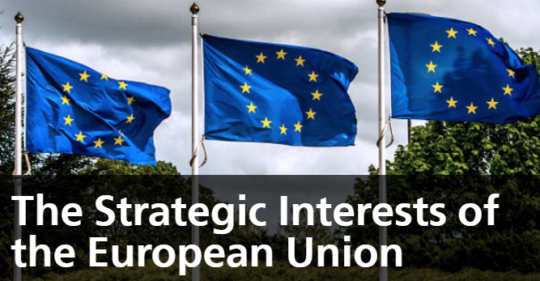
OIL FLOW TO EUROPE – SHIFTING ENERGY SUPPLY FROM RUSSIA – COMPETITION W/EMERGING COUNTRIES TOP 4
https://www.youtube.com/watch?v=MRjw3PXANLg

Slide 12
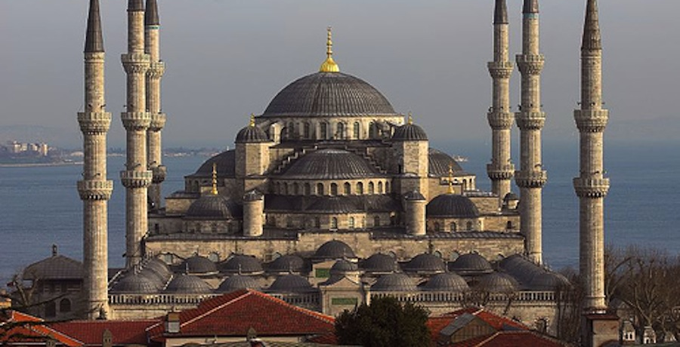
https://www.youtube.com/watch?v=WlomIAoahbA
MIGRATION – REFUGEES - REPUTATION
KURDS - IPG – SYRIAN CIVIL WAR
US NATO RUSSIA MINY MINI MO
THE STRONG MAN SYNDROME

Slide 13
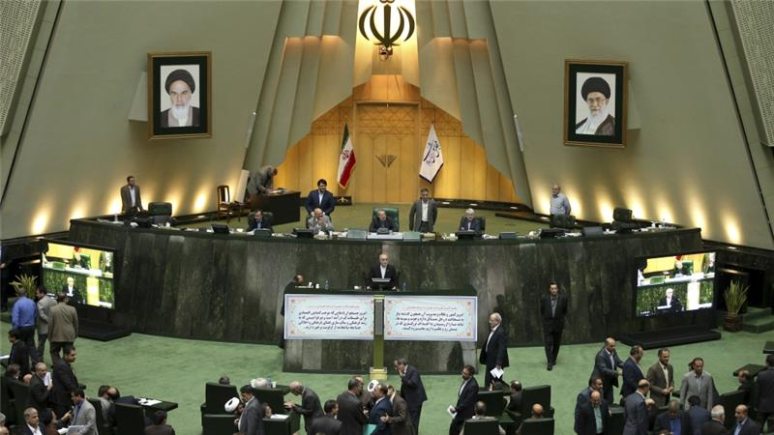
https://www.youtube.com/watch?v=Huazdsa9KLc
ANTI WEST ALLIANCE WITH RUSSIA
SHIA LEADERSHIP
BALANCE SAUDI-ARABIA
ENCIRCLE THE MIDDLE EAST (IRAQ)
STEM POPULAR UNREST AND WESTERN ASPIRATIONS

Slide 14
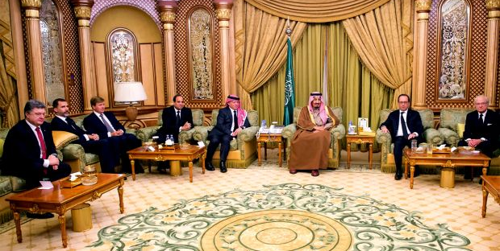

https://www.youtube.com/watch?v=d-lDKdmN9Qg
SUNNI MIDDLE EAST – NUCLEAR IRAN THREAT – US ALLIANCE – OIL REVENUE DISPLACEMENT – DIVERSE ECONOMY – MODERNIZATION – STRATEGIC ALLIANCES (ISRAEL)

Slide 15
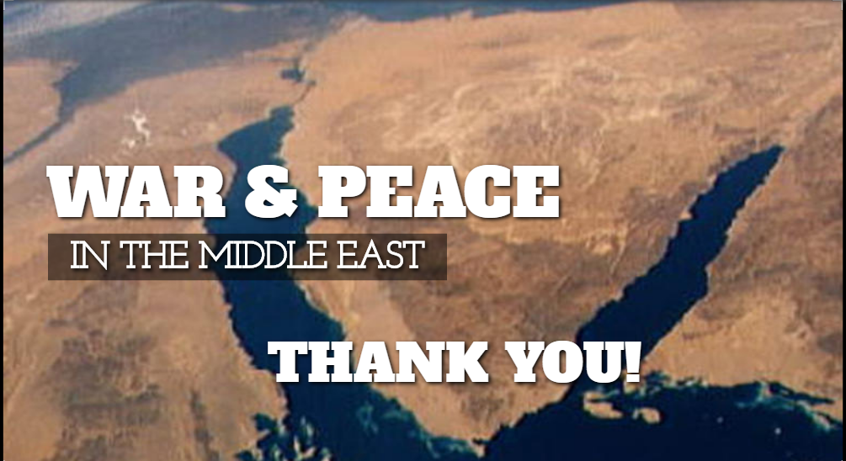
REGIONAL DEVELOPMENT CHALLENGESS & OPPORTUNITIES
THE ISRAELI CASE STUDY NATURE FORCES BRING PEACE?

