Slide 1


Slide 2

Introductions & Objectives
Football or Soccer
Origins of the Game
Popularity of the Game
Club & Nation
A National Mirror

Slide 3
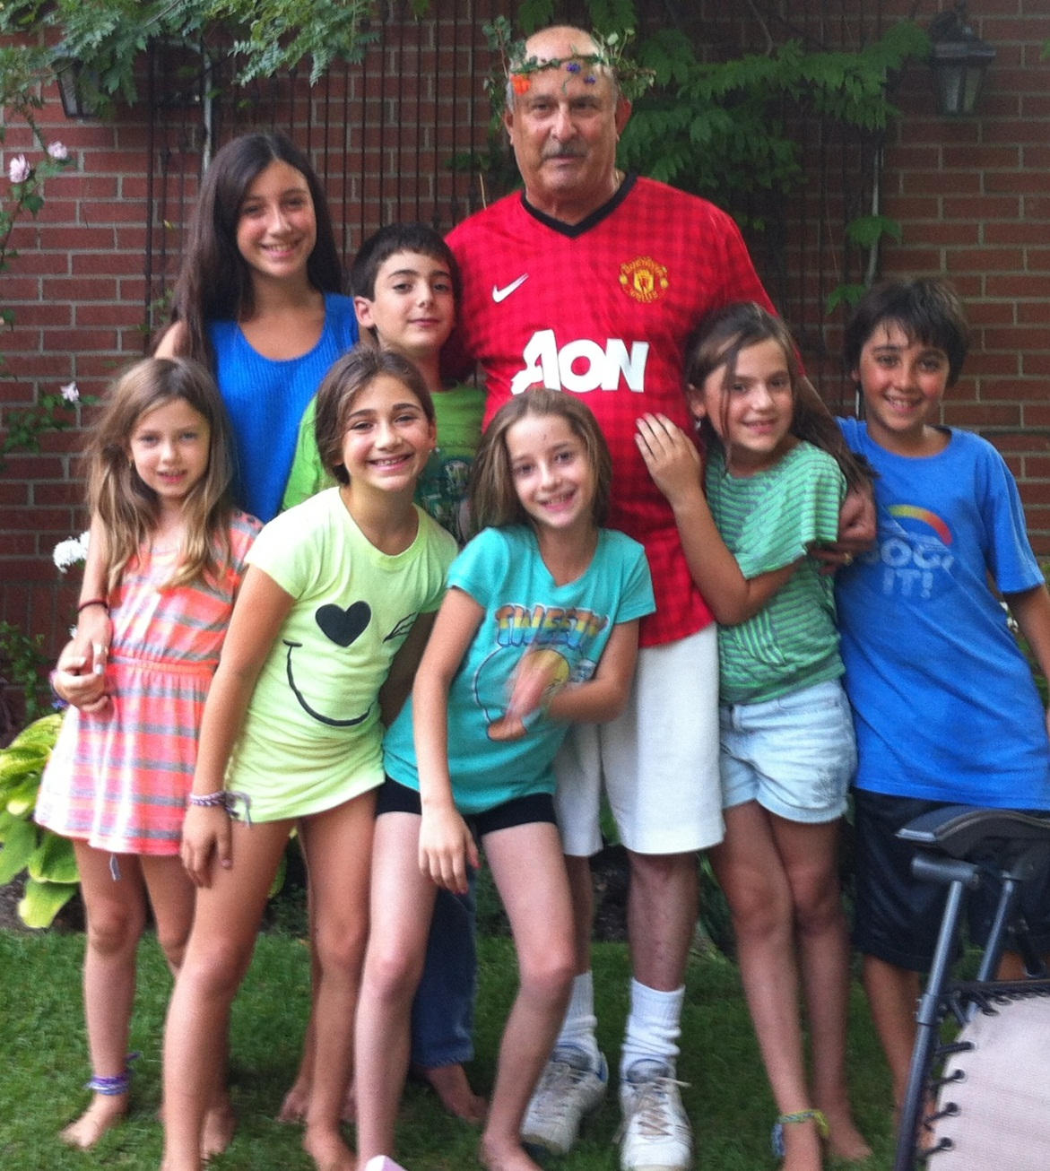
Amnon Zohar
  Born & Educated in Israel
  Corporate Executive
  Serial Entrepreneur
  Business Advisor
  Student York University
  Student Tel-Aviv university
  Student Harvard University
  Football Fanatic
  Best Sabba in The World

Slide 4
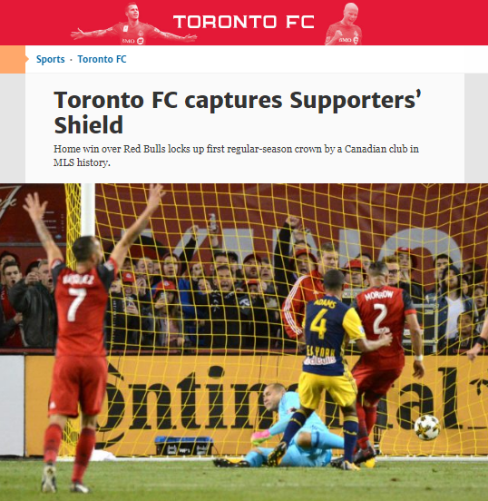

Slide 5
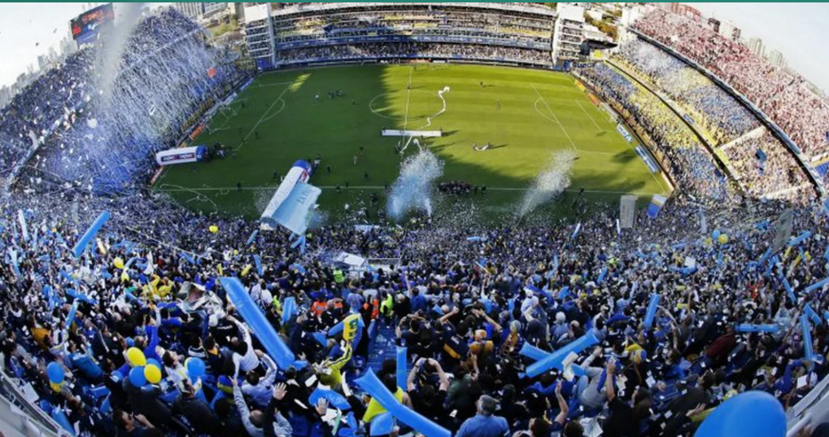
We examine the transcendent power of soccer in the world- a game that is helping to change the lives of individuals and communities across all continents.
We analyze the relationship of soccer to social movements, gender, architecture, ethics and aesthetics.

Slide 6
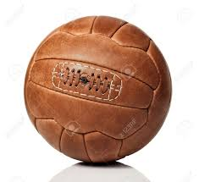
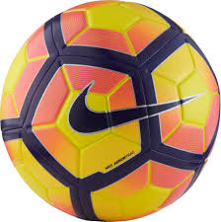


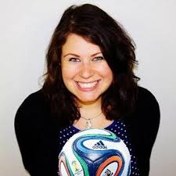
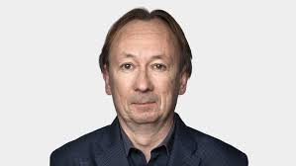
HISTORY- ORIGINS
STYLES - STARS
FOOTBALL HEROES & VILAINS
PELE, MARADONA, ZIDANE
1
5
AESTETICS
“THE BEAUTIFUL GAME”
GENDER, SEXISM,RACISM
2
6
FOOTBALL & POLITICS
HISTORICAL EVENTS
FOOTBALL IN AFRICA
7
3
FOOTBALL & ENTERTAINMENT
GOVERNANCE, FIFA
CORRUPTION & REFORMS
8
4

Slide 7
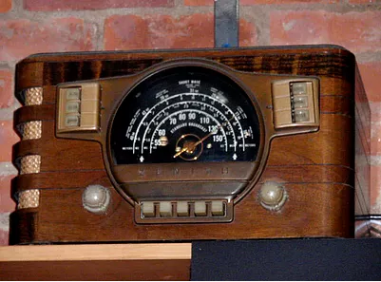
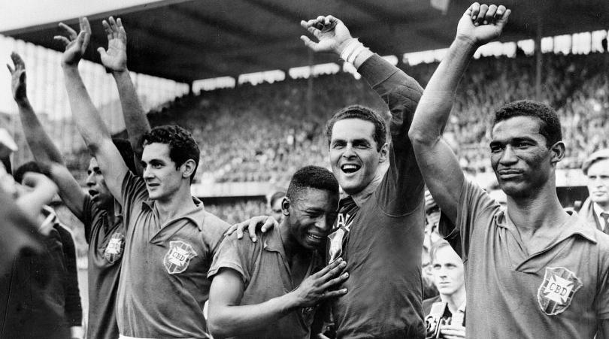
When I fall in love – It will be forever

Slide 8
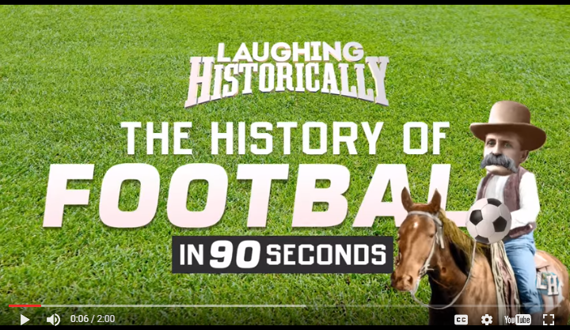
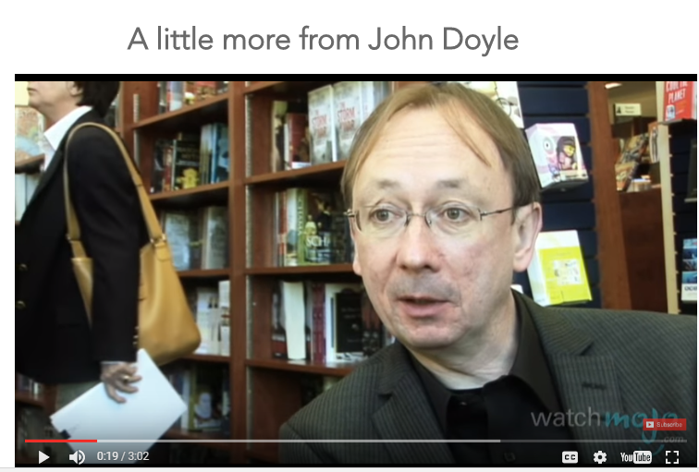

Slide 9
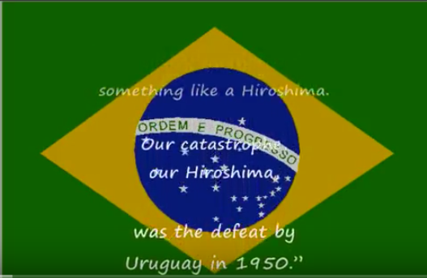
A National Tragedy in front of 220,000

Slide 10
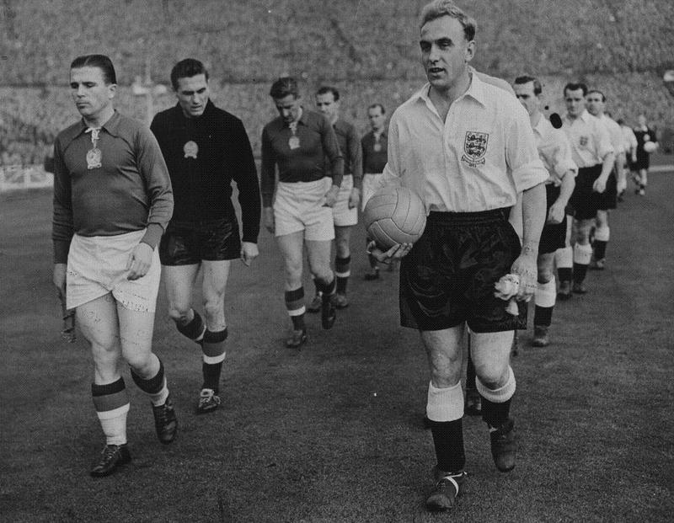
Match of the Century (1953 England v Hungary football match)

Slide 11
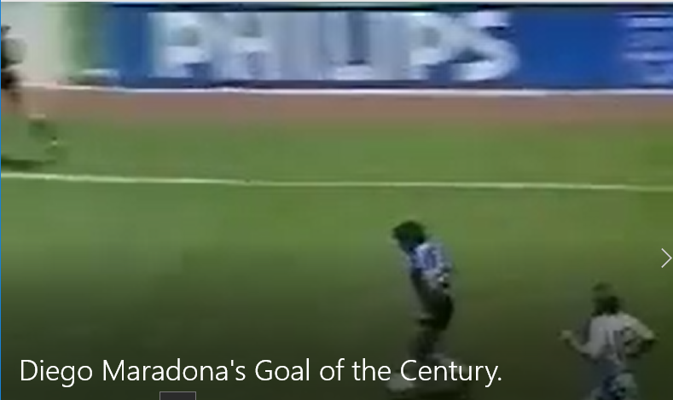
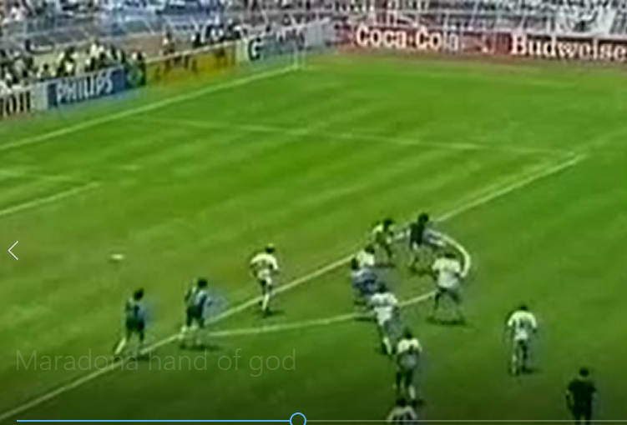
Post Falkland War - 1986
Argentina 2 England 1

Slide 12
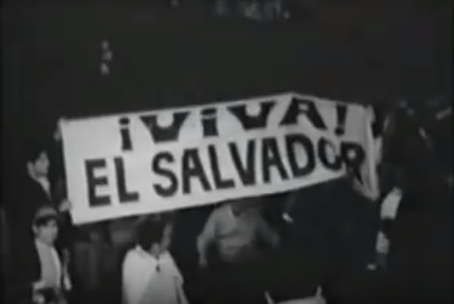
1969: The Soccer War
A four day war, known as the "Soccer War", was fought between central American neighbours El Salvador and Honduras following a World Cup qualifier. On July14th, 1969, the Salvadoran army launched military attacks on their neighbours, forcing the Organisation of American States to negotiate a cease fire five days later. The dispute was eventually settled in 1980.

Slide 13
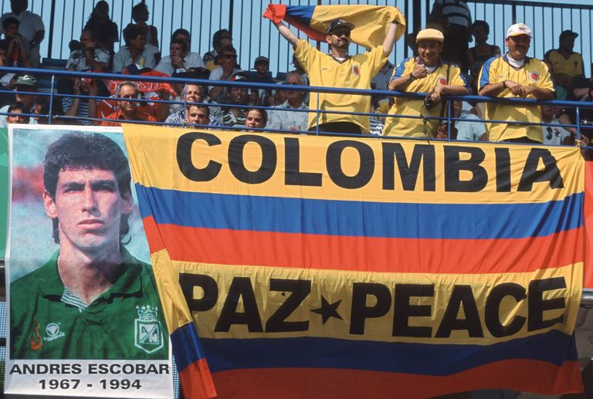
1994 The murder of Andreas Escobar
THE OWN GOAL
Andres Escobar’s 34th-minute own goal signaled the death knell for Colombia’s hopes of qualification. The number 2 stretched to intercept a left-wing cross from John Harkes but only succeeded in wrong-footing his goalkeeper Oscar Cordoba and putting the US in front. The hosts won 2-1, Colombia were on their way home and Andres Escobar was devastated.
THE ANDRES ESCOBAR MURDER
Andres Escobar was allegedly baited about his own goal in a nightclub and went out to the car park to drive home. He was accosted by three men and a woman and as he argued with them, protesting that his own goal had been a mistake, two men took out handguns and shot him six times. He was escorted to the hospital and pronounced dead after 45 minutes.

Slide 14
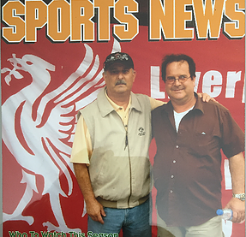
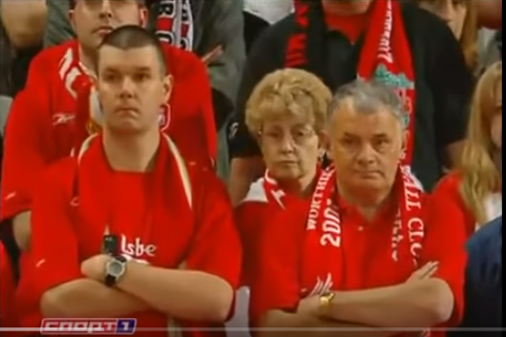
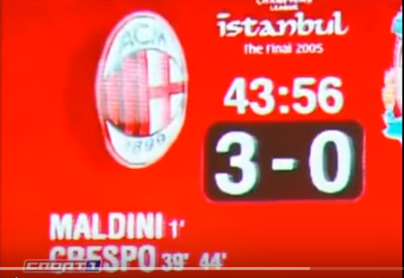
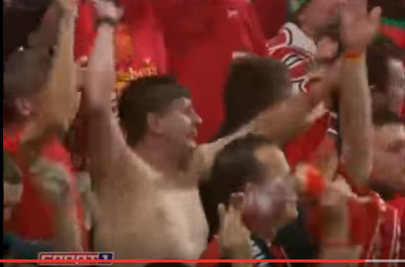
The Most Exciting Football Match of All Times (My opinion)

Slide 15
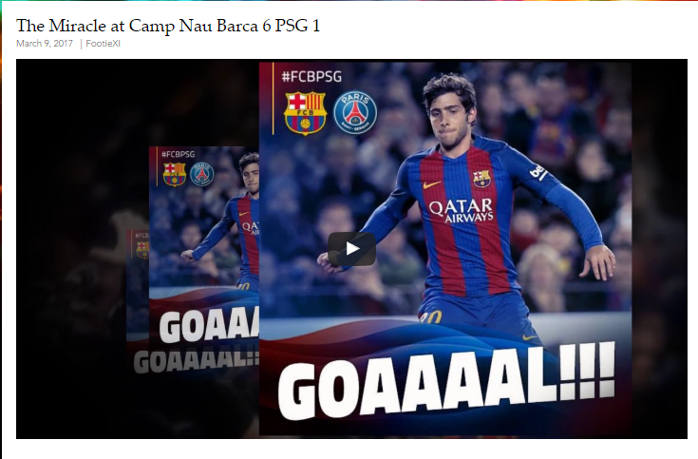

Slide 16





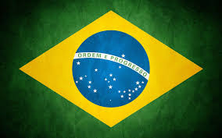


Origins of the game

Slide 17
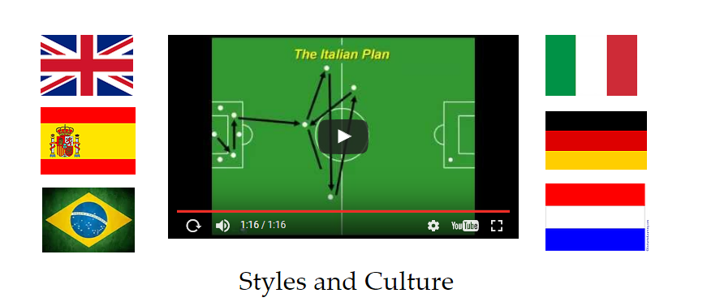

Slide 18



Catenaccio
Manschaft
Tiki Taka
Jogo Bonito
Total Football
Let’s get Physical

Slide 19
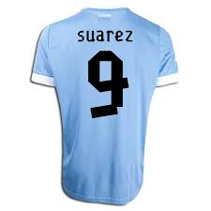
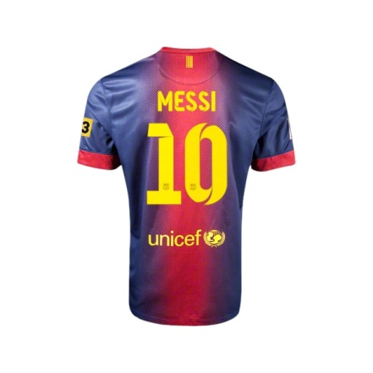
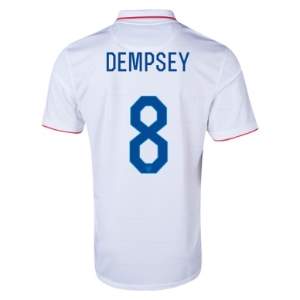
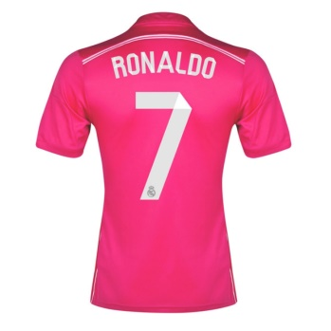
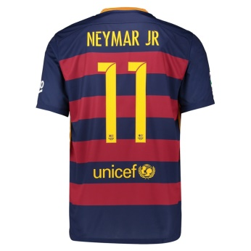
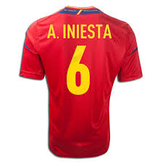
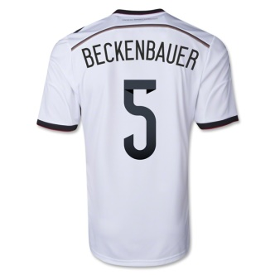
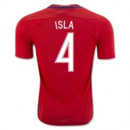
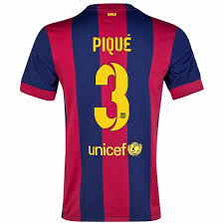
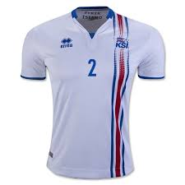

International
Diversity
Year Round
Jogo Bonito
Technical Skills
Fluid Play
Normalcy of Physic
Safety
Affordability
Easy-2-Learn
Accessibility

Slide 20


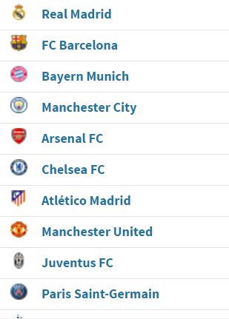


Slide 21
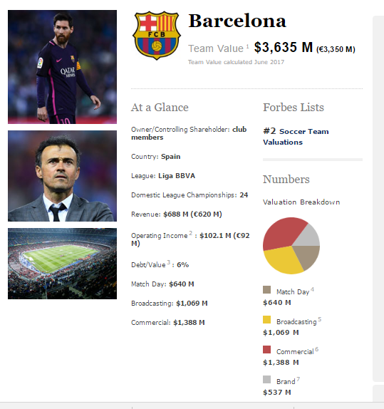
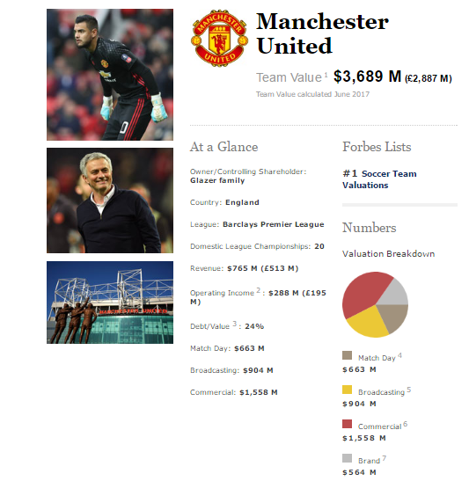

Slide 22
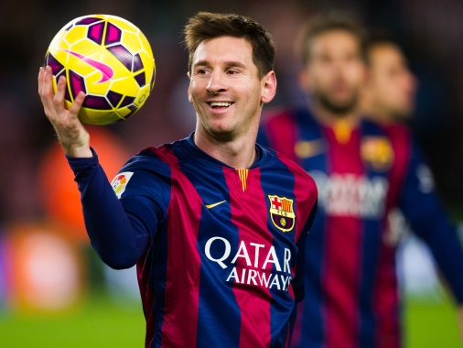
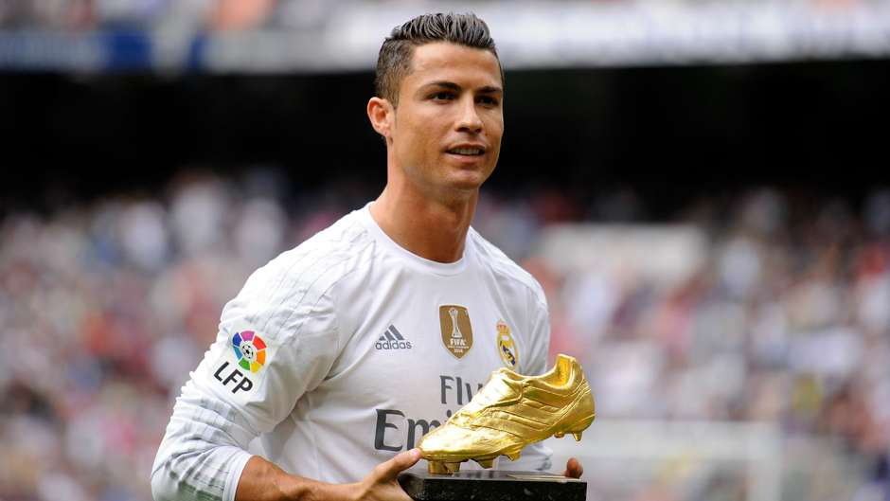
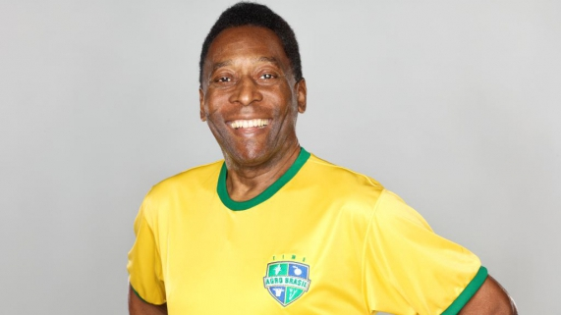
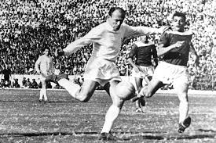
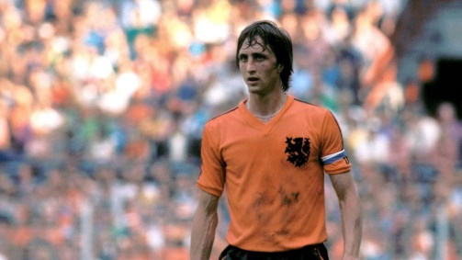
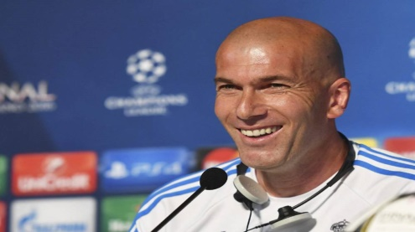
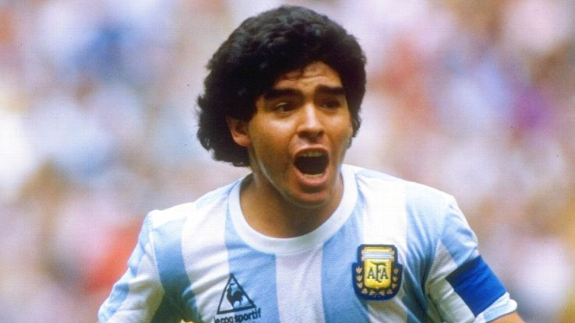
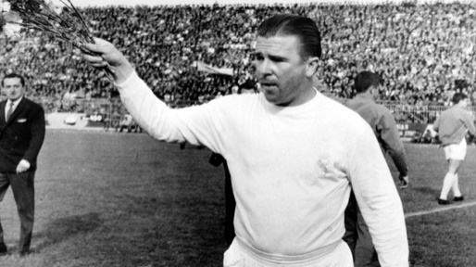
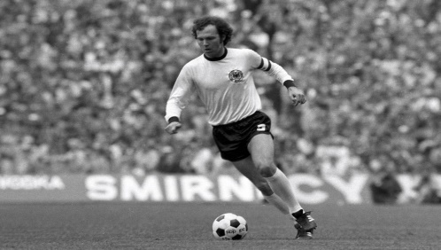
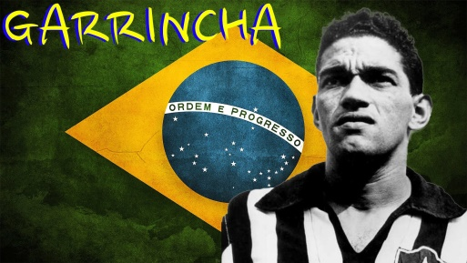
Top 10 Ever
3
7
4
8
1
9
5
6
2
10

Slide 23

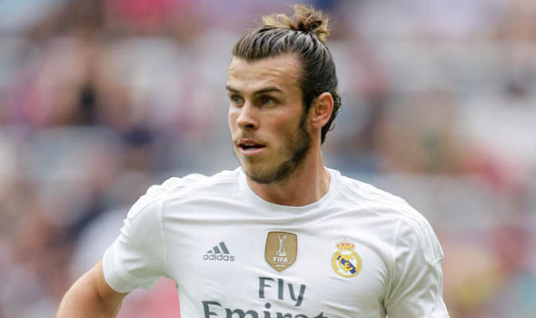

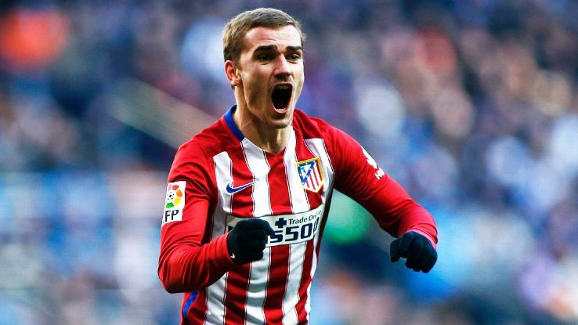
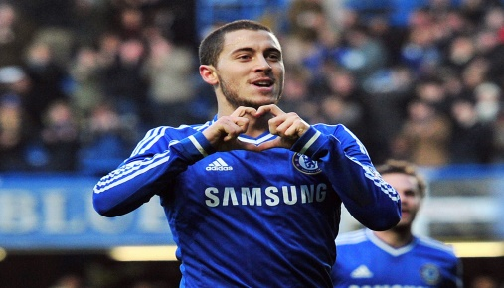





Top 10 - Active
1
5
2
6
9
3
7
10
4
8

Slide 24






Slide 25







Slide 26
Next Week
The beauty of the "Beautiful Game": Aesthetics in (and of) soccer
-Plays, Goals, Saves
- Screening of "Lineker in Brazil The Beautiful Game" Documentary 2014

Slide 27
https://www.youtube.com/watch?v=9SgbMNY9IQ4
https://www.youtube.com/watch?v=roMaZW8nrfE
https://www.youtube.com/watch?v=S9eHm1raXEo
https://www.youtube.com/watch?v=nmK8s1JZRx0
https://www.youtube.com/watch?v=vhW6xqSzbPs
https://www.youtube.com/watch?v=TGtWWb9emYI

Slide 28


