Slide 1
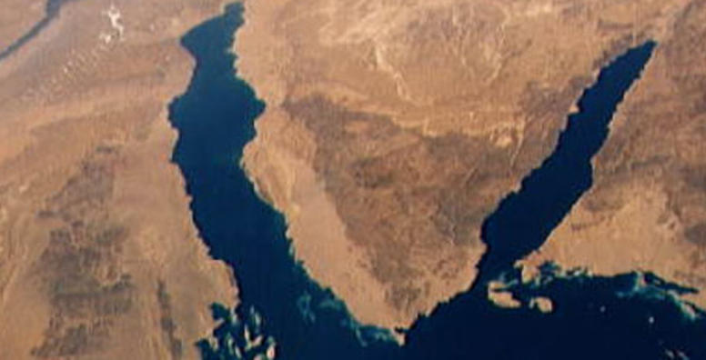
War & Peace
In The Middle East

Slide 2
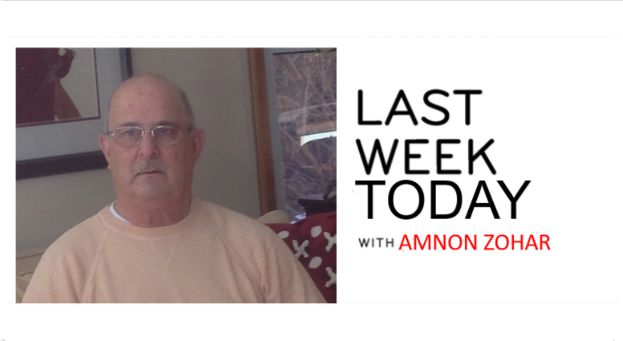

Slide 3
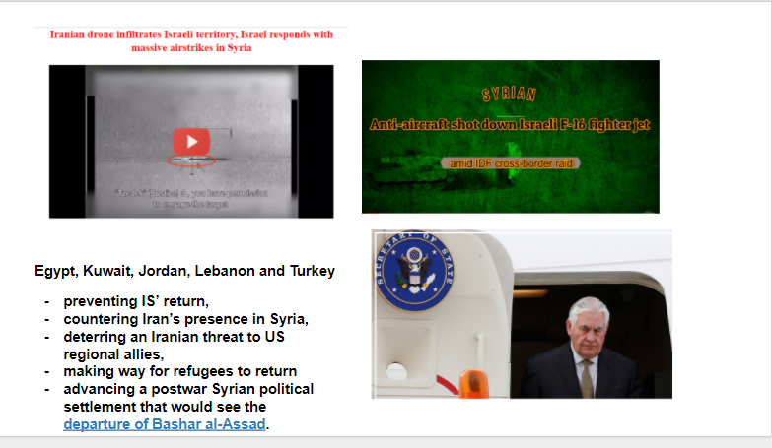

Slide 4
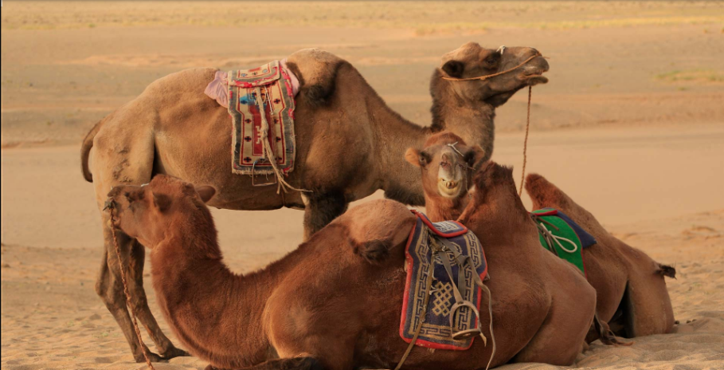
Last week today
Middle East in crisis – 5 Reasons
Origin of the Radical Jihad
Wahhabism/Salafism
Asymmetric Warfare
Terrorism as Ideology, Strategy, Tactics
Terror Organizations
  ISIS, Al- Qaeda , Hamas, Hezbollah
Discussion Q&A

Slide 5
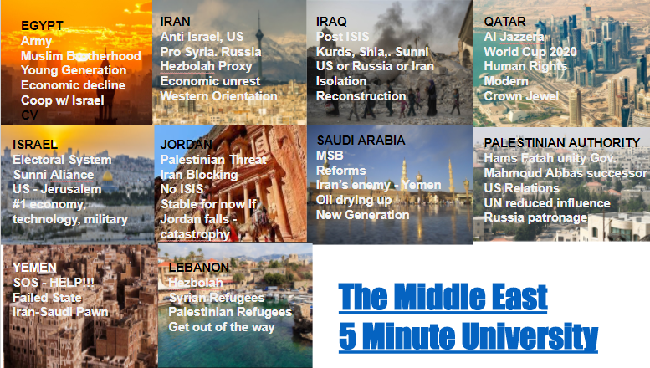

Slide 6
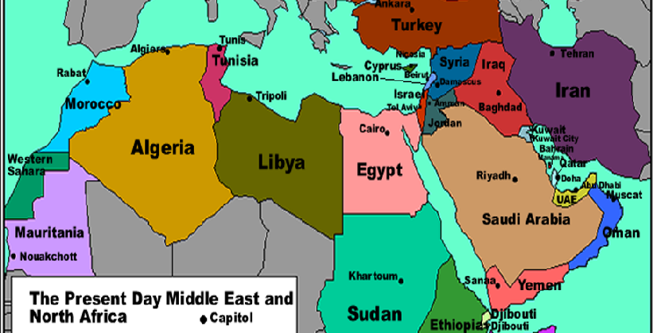
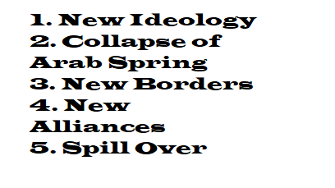
https://www.youtube.com/watch?v=XjgfnS7qKCI&t=14s

Slide 7
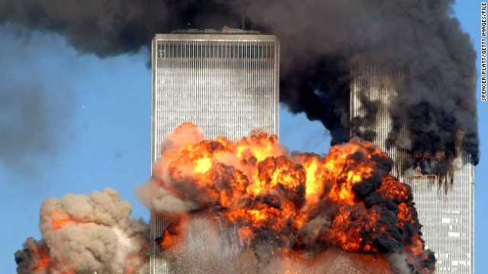
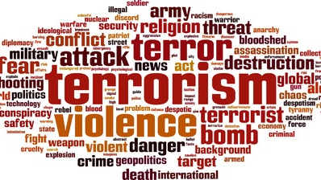
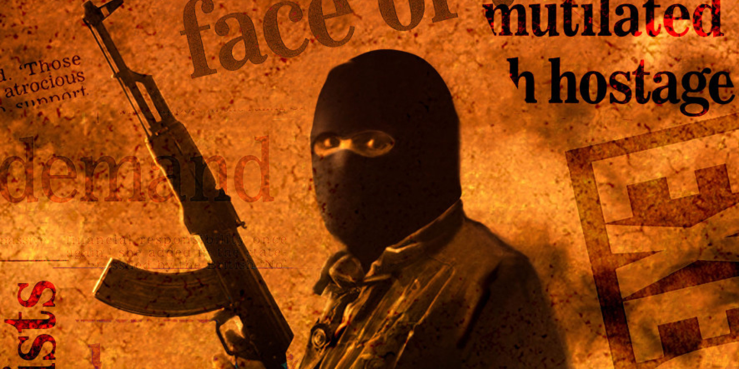
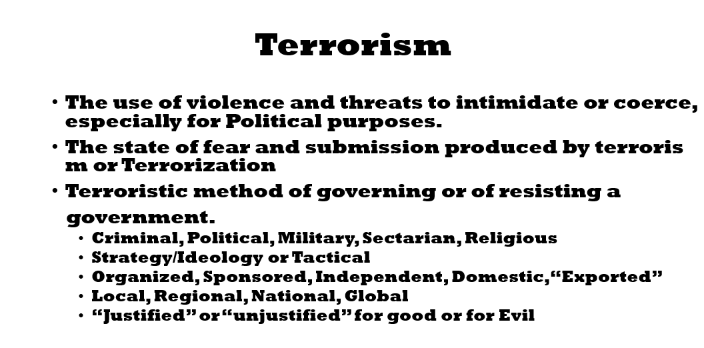
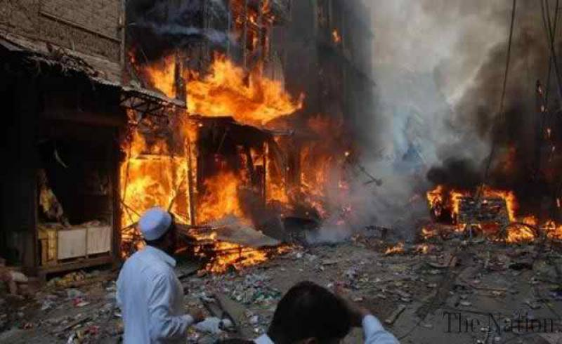
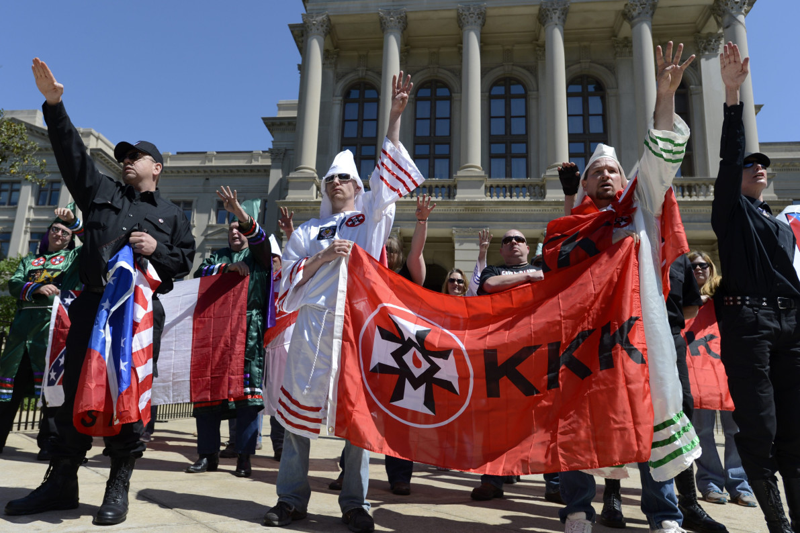

Slide 8
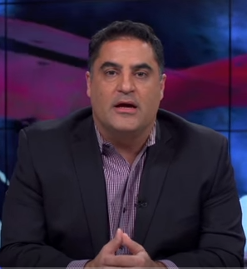
Mega Trends
Secularism >Fundamentalism
Fundamentalism > Fanaticism – ISIS
State & Religion in SA
New Age Media
Effect versus Cause
https://www.youtube.com/watch?v=AmbkoiI5IYg&t=4s

Slide 9
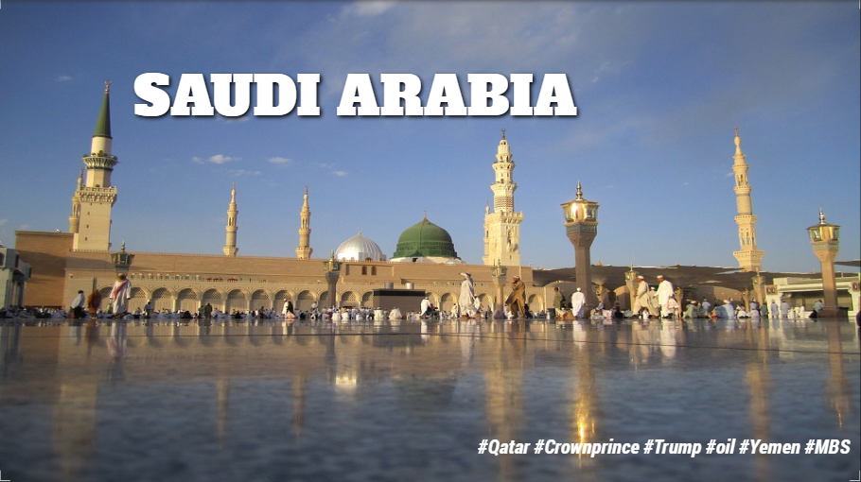
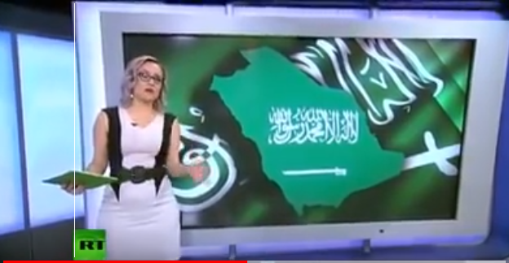
https://www.youtube.com/watch?v=kMATFu6QjlA&t=130s

Slide 10
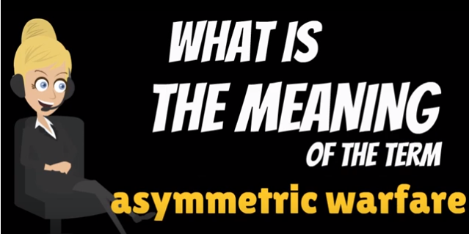
No More “Fair” Fight
State Actors
Non-State Actors
International Conventions
Lawlessness
Accountability
Leverage
Consequences
Sacrifices
https://www.youtube.com/watch?v=yNu8ei8bj04&t=8s

Slide 11
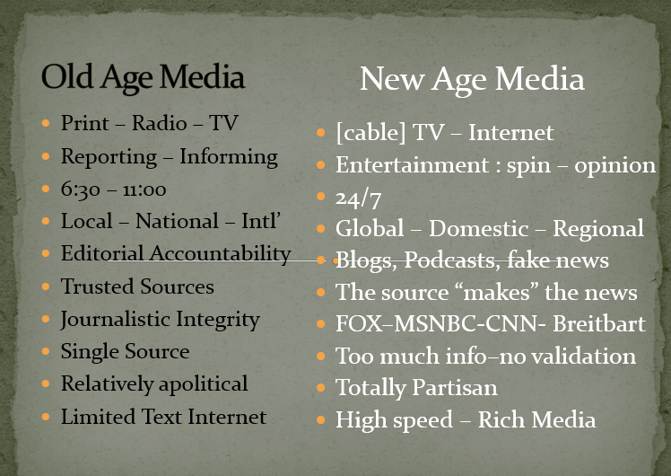

What Technology & Media Got to do with it?

Slide 12
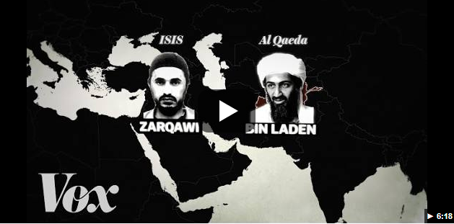
https://www.youtube.com/watch?v=pzmO6RWy1v8&t=25s

Slide 13
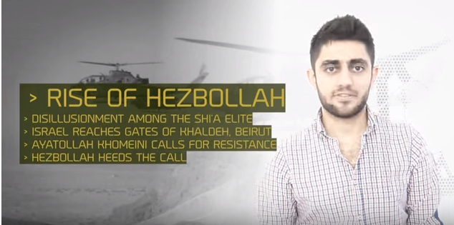
https://www.youtube.com/watch?v=nTyuYhvv5fA

Slide 14
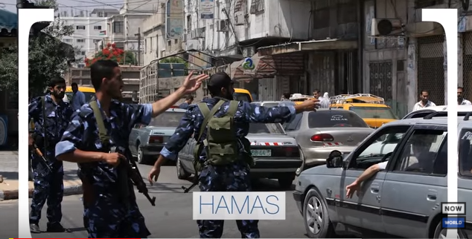
https://www.youtube.com/watch?v=RmlGcQUFmEA&t=52s

Slide 15
