Slide 1
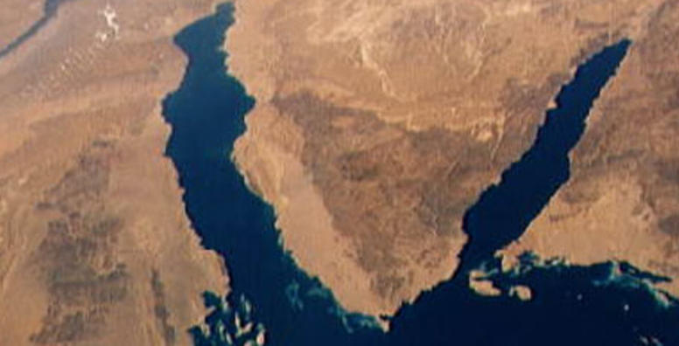
War & Peace
In The Middle East
Lecture #2

Slide 2
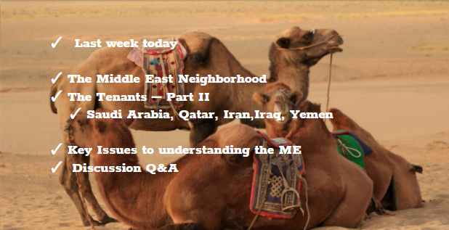

Slide 3
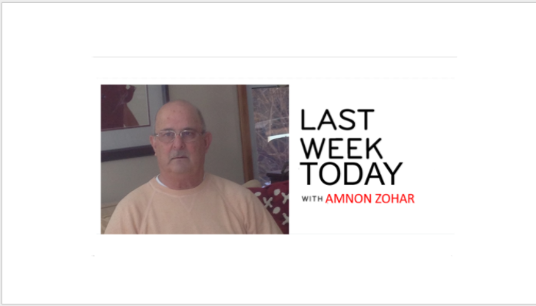

Slide 4
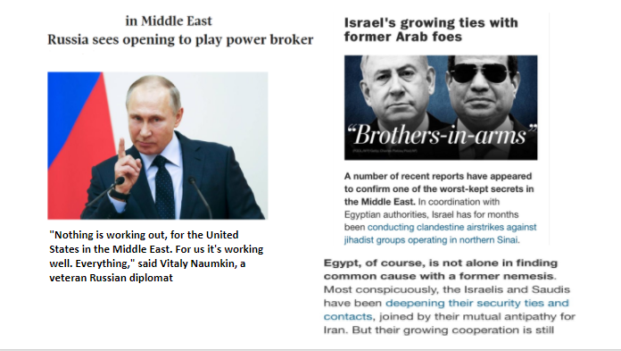
https://www.youtube.com/watch?v=HGxWuwBKy6E&t=8s

Slide 5
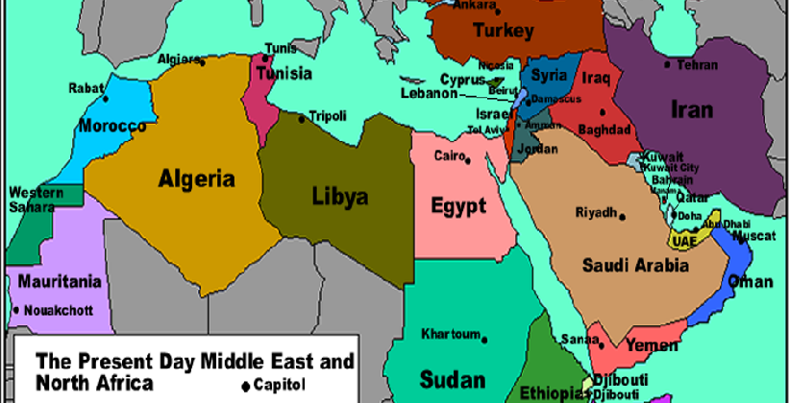
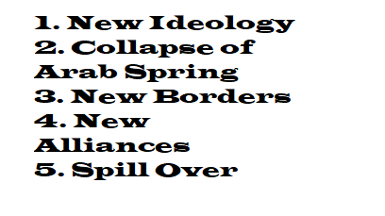
https://www.youtube.com/watch?v=2Td-7bl9jp8

Slide 6

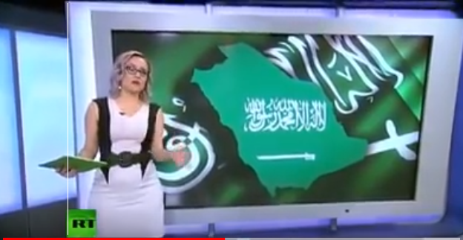
https://www.youtube.com/watch?v=bl3gd0IwNKA

Slide 7
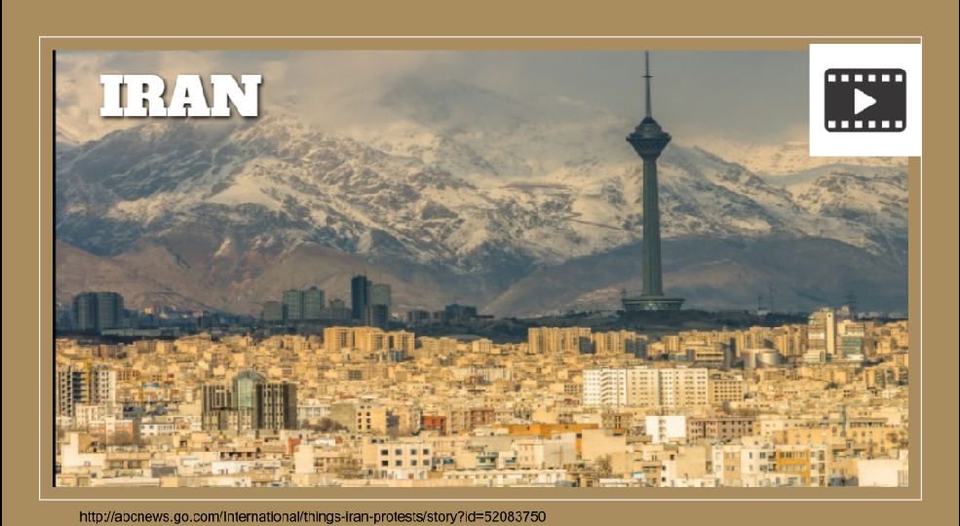
https://www.youtube.com/watch?v=WKfVxoPO_Qc&t=18s

Slide 8

https://www.youtube.com/watch?v=nLRgdFP-s30

Slide 9
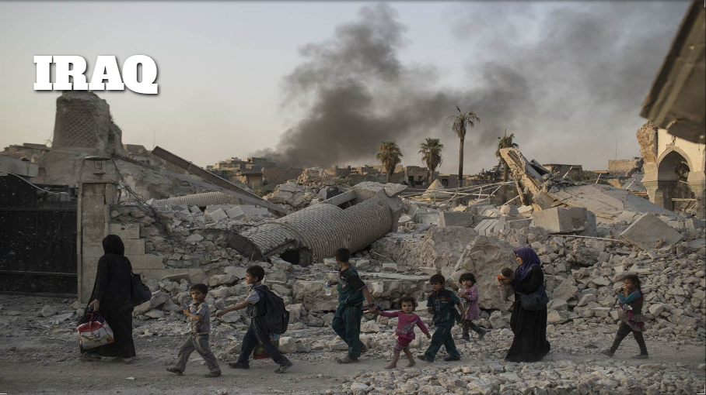
https://www.youtube.com/watch?v=AQPlREDW-Ro&t=5s

Slide 10

World Cup 2020 Qatar Blockade
https://www.youtube.com/watch?v=5K8Ddh3MHQg

Slide 11

Religion, Autocracy, Ethnicity, Tribalism, Poverty

Slide 12
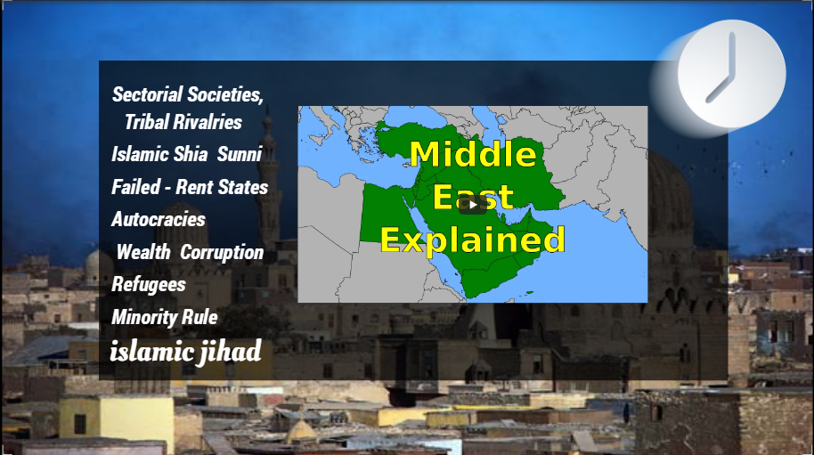
https://www.youtube.com/watch?v=XjgfnS7qKCI&t=9s

Slide 13
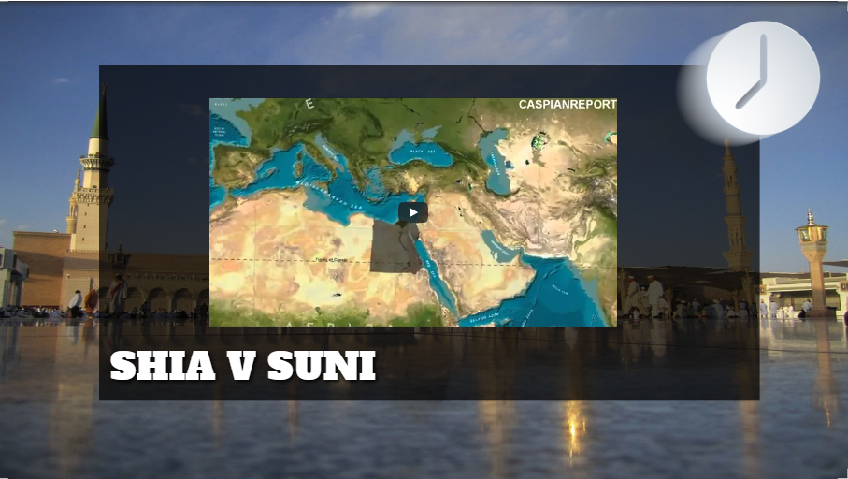
https://www.youtube.com/watch?v=5KLvjs7Yrtw&t=48s

Slide 14
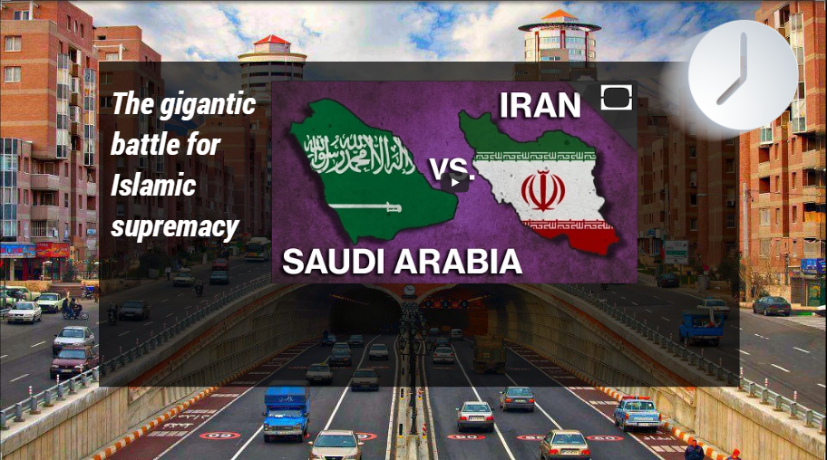
https://www.youtube.com/watch?v=XUvkhRnzfSA

Slide 15
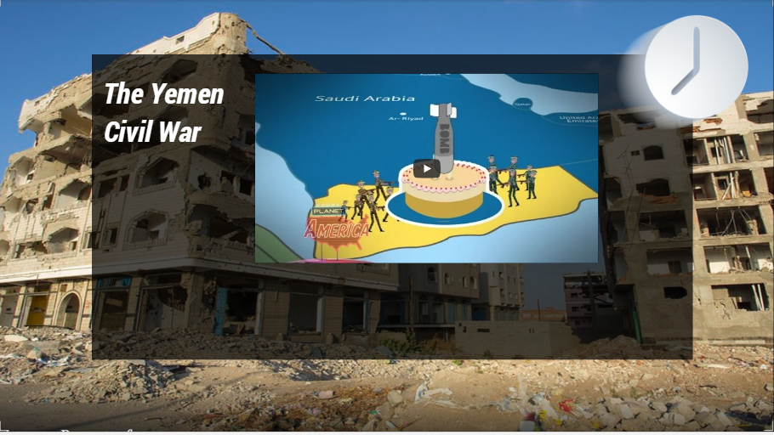
https://www.youtube.com/watch?v=SyWJfqpx370

Slide 16
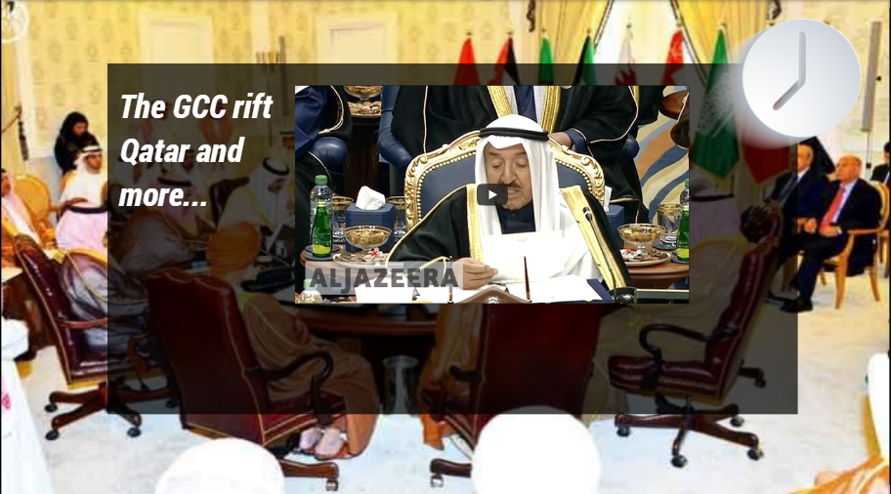

Slide 17

Canada, Lebanon, Jordan, Turkey, USA
https://www.youtube.com/watch?v=KVV6_1Sef9M&t=5s

Slide 18
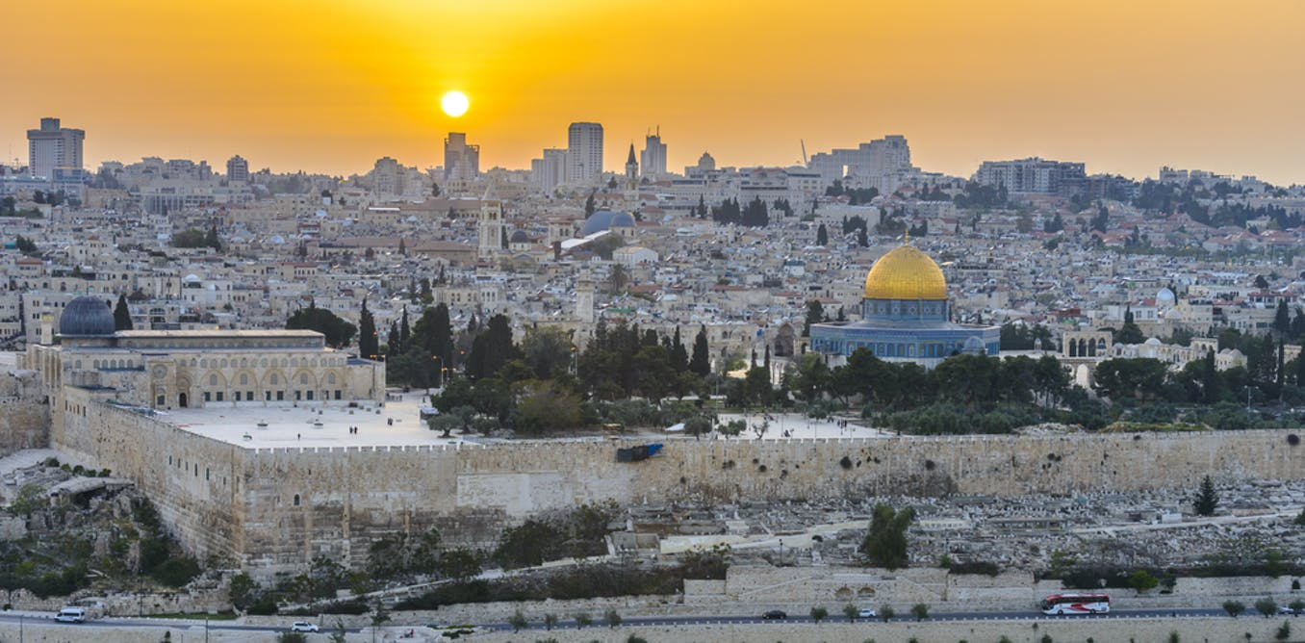

Slide 19


Slide 20


