Slide 1
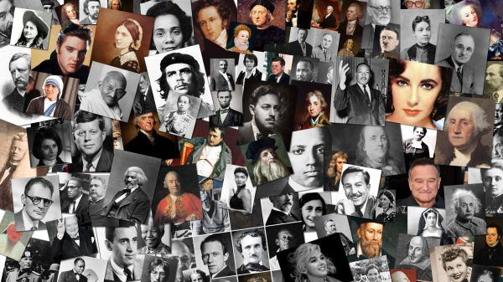
Leaders & Heroes
People who made a difference
Lecture #4 – Science & Technology

Slide 2
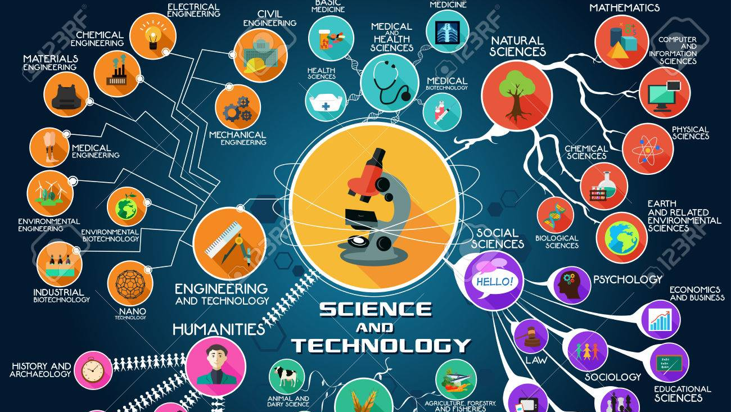

Slide 3
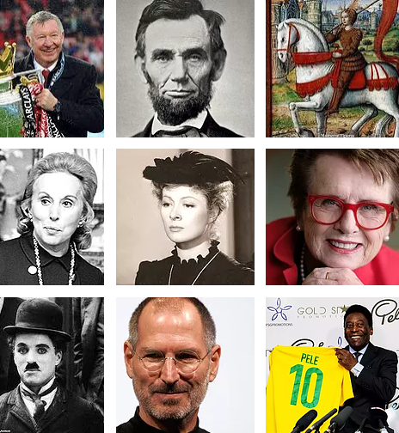
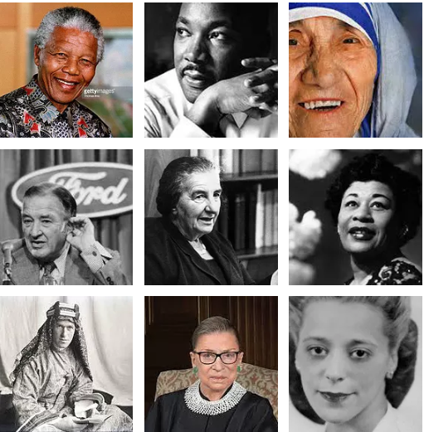
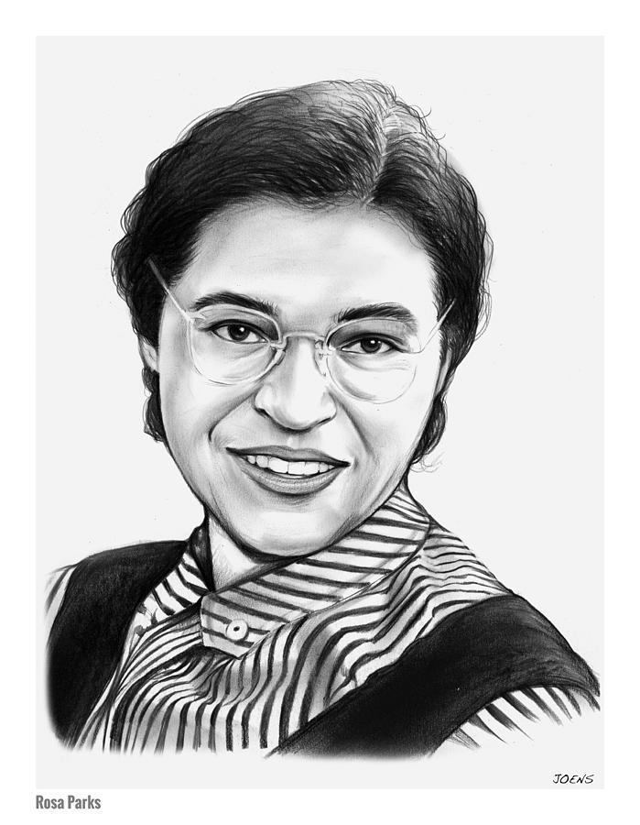


Slide 4
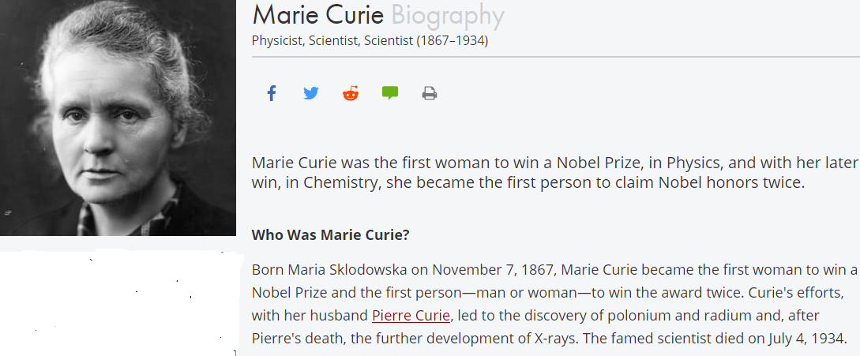

Slide 5
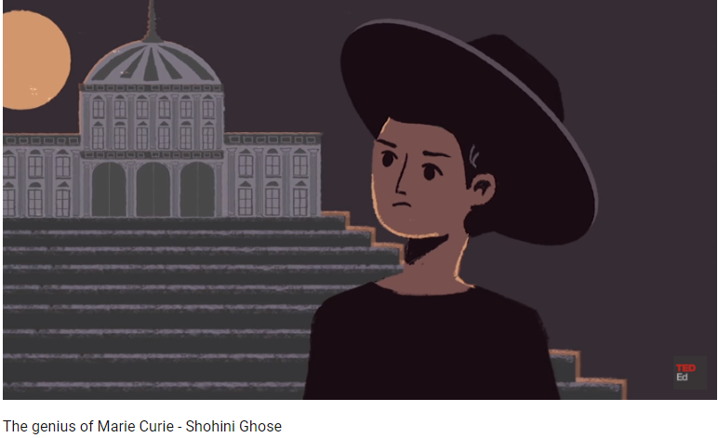
RADIATION CURIE

Slide 6


Slide 7
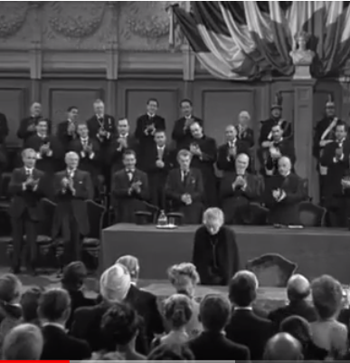
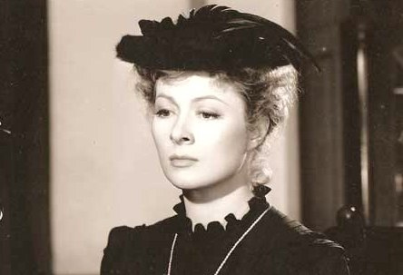
Curie on Science

Slide 8
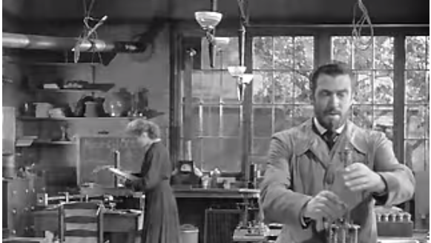
The Curie Collaboration – Changed Our Lives

Slide 9
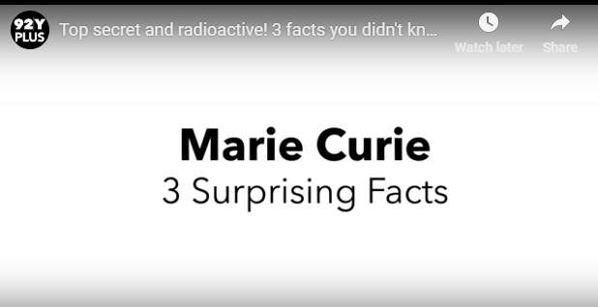

Slide 10
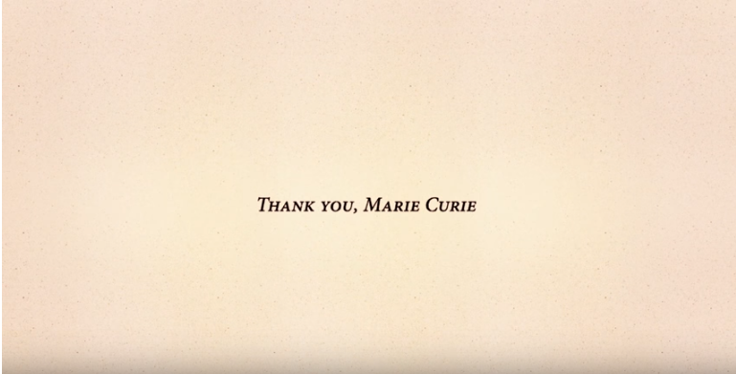

Slide 11
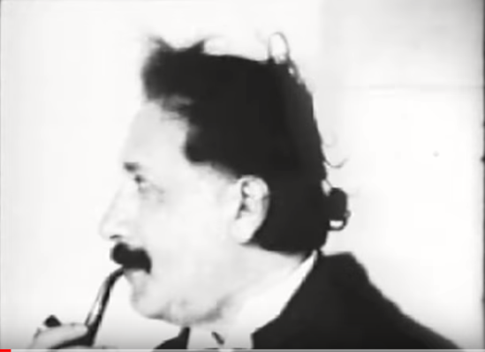
Apple Steve Jobs The Crazy Ones - NEVER BEFORE AIRED 1997 - (Original Post)
3,784,057 views
3,784,057 views
28K

Slide 12
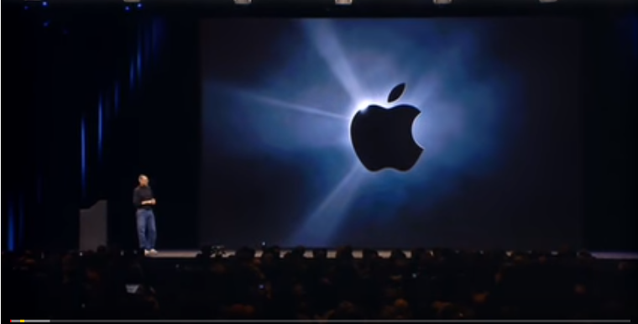
Steve Jobs introduces iPhone in 2007

Slide 13
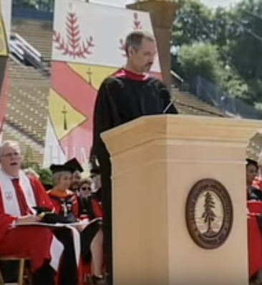
2005 Stanford University Commencement Address

Slide 14
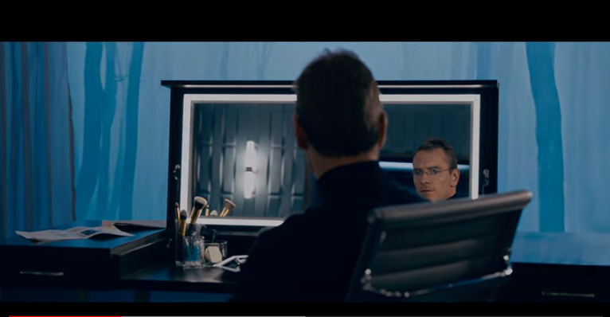
Steve Jobs – The Movie

Slide 15
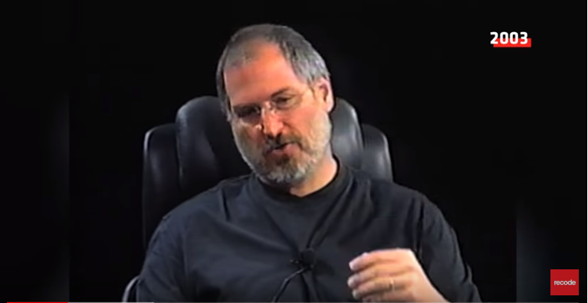
The Interviews

Slide 16
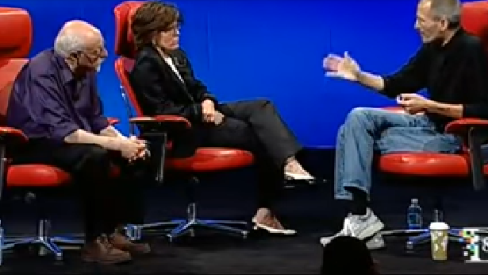
How Apple Works!

Slide 17
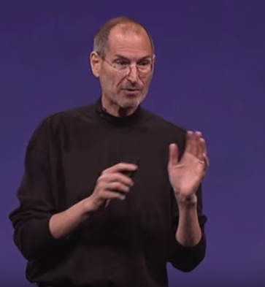
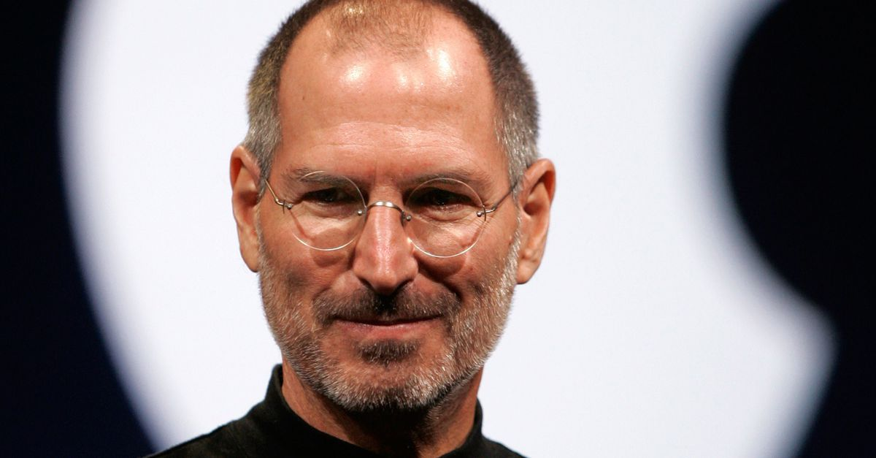
Outspoken? Rude? Nasty? Genius?

Slide 18
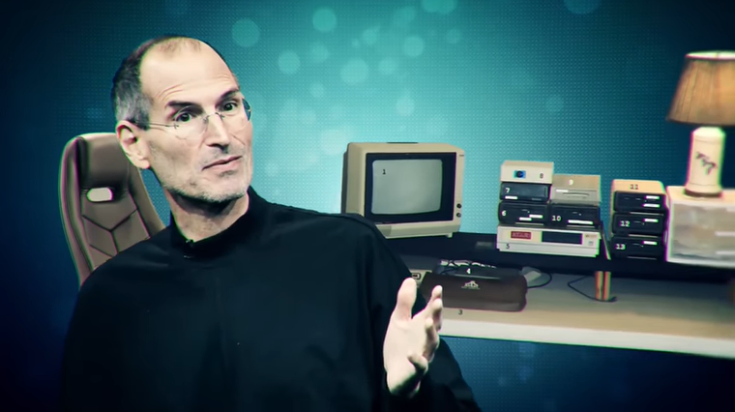
10 Things you didn’t know about Steve Jobs
https://www.youtube.com/watch?v=A5ughsPP2S4

Slide 19
