Slide 1


Slide 2


Slide 3
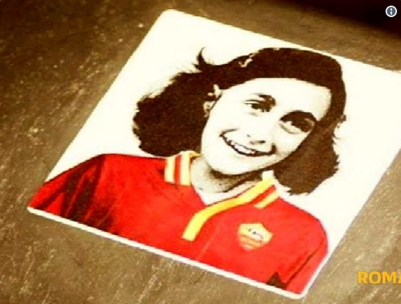
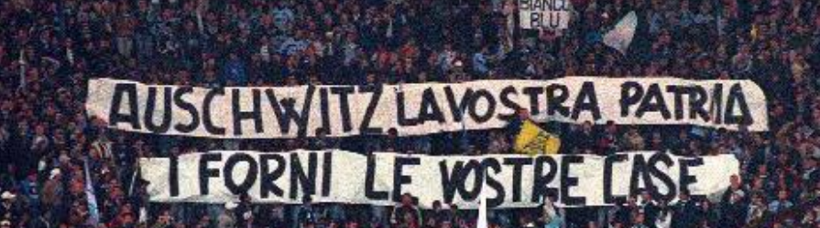
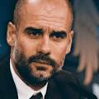
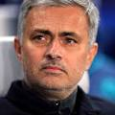
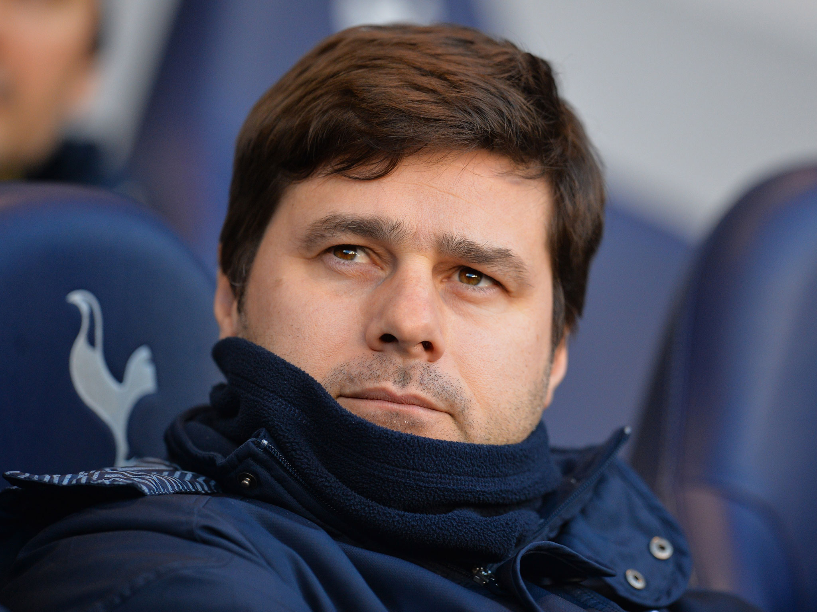
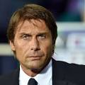
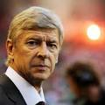
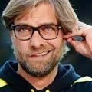
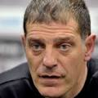
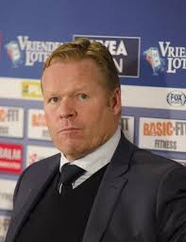
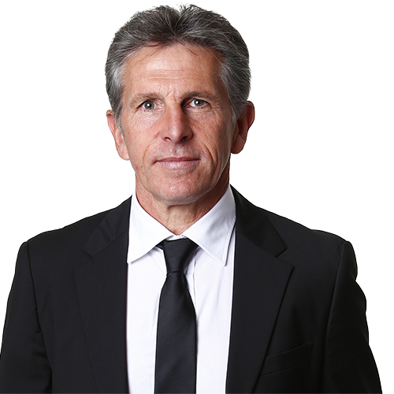
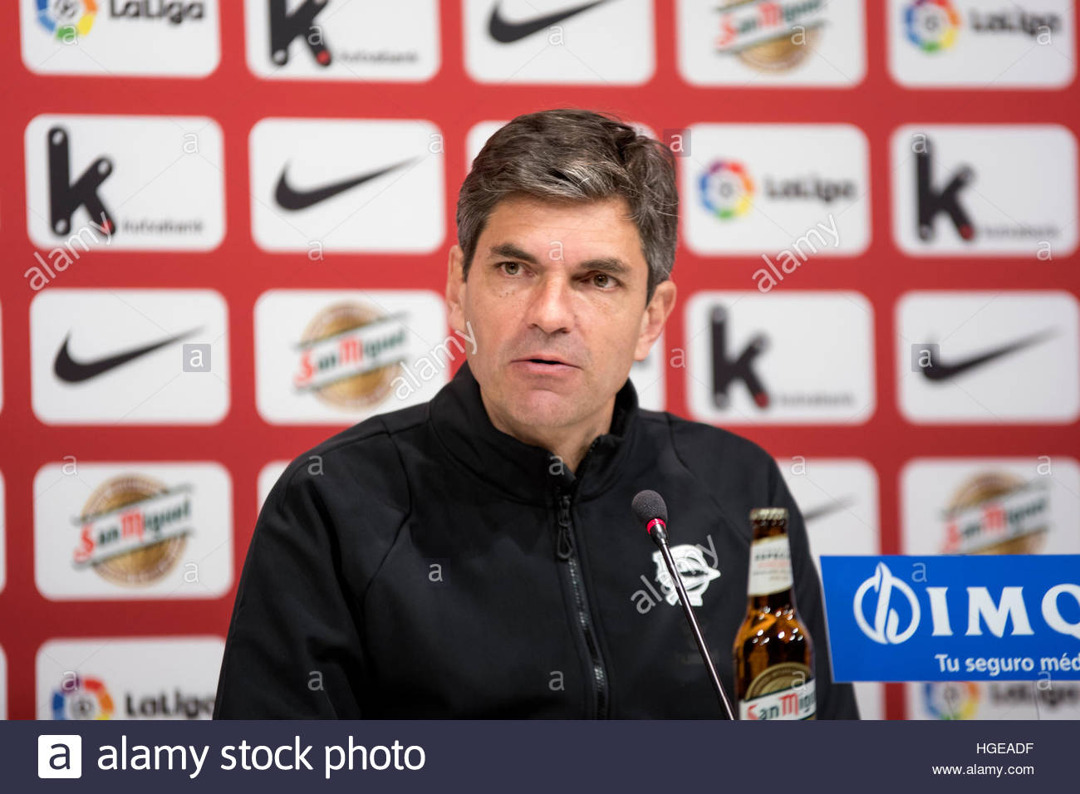
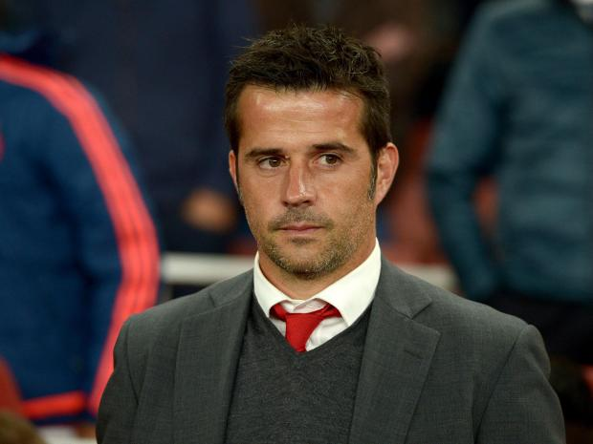
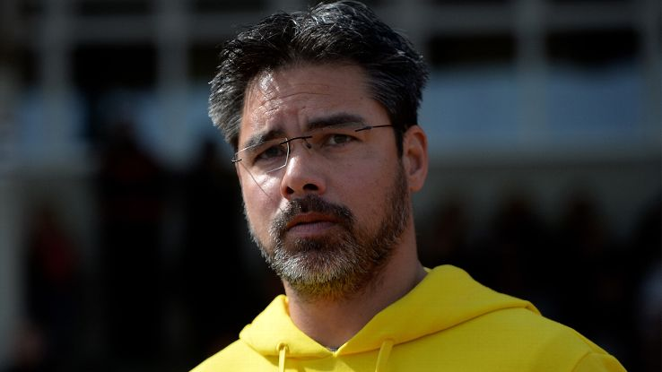
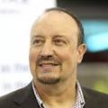
LAST WEEK TODAY…
Lazio president Claudio Lotito decided on the move to show that the club is committed to fighting racism and anti-Semitism and also said he would organise an annual trip to the former concentration camp at Auschwitz to educate fans about the horrors of the Holocaust.

Slide 4

The Governance of World Football
FIFA
PAST & PRESENT
FUTURE?

Slide 5
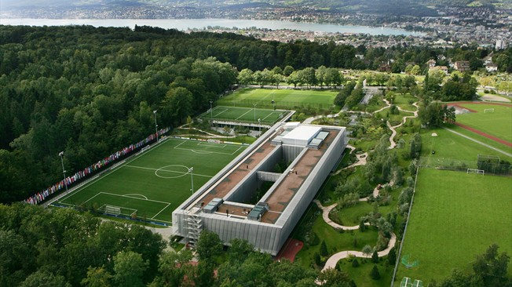
FIFA
∑(M+P) (#a+#t) =∞C
Money + Power multiplied by lack of Accountability plus lack of Transparency = Infinite Corruption

Slide 6
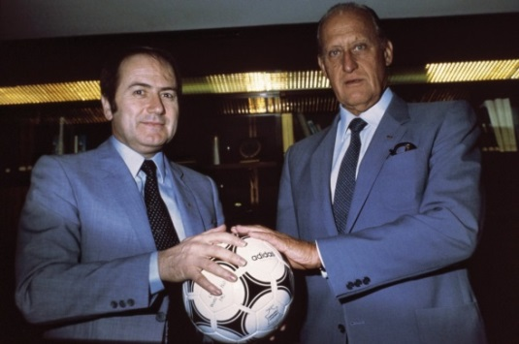
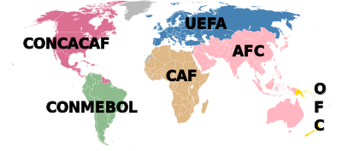

Making Modern FIFA
Well-known story…
1974: FIFA Presidency - Havelange beats Rous
Close ties to Adidas
Cycle of global expansion: commerce, tournaments, membership, governance structures, development programmes
Patronage system: finances, status, ties, loyalties

Slide 7


Slide 8
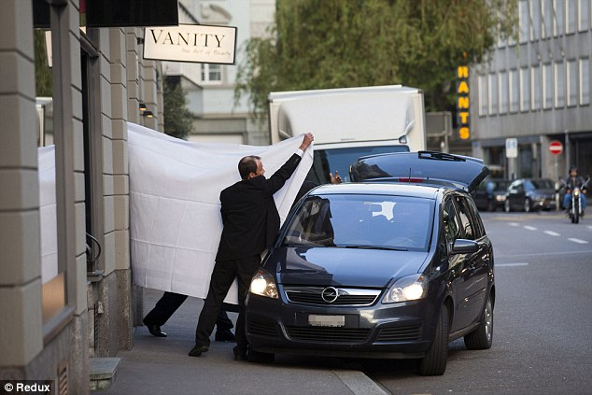
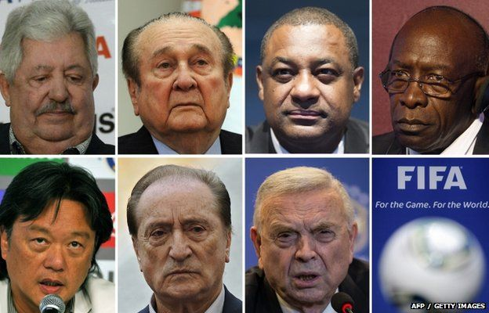
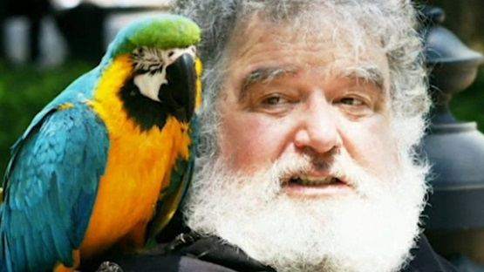
FIFA Episodes: 1. Main Corruption Case
US investigations – Chuck Blazer – guilty/informant
May 2015 – FIFA Congress:
  Initial arrests: 22 people, including Blazer, Nicolas Leoz, Jose Maria Marin of Brazil, Jack Warner, Jeffrey Webb
  CONCACAF, CONMEBOL and sport media/marketing deals
December 2015 – more charges: 16 Central and South American football officials
27 football officials charged, including 5 current/former FIFA VPs and numerous (ex-)members Exco
Blatter tries to stay on, wins re-election, resigns, banned with Platini

Slide 9
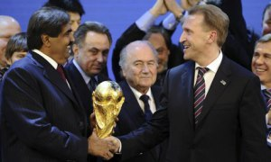
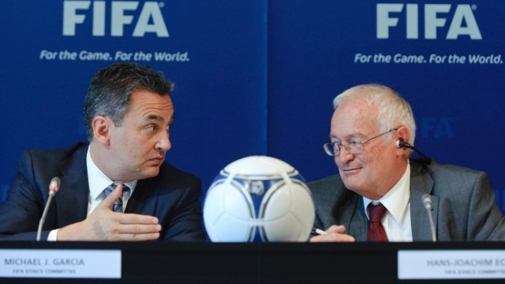
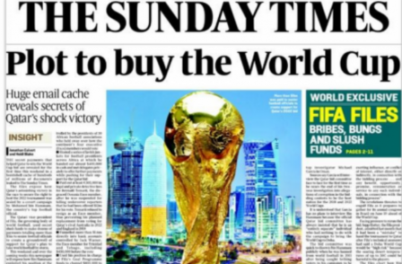
FIFA: 3. 2018 and 2022 World Cups
Russia, Qatar – alleged corruption, vote-rigging
15 of 22 Exco voting members: fined, suspended or banned, indicted by US or other authorities, or strong allegations
Sunday Times team – vast evidence on Qatar
Garcia Report into allegations: findings buried; FIFA official summary rejected by Garcia

Slide 10
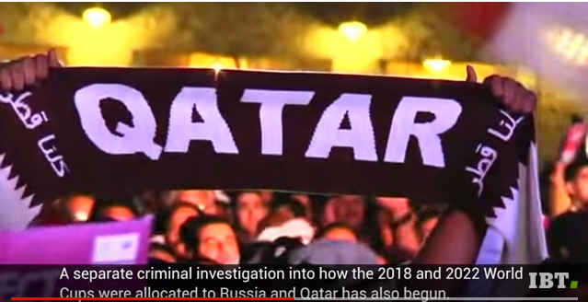

Slide 11
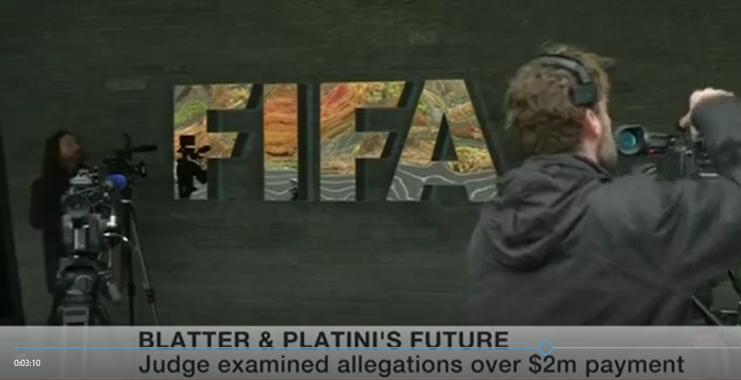

Slide 12
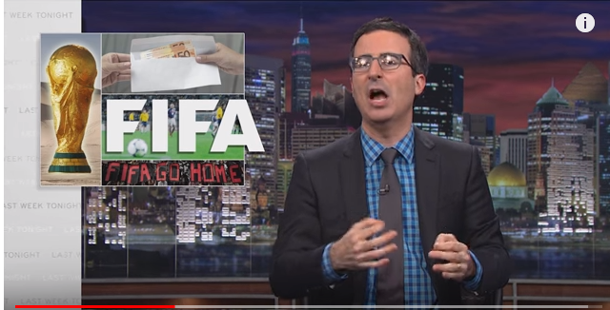

Slide 13
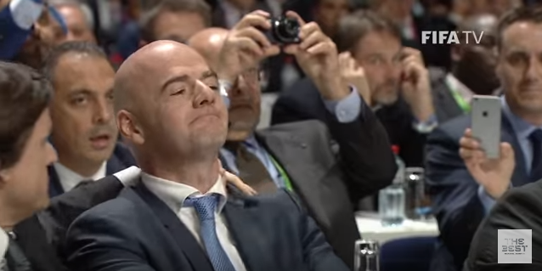

Slide 14
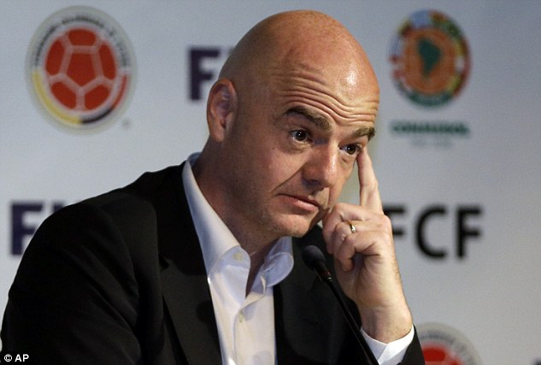
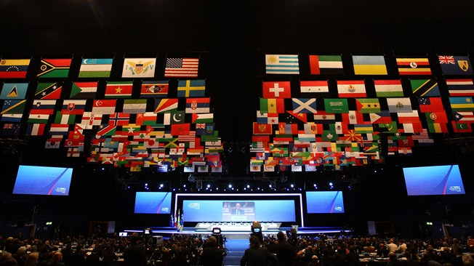
Governance – Realities
Recognize the realpolitik of FIFA…
Infantino et al. – pragmatics of survival
ONOV: FIFA rankings / 48-team World Cup
Entrenched multi-scale clientelist networks

Slide 15
FIFA

Slide 16
NEXT WEEK – LECTURE #6
Gender and Sexism in Soccer
Racism and Discrimination
My Story – Sonja Misso
Guest Speaker

