Slide 1
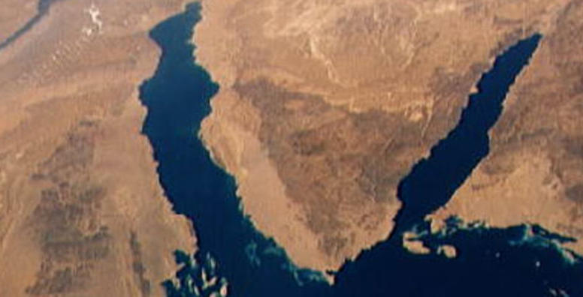
War & Peace
In The Middle East
Lecture #9

Slide 2
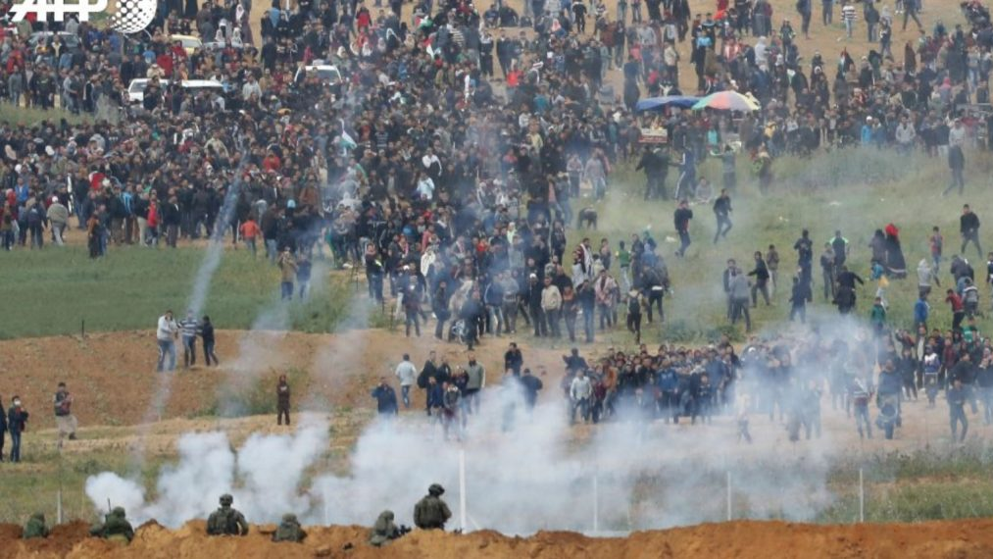
March of Return

Slide 3
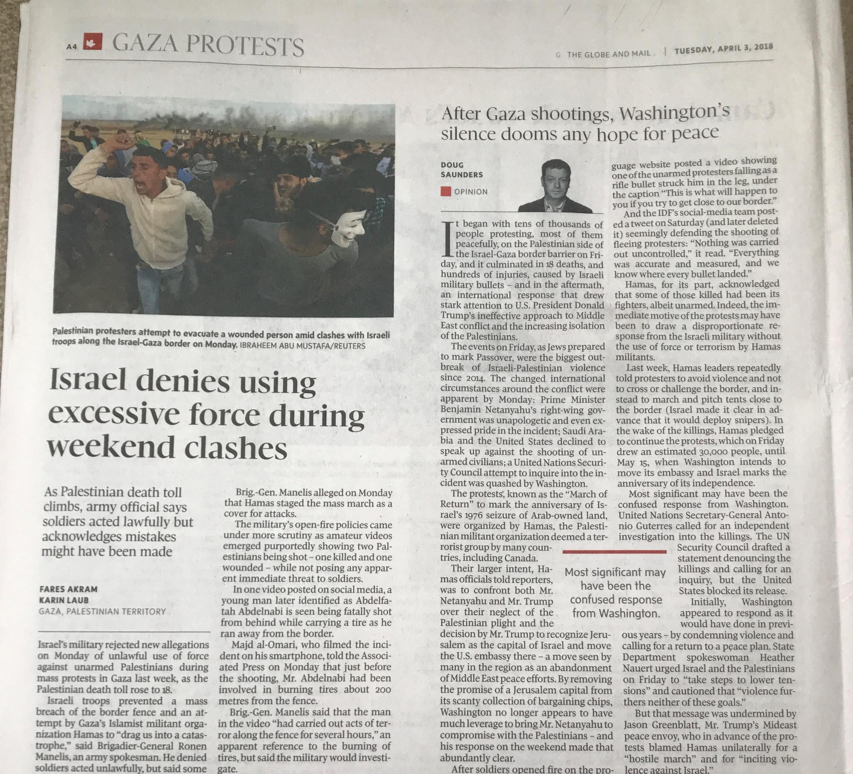
Situation Analysis
Data:
30,000 Gazan march on or near the Israeli border
18 Palestinians killed by IDF
Worst violence since 2014
Information:
Hamas organized /participated
Stones, tires, Molotov cocktails
Some protesters were shot in back
Intelligence:
March of “Return”
Not PA – West Bank (Unity)
U.S. Cover – Saudi recognition

Slide 4
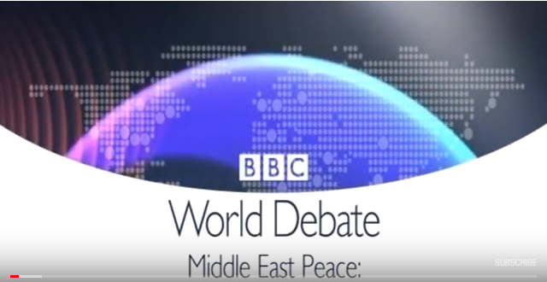

Slide 5
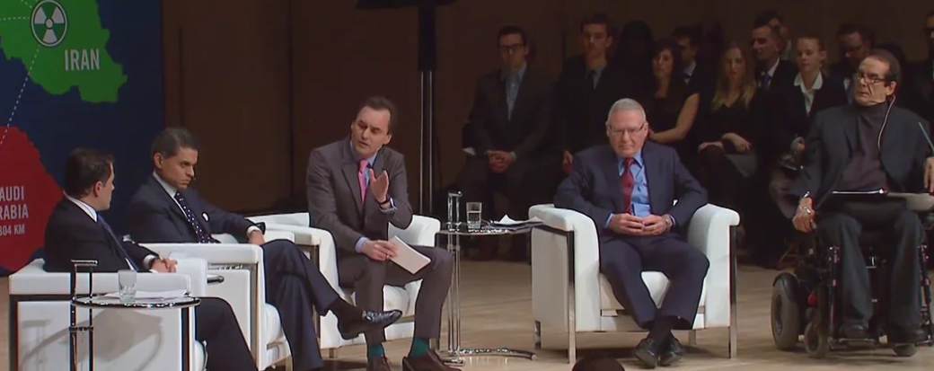
The Munk Debates – November 2012
Be it resolved that the world cannot tolerate an Iran with nuclear weapons capability...

Slide 6
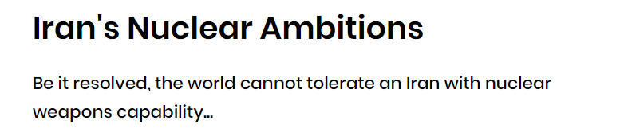
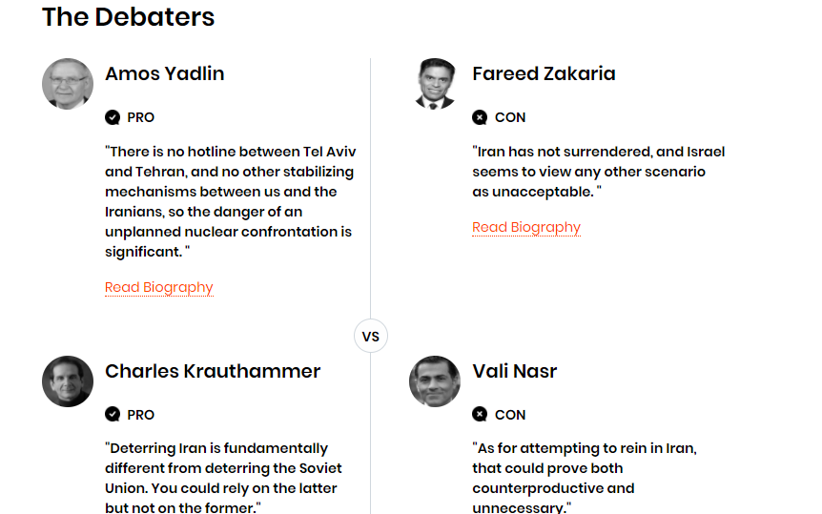


Slide 7
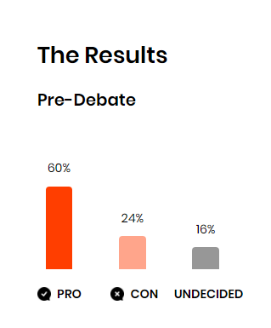
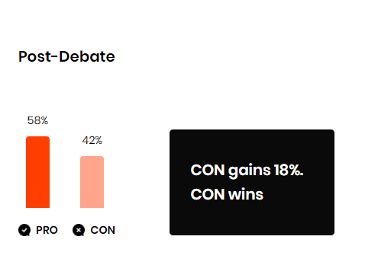

Slide 8
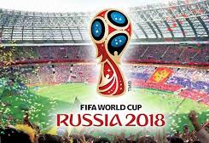
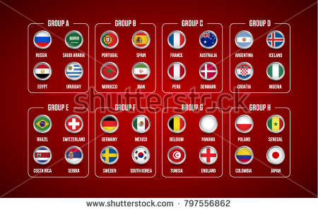
The greatest show on Earth.

Slide 9
If you’re staying in town this summer (and even if you’re not)
If you’re frequenting a pub – you’ll have to speak Soccer;
If any of your friends have an affinity to any of the 32 flags – you’ll have to speak Soccer;
If you are still working in an office environment you will not get to the water cooler if you can’t speak Soccer.
The solution:
Sign up to Football (that’s the right name) – A National Mirror a course I will be lecturing beginning May 2 – Limited Space still available
If it’s not for you forward to a LIFE member friend.

Slide 10


Slide 11
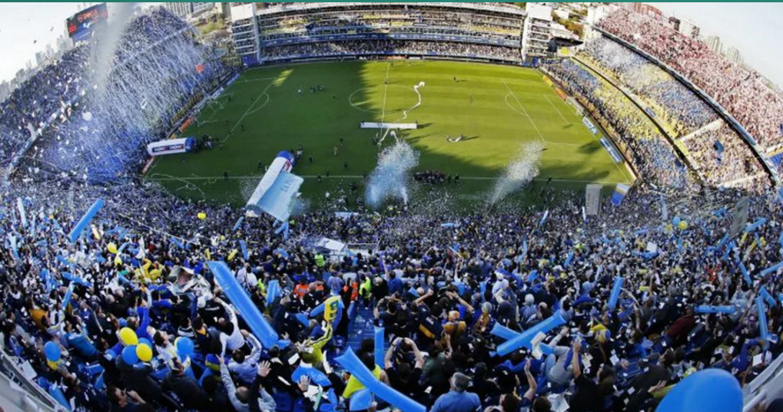
We examine the transcendent power of soccer in the world- a game that is helping to change the lives of individuals and communities across all continents.
We analyze the relationship of soccer to social movements, gender, architecture, ethics and aesthetics.

Slide 12
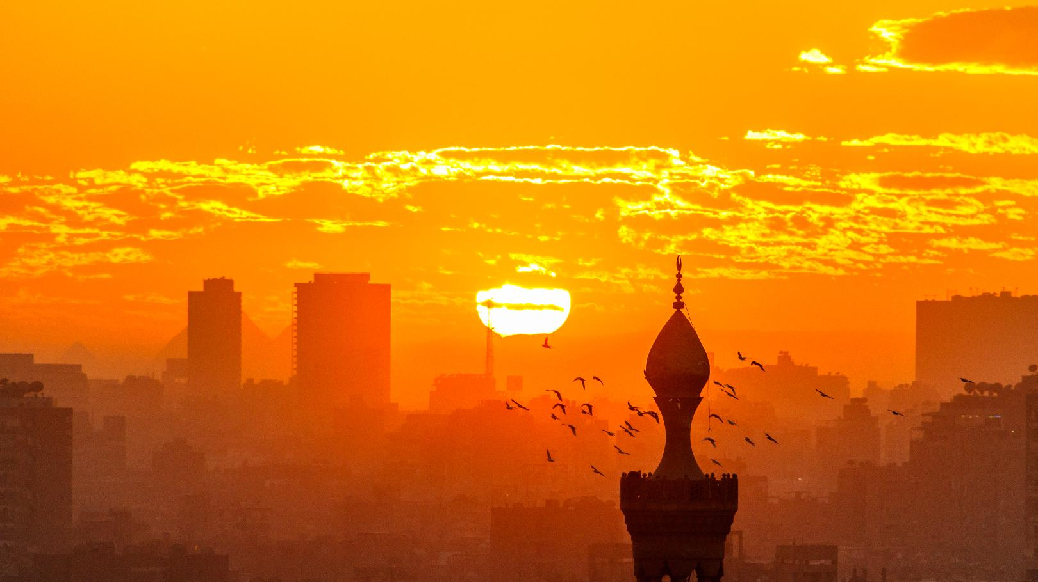
War & Peace
In The Middle East
This is not an official CERTIFICATE
This is a THANK YOU note for your interest, patience and now a better understanding of the Middle East
Amnon Zohar
azohar.amnon@gmail.com

