Slide 1


Slide 2

Lecture #7 – Heroes and Villains
Soccer as a force for good in Africa
Africa United behind the Beautiful Game

Slide 3
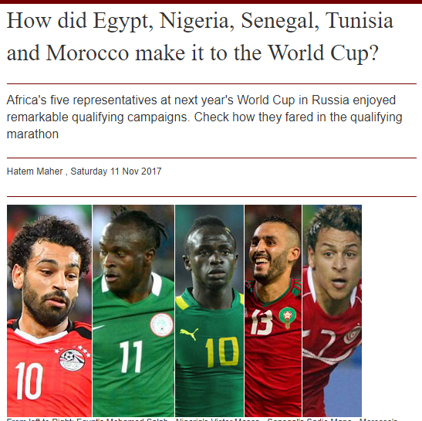


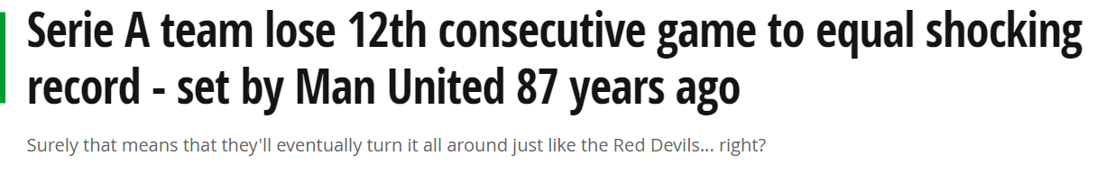
Last Week Today

Slide 4
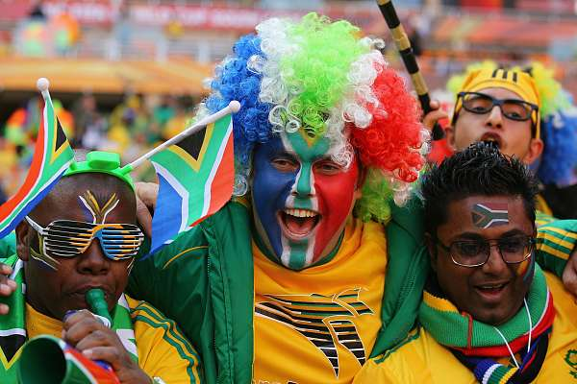

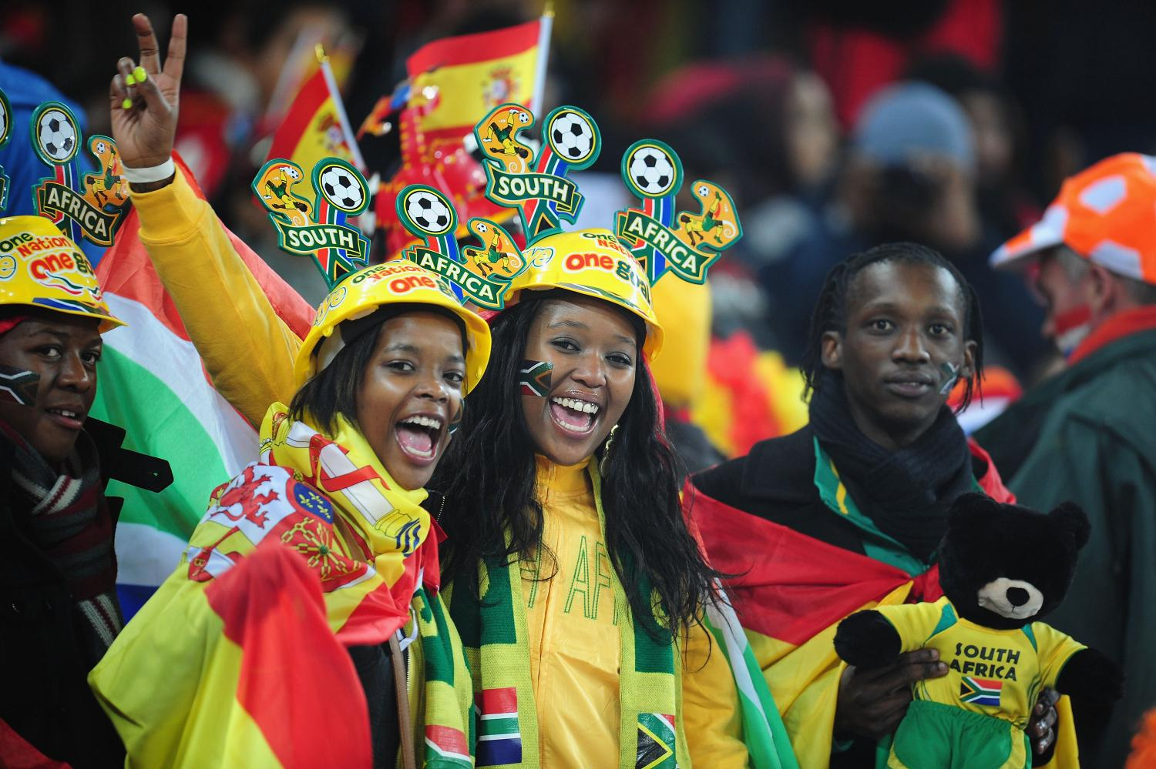

Soccer History in Africa

Slide 5
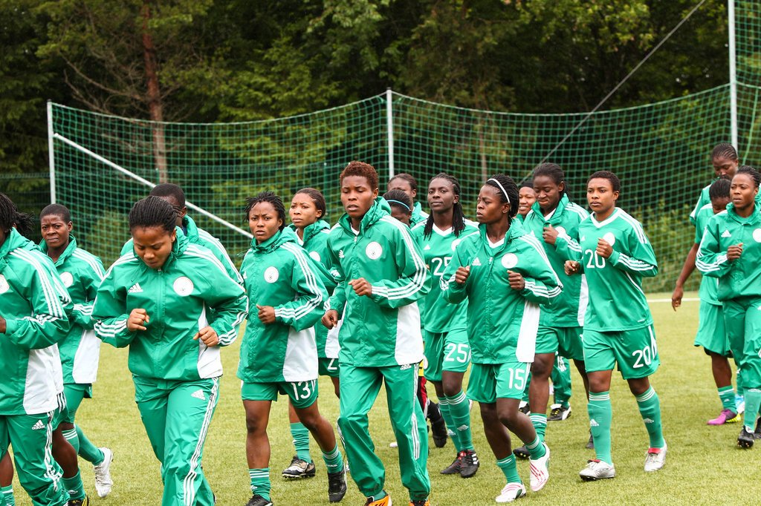

Slide 6



Slide 7
Next Week
Football and Popular Culture
The Joy of Football
Life is a Ball – John Doyle

