Slide 1
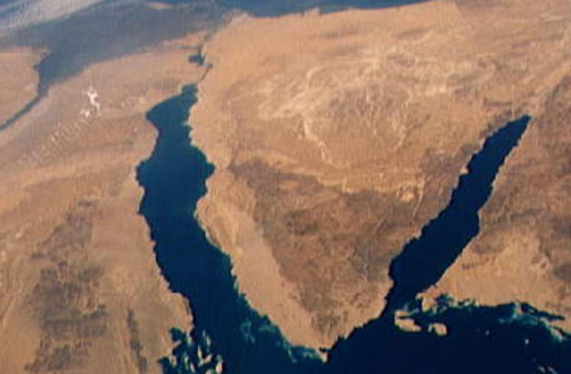
War & Peace
In The Middle East
Lecture #8

Slide 2
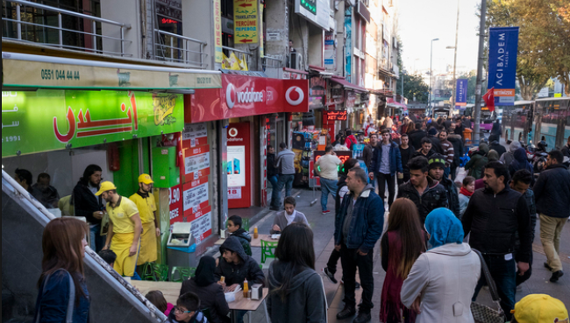
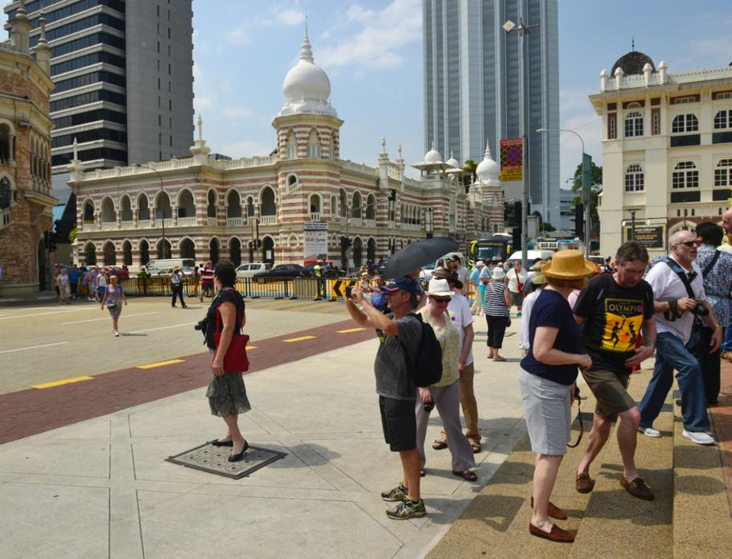

Come see the Middle East

Slide 3
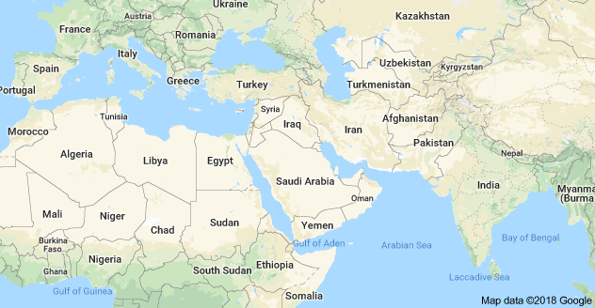

Slide 4
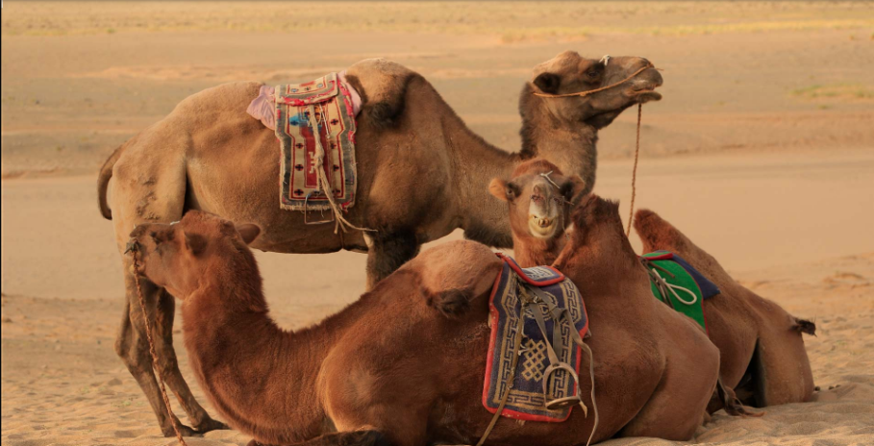
Last week today
Touring the Middle East
  Jerusalem
  Mekka and Medina
  Pyramids of Giza
  Petra
  Oman Fjords
  Jeita Groto
  Iran
  Palmyra
  Dead Sea
  Hanging Gardens of Babylon
Discussion Q&A

Slide 5
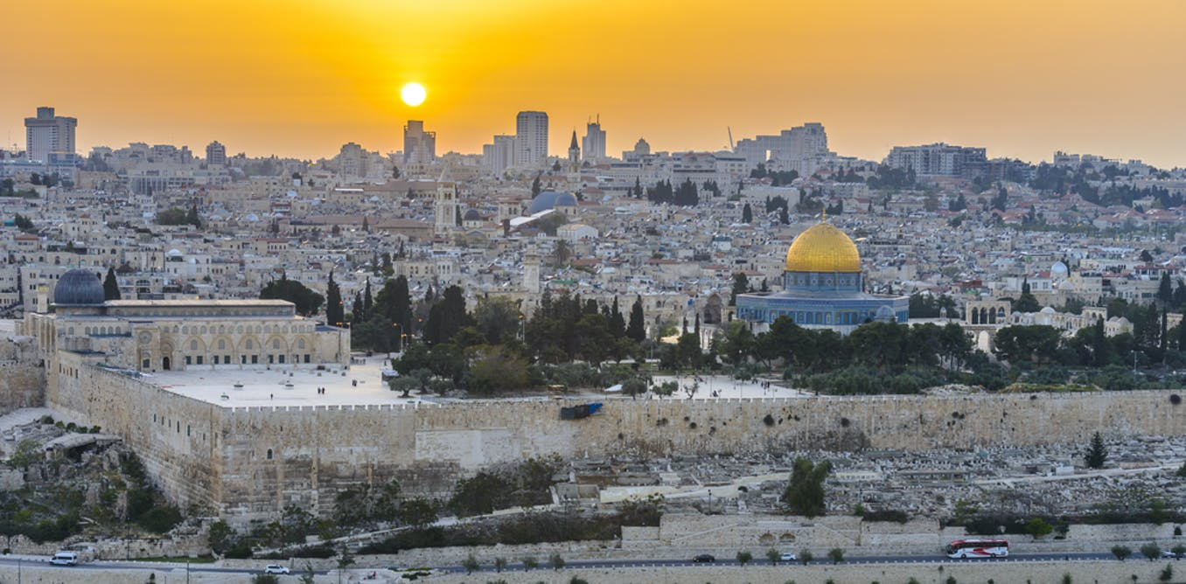
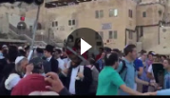

Slide 6
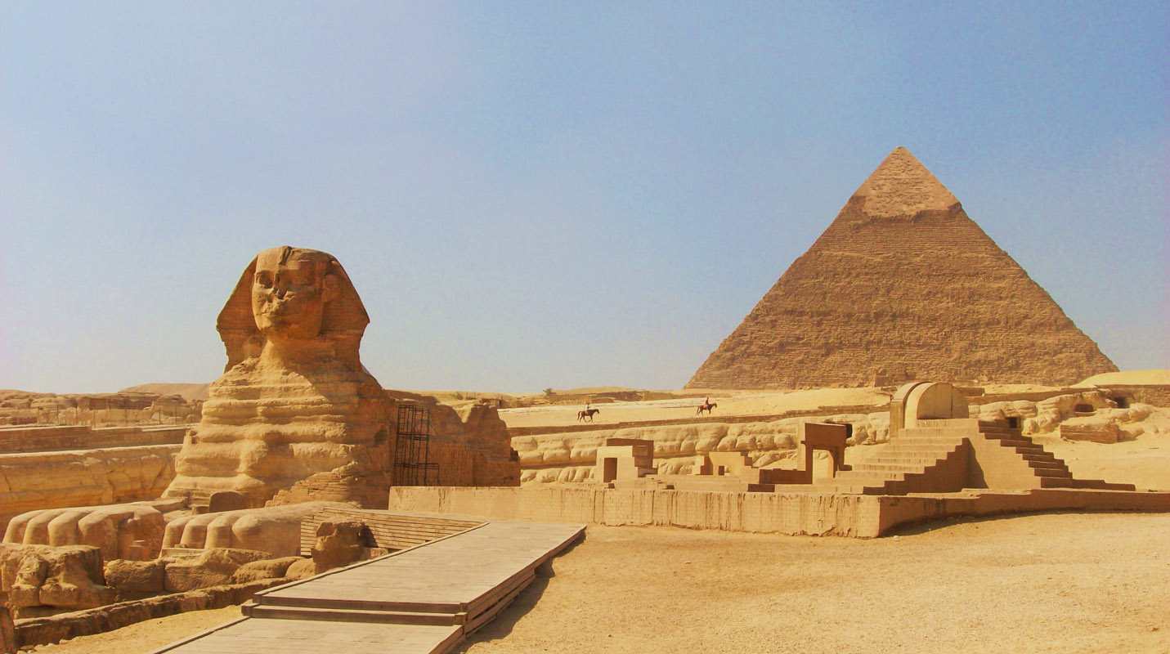

These pyramids were built over three generations. By Khufu, his second son Khafre, and Menkaure. It is believed that Khufu’s pyramid was built by slaves. This is not true. 100,000 people had worked on it for three months out of every year during the Nile’s flooding period. It was impossible to farm during this period so most people were unemployed. Khufu provided good food and clothing for the workers and was remembered kindly in folk tales for centuries after.
Inside the Pyramids there were several different passage ways. Though, only one would lead to the tomb of the pharaoh buried inside of the Pyramid. The other passage ways were built to confuse the tomb robbers so they could not get to where the mummified pharaoh lay. Gold, food, clothing, weapons and other items could be found along with the pharaoh in a separate room next to where the mummy was kept

Slide 7
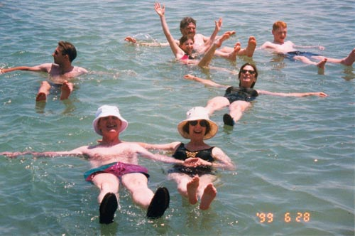
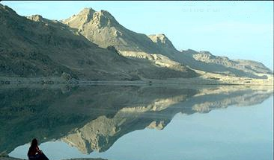

  The lowest point on earth, 400 m below sea level.
  Formed 3 million years ago when a fracture occurred amidst the Jordan rift valley.
  No form of life has been able to exist in its salty waters.
  32% salinity, the highest salt content of all seas' waters.
  The Dead Sea contain 43 billion metric tons of salt.
  Humidity: 50%. Pressure: 795mm. Oxygen level: 10 times higher than that of any earth atmosphere.

Slide 8

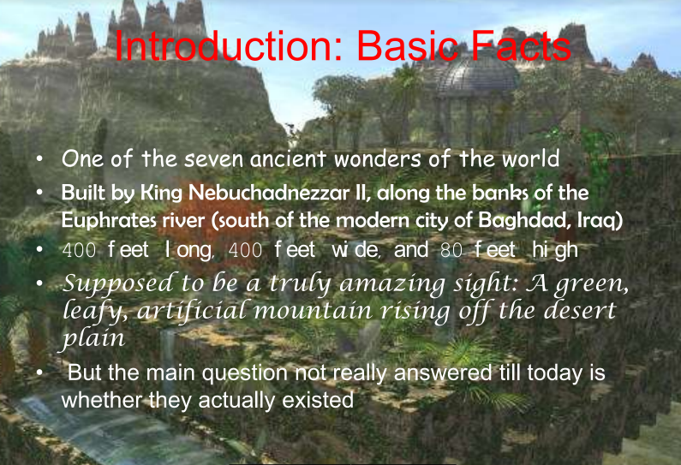


Slide 9
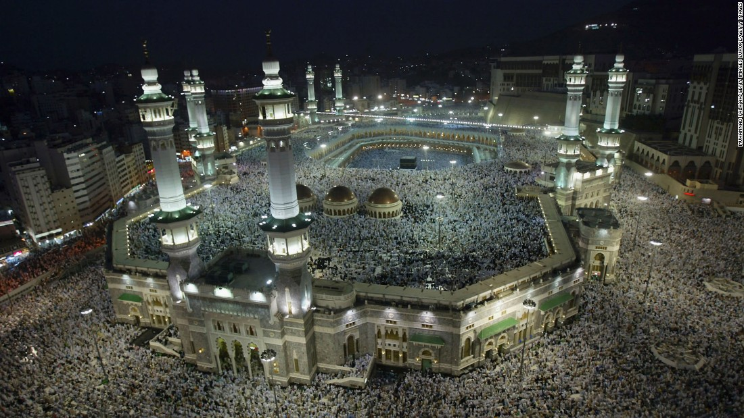


Slide 10
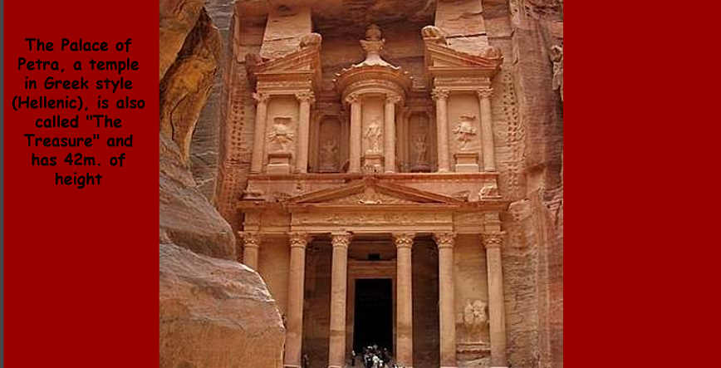
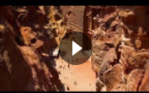

Slide 11



Slide 12
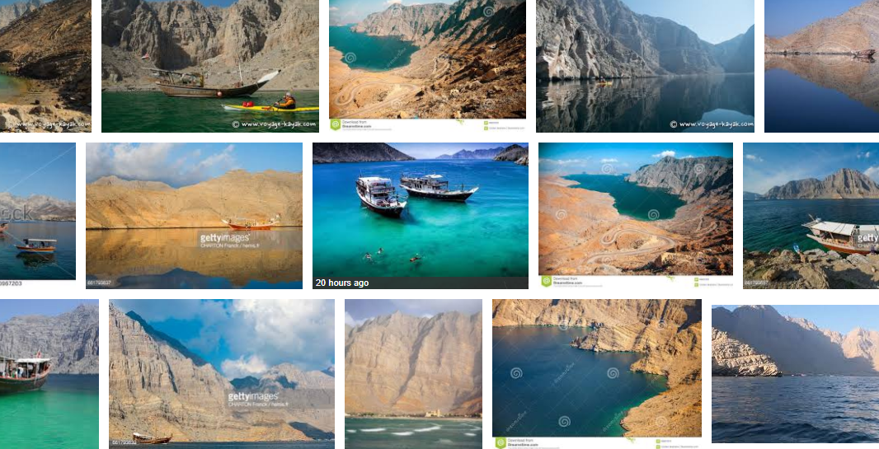
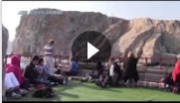
The Oman Fjords

Slide 13
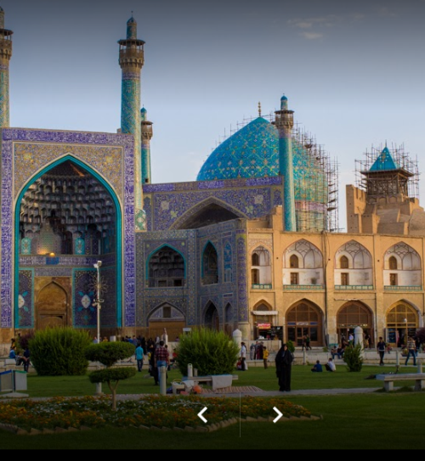
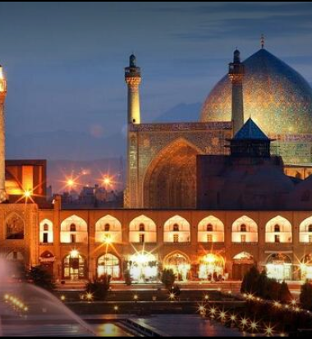
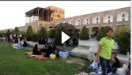

Slide 14
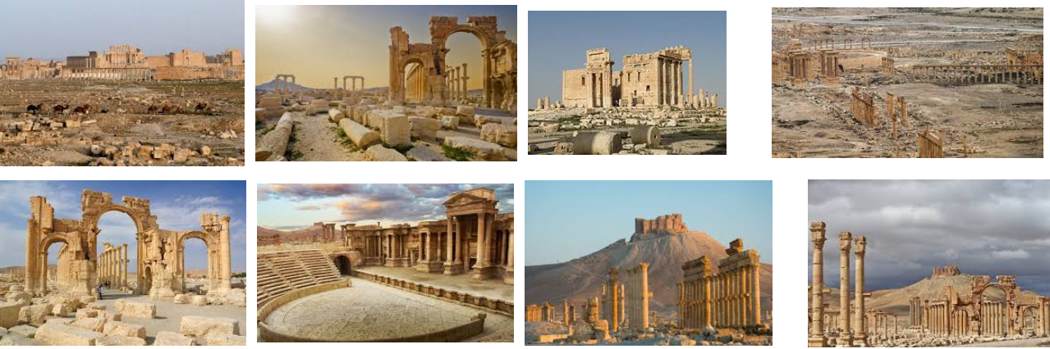

Palmyra, Syria

Slide 15
War & Peace in The Middle East
Next Week:
Let’s Debate Some Key Issues
Thank You

Slide 16
https://www.slideshare.net/secret/2e8wfy7gbVvriE
https://www.youtube.com/watch?v=tfJM_r9YAOI Slide 6
https://www.youtube.com/watch?v=RmN8Y8zvuFk Slide 7
https://www.youtube.com/watch?v=mi133Zr9EKw Slide8
https://www.youtube.com/watch?v=hdaZVfxoOK8 slide 9
https://www.youtube.com/watch?v=IQMAhXJl27Q slide 10
https://www.youtube.com/watch?v=YKk-JGeU_yY&t=13s Slide 11
https://www.youtube.com/watch?v=IZXate5oxpk Slide 12
https://www.youtube.com/watch?v=dRqLHlk9heg&t=5s Slide 13
https://www.youtube.com/watch?v=56LN995DR2E&t=367s Slide 14
https://www.youtube.com/watch?v=dp0x9wfTpdc&t=29s Slide 15

