Slide 1
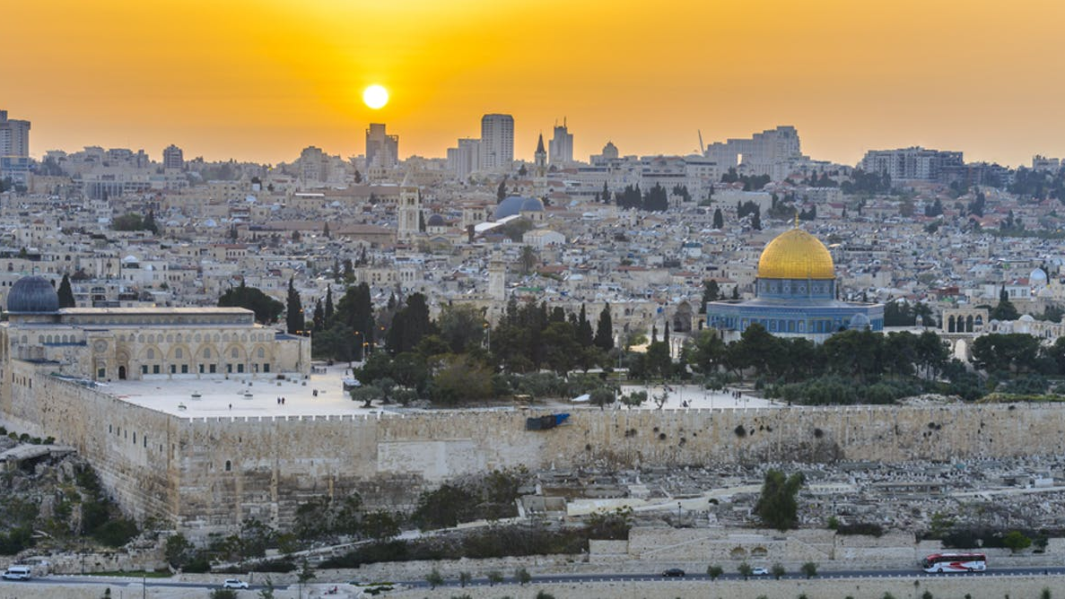
Israel 70 Years Later
The heroics of fighting for and developing the mostly arid land, to absorbing millions of Jewish Immigrants to fostering high learning institutions and becoming a Start-Up Nation second only to Silicon Valley as a world leader in technology and innovation. The struggles, the achievements and the challenges still facing Israel 70 years later.

Slide 2

Amnon Zohar
  Corporate Executive
  Marketing Consultant
  Serial Entrepreneur
  Student York University
  Student Tel-Aviv University
  Student Harvard University
  Football Fanatic
  Best Sabba in The World

Slide 3
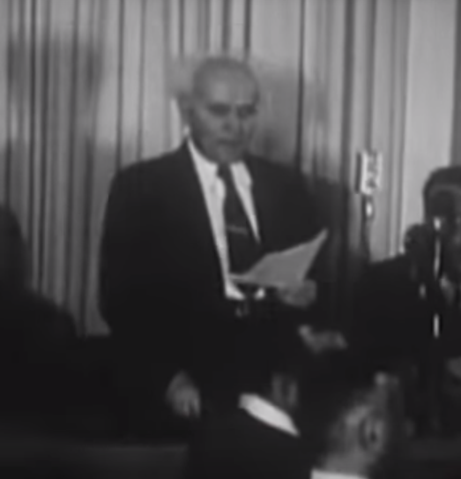
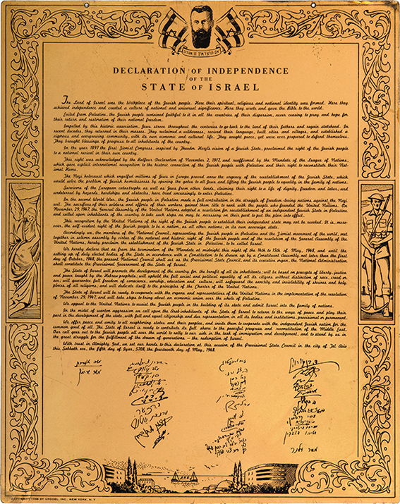
Israel is born May 14, 1948

Slide 4
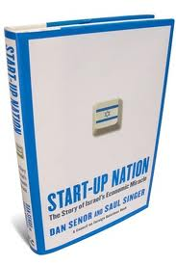


Slide 5
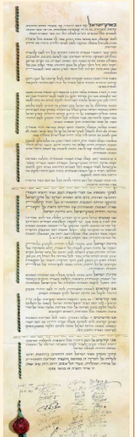
Declaration Of Independence
IDENTITY
The Land of Israel was the birthplace of the Jewish people. Here their spiritual, religious and political identity was shaped. Here they first attained to statehood, created cultural values of national and universal significance and gave to the world the eternal Book of Books.
Pioneers, defiant returnees, and defenders, they made deserts bloom, revived the Hebrew language, built villages and towns, and created a thriving community controlling its own economy and culture, loving peace but knowing how to defend itself, bringing the blessings of progress to all the country's inhabitants, and aspiring towards independent nationhood.

Slide 6
Declaration Of Independence
LEGITIMACY
In the year 5657 (1897), at the summons of the spiritual father of the Jewish State, Theodore Herzl, the First Zionist Congress convened and proclaimed the right of the Jewish people to national rebirth in its own country.
This right was recognized in the Balfour Declaration of the 2nd November, 1917, and re-affirmed in the Mandate of the League of Nations which, in particular, gave international sanction to the historic connection between the Jewish people and Eretz-Israel and to the right of the Jewish people to rebuild its National Home.
On the 29th November, 1947, the United Nations General Assembly passed a resolution calling for the establishment of a Jewish State in Eretz-Israel; the General Assembly required the inhabitants of Eretz-Israel to take such steps as were necessary on their part for the implementation of that resolution. This recognition by the United Natio

Slide 7
Declaration Of Independence
DEMOCRACY
The State of Israel will be open for Jewish immigration and for the Ingathering of the Exiles; it will foster the development of the country for the benefit of all its inhabitants; it will be based on freedom, justice and peace as envisaged by the prophets of Israel; it will ensure complete equality of social and political rights to all its inhabitants irrespective of religion, race or sex; it will guarantee freedom of religion, conscience, language, education and culture; it will safeguard the Holy Places of all religions; and it will be faithful to the principles of the Charter of the United Nations.
RECONCILIATION
We appeal - in the very midst of the onslaught launched against us now for months - to the Arab inhabitants of the State of Israel to preserve peace and participate in the upbuilding of the State on the basis of full and equal citizenship and due representation in all its provisional and permanent institutions.
PEACEFULL
We extend our hand to all neighbouring states and their peoples in an offer of peace and good neighbourliness, and appeal to them to establish bonds of cooperation and mutual help with the sovereign Jewish people settled in its own land. The State of Israel is prepared to do its share in a common effort for the advancement of the entire Middle East.

Slide 8
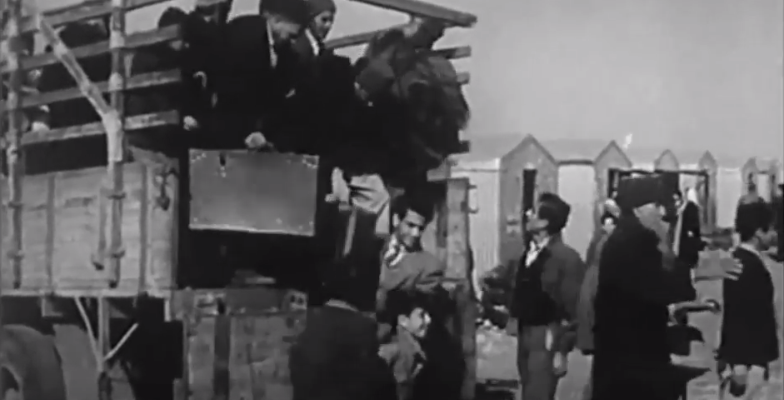
Year | Jews | Christians | Muslims | Total
1947 | 630 | 143 | 1,181 | 1,970

Slide 9
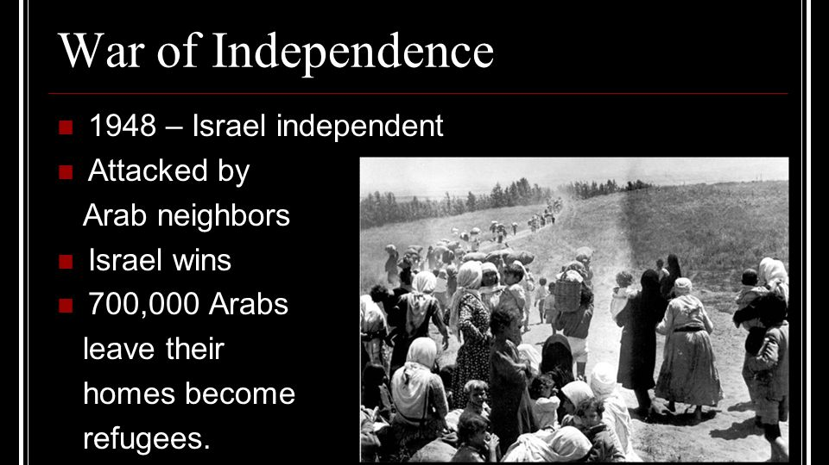

Slide 10
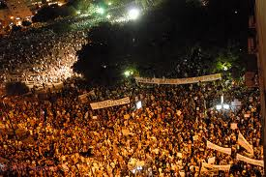
8.79 Million
75% - 6.6 million JEWS 20% 1.8 million Arabs , 5% other minorities 450,000

Slide 11
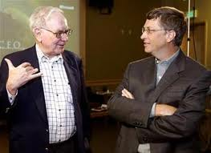


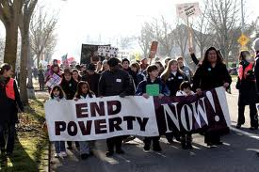

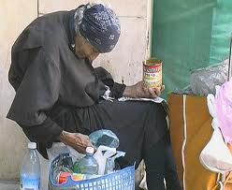
Wealth
USA – 585
1/564,000
Canada – 39
1/871,000
Israel – 18
1/490,000
Poverty
49.5 million/ 15%
4.8 million/ 15%
1.8 million/ 21%

Slide 12
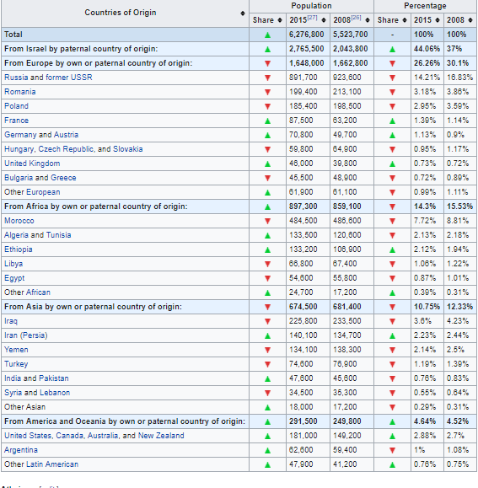
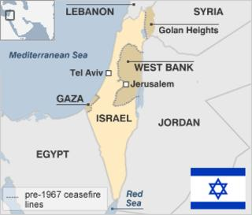

Slide 13
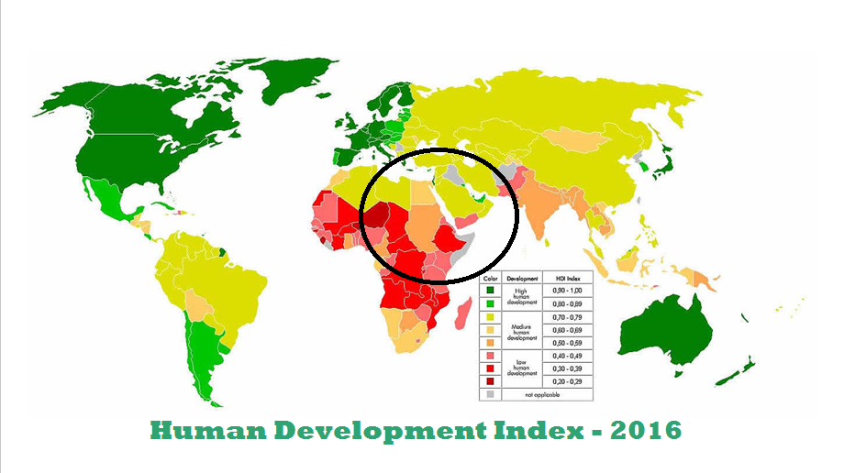

Slide 14
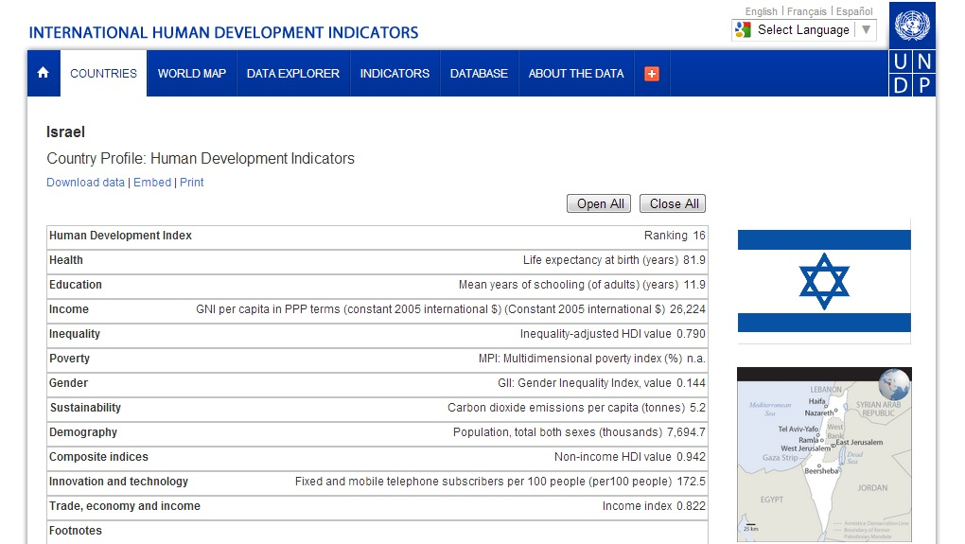
81.9
12.9
$26.2
172.5

Slide 15
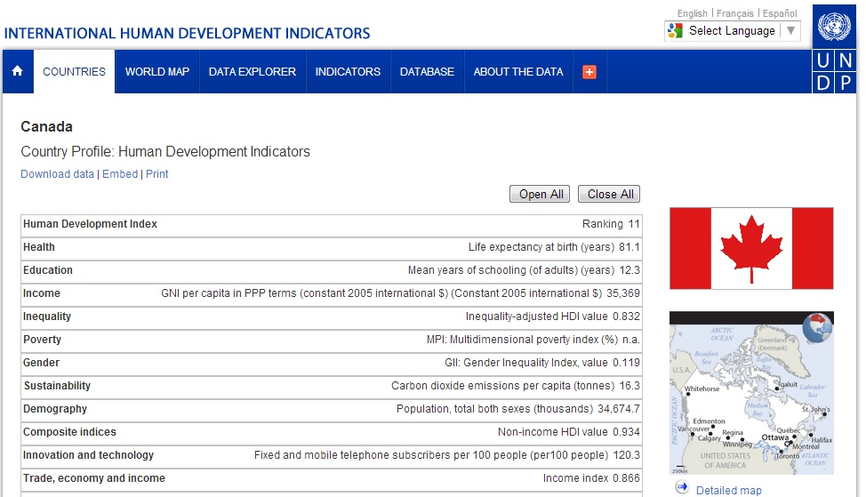
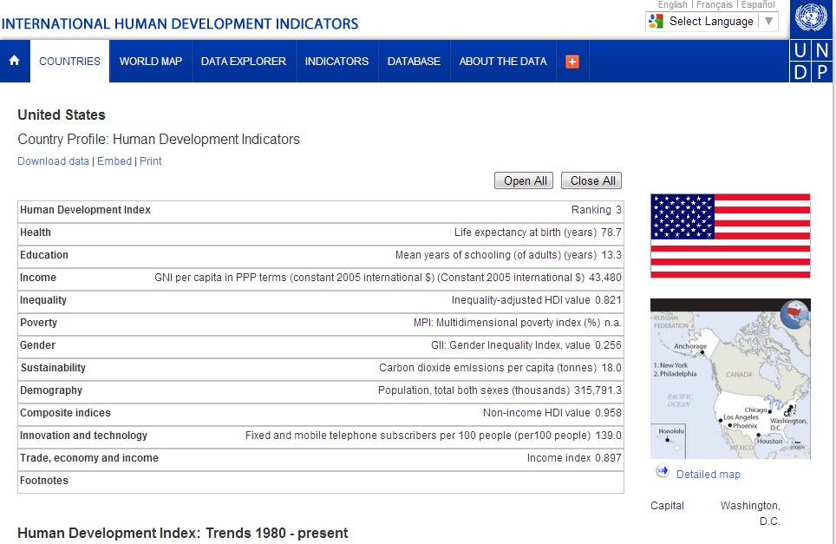
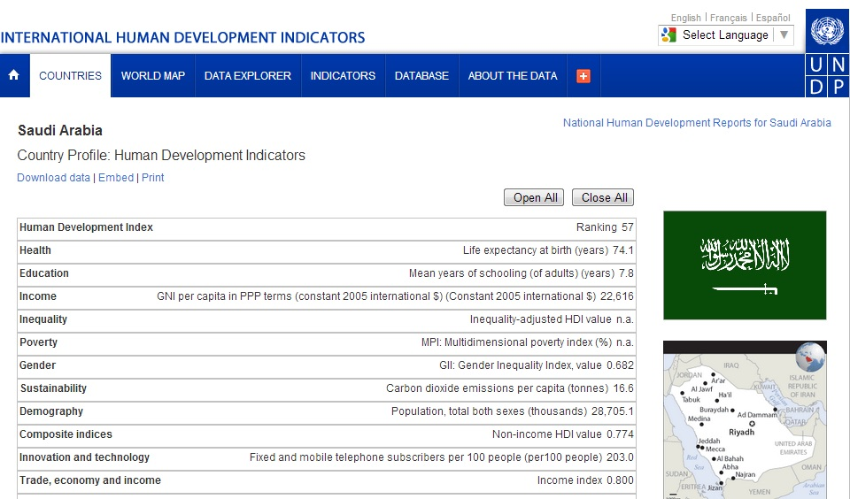
19
10
10
57

Slide 16


Slide 17


Slide 18
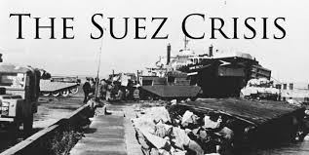

Slide 19
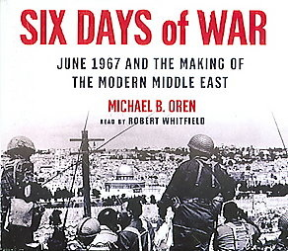
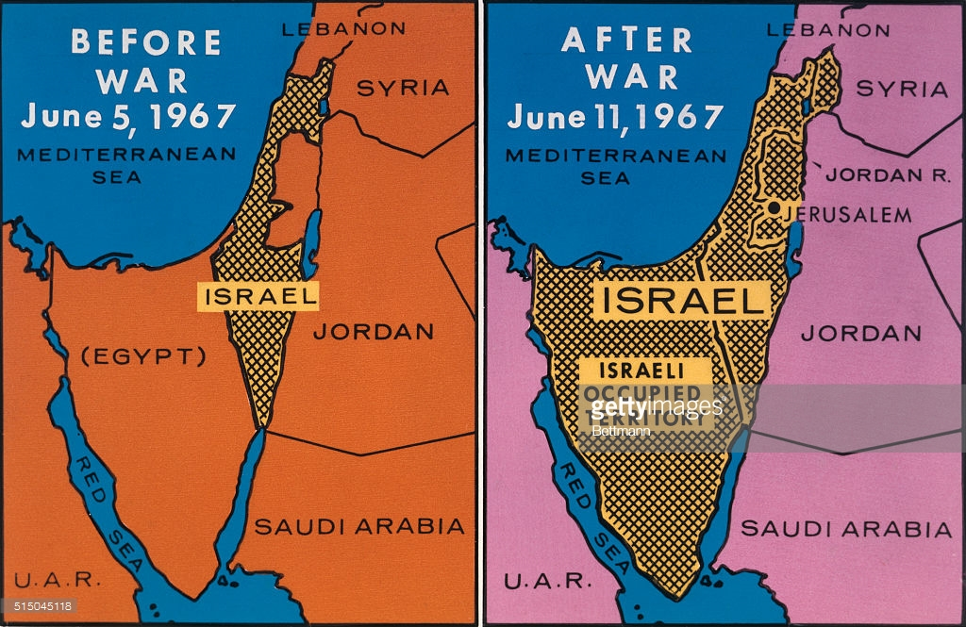
The War that changed The Middle East forever

Slide 20

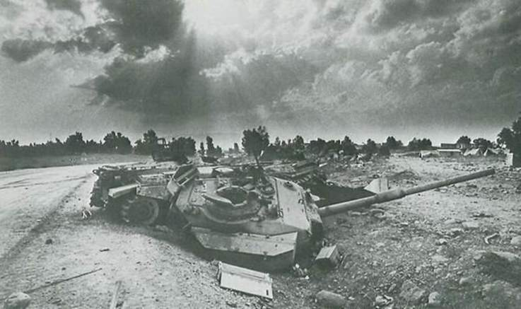

Slide 21

The State of Tel-Aviv

Slide 22


Slide 23
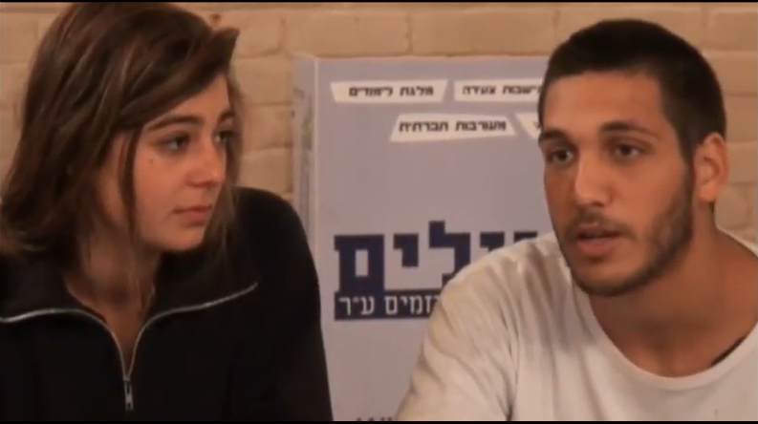

Slide 24
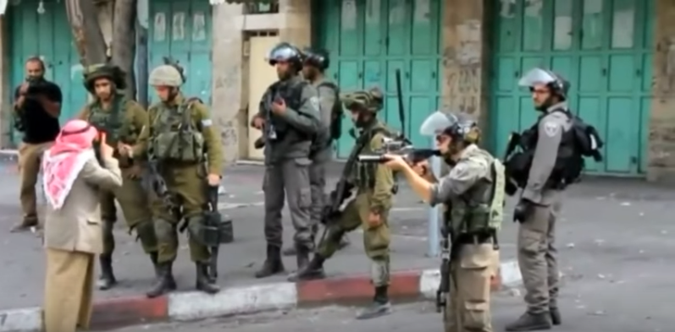

Slide 25
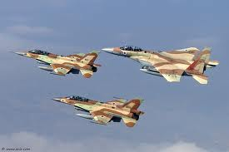
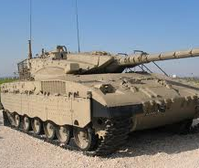
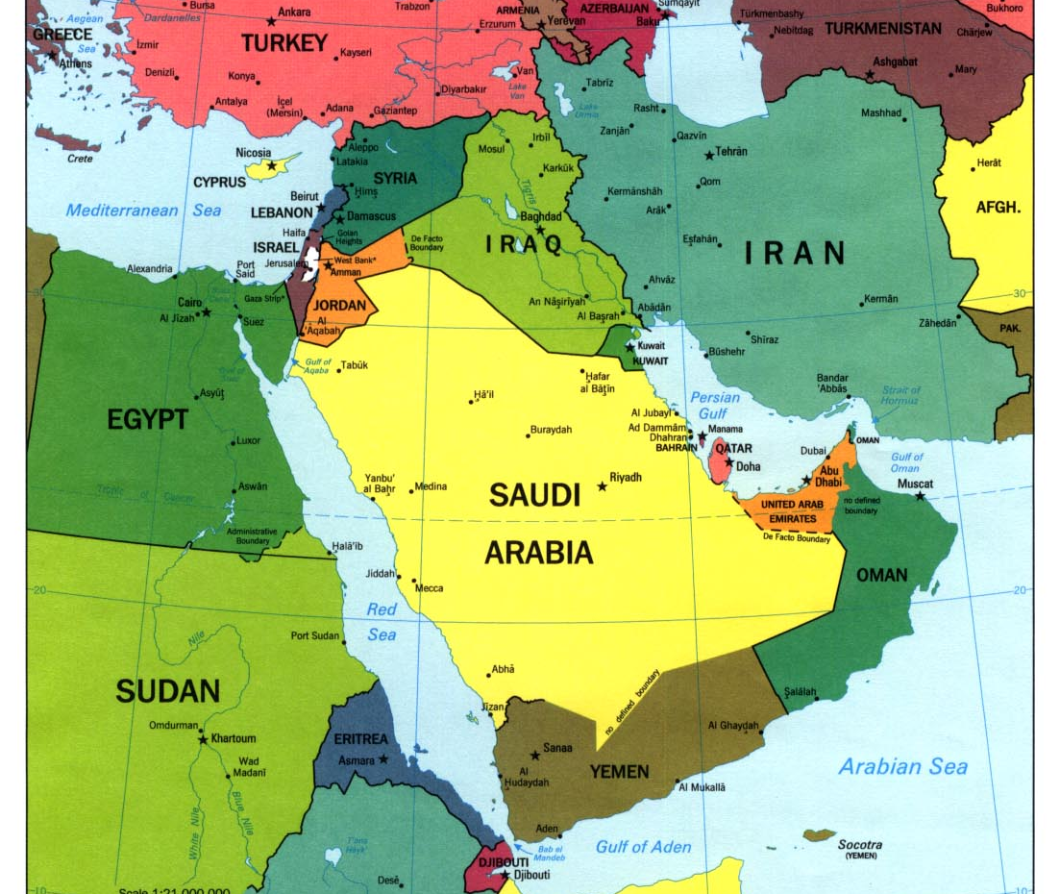
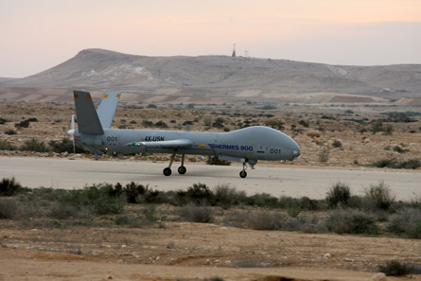
Military Superiority – Self-Sufficiency

Slide 26
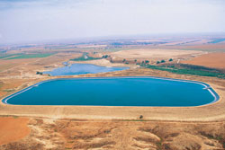
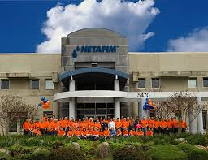
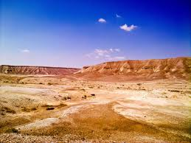

Lack of Natural Resources

Slide 27
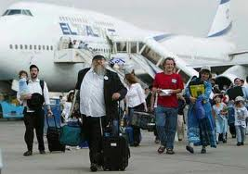
Immigration - Absorption

Slide 28

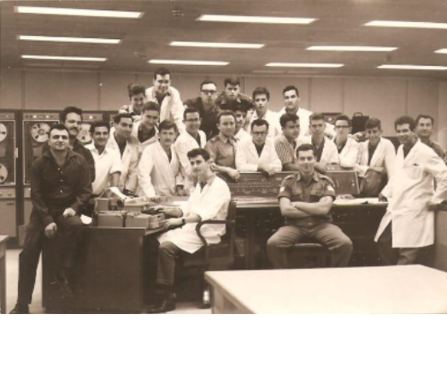
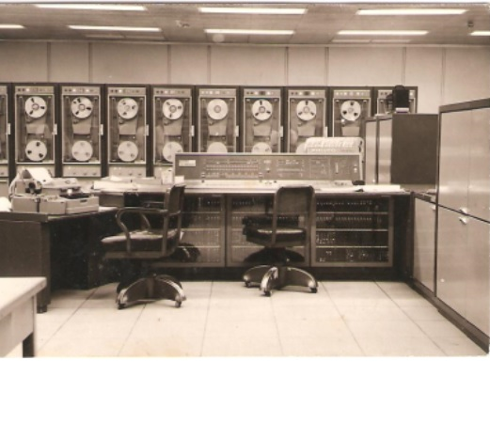
Technology
&
Education

Slide 29
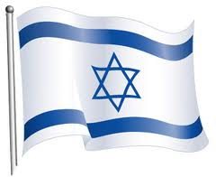
Why and how has Israel become a hot-bed for technological innovation and a power house in technology applications
Start-up Nation

Slide 30
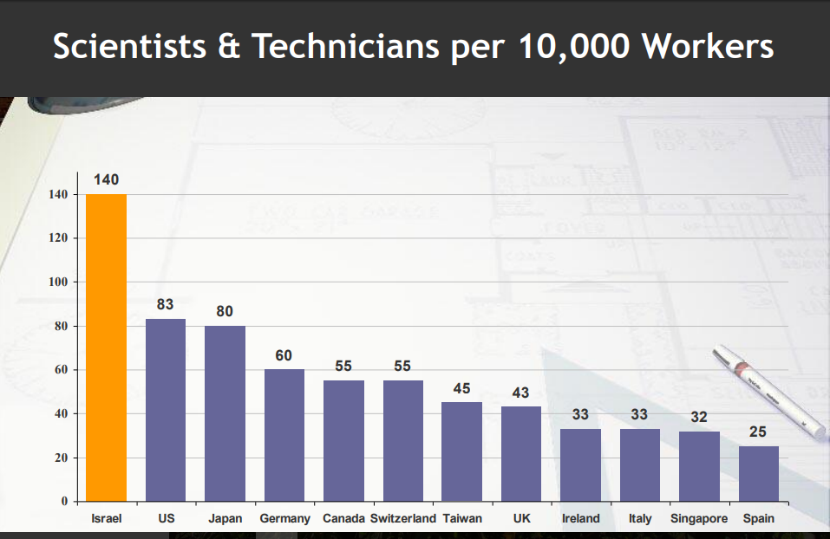
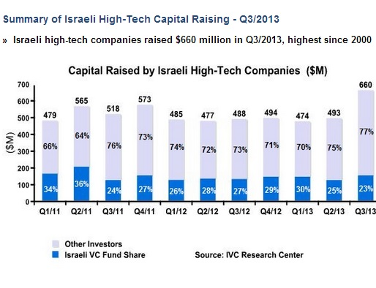
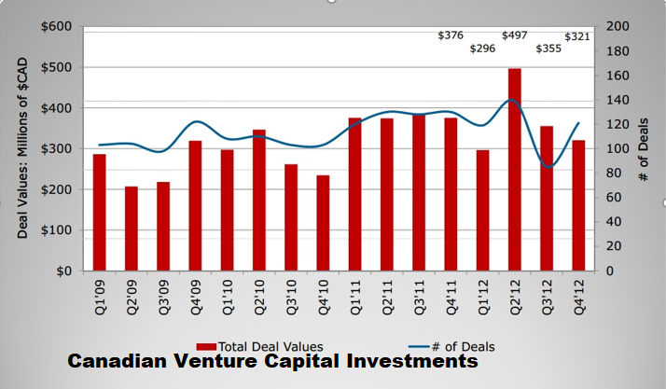

Slide 31
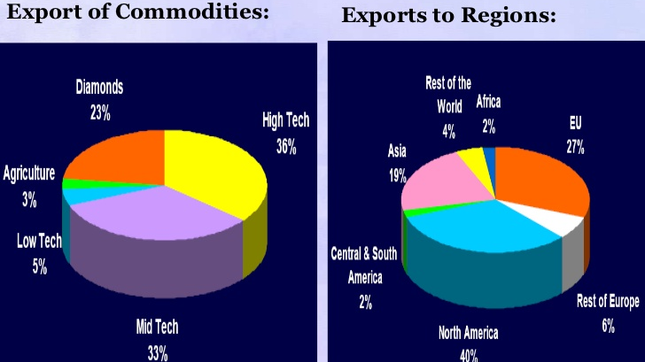

Slide 32

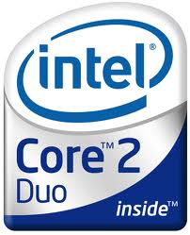



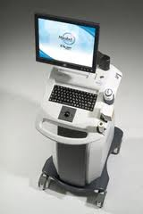





Slide 33
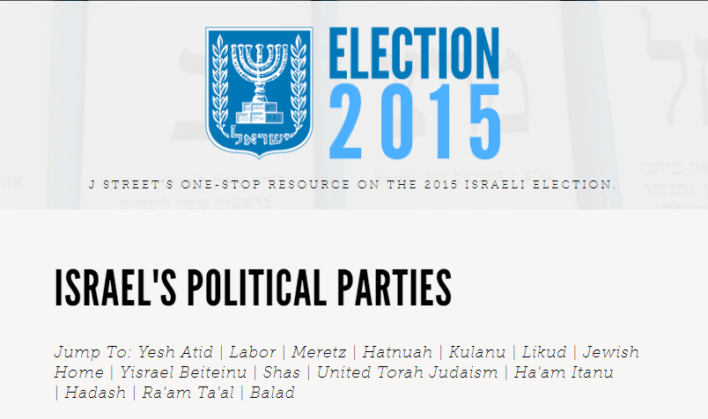
Israel

Slide 34
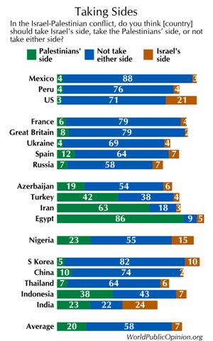
Israeli diplomatic conduct and discourse
International Poll:

Slide 35
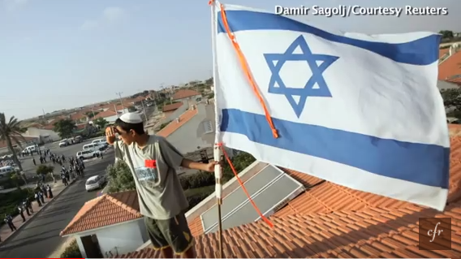
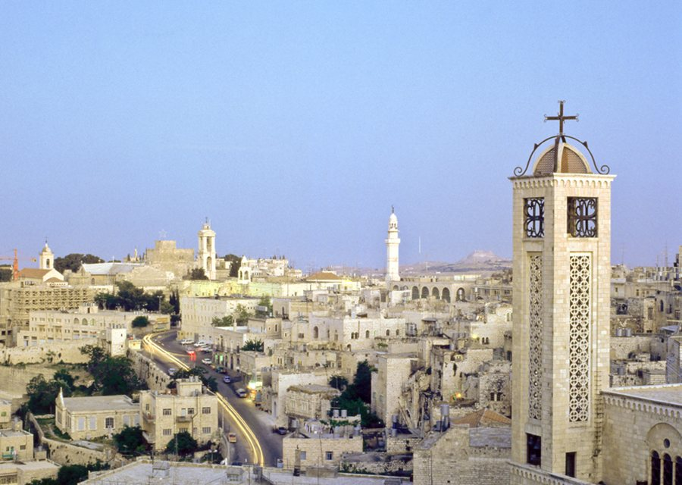
Settlements

Slide 36
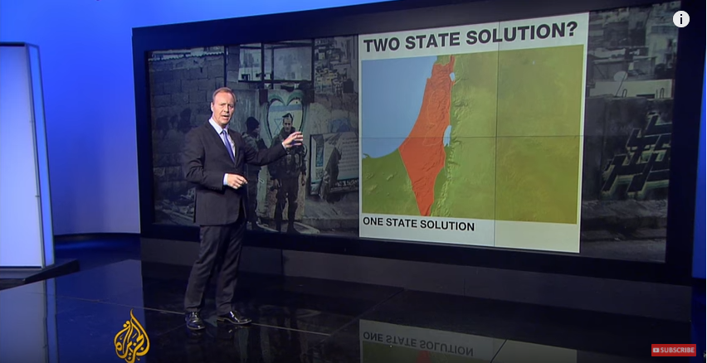

Slide 37
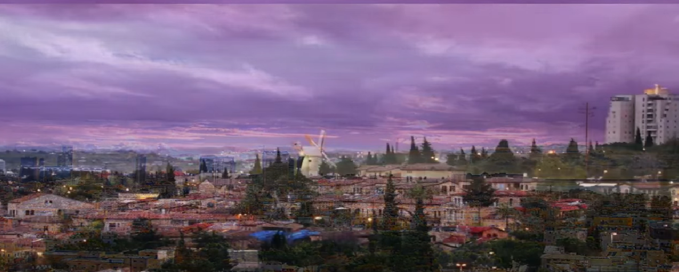

Slide 38

תודה רבה!!!

