Slide 1
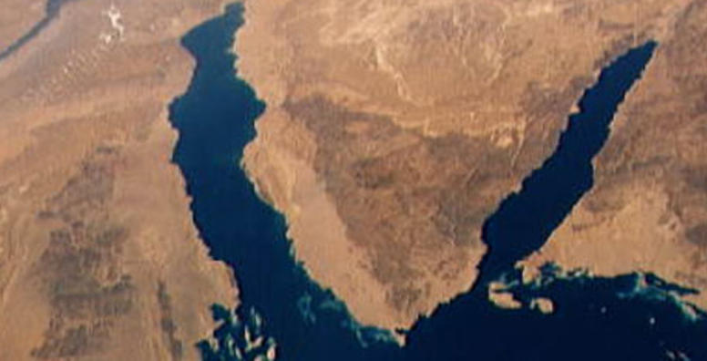
War & Peace
In The Middle East
Lecture #4

Slide 2
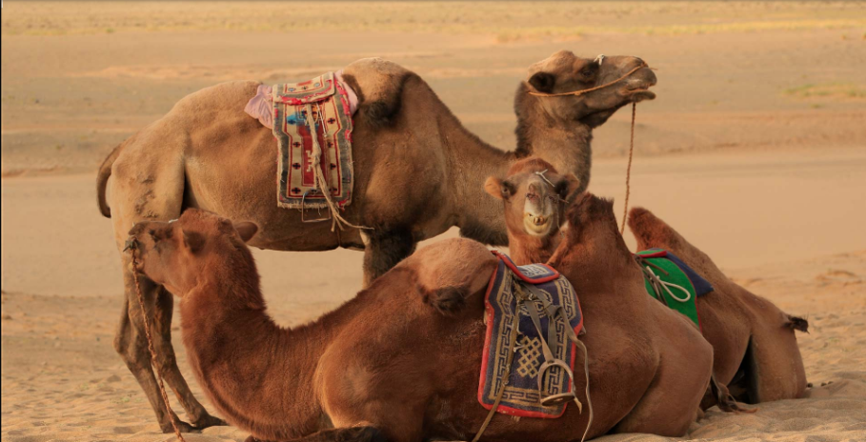
Last week today
The Israeli – Palestinian Conflict – Part I
  The history of the Israeli Palestinian Conflict
  The Nakba – Catastrophe
  The post Six Days War
  The search for peace
  The potential solutions
  The Core Issues – Next Week
  Discussion Q&A

Slide 3
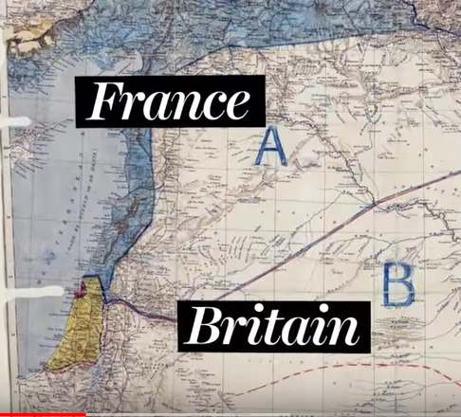
The Israeli – Palestinian Conflict History
In
10 Minutes
https://www.youtube.com/watch?v=iRYZjOuUnlU&t=4s

Slide 4
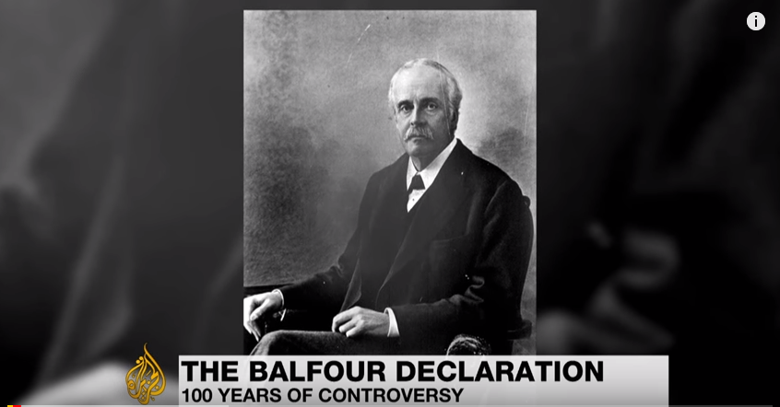
https://www.youtube.com/watch?v=ljzfsxOx_r0&t=74s

Slide 5
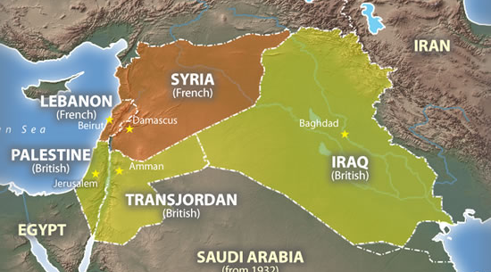
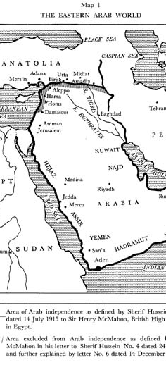

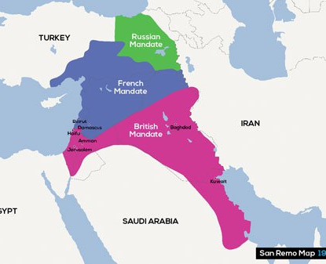
THE MCMAHON - HUSSEIN CORRESPONDENCE 1915-1916
https://www.youtube.com/watch?v=Af_egeamiQ8

Slide 6
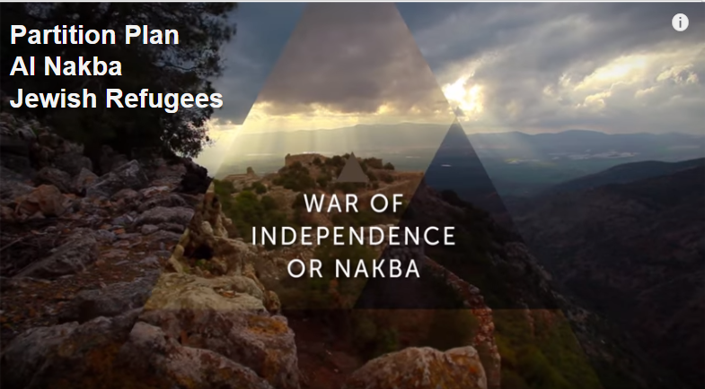
https://www.youtube.com/watch?v=OhQ7yfI0Nbo

Slide 7
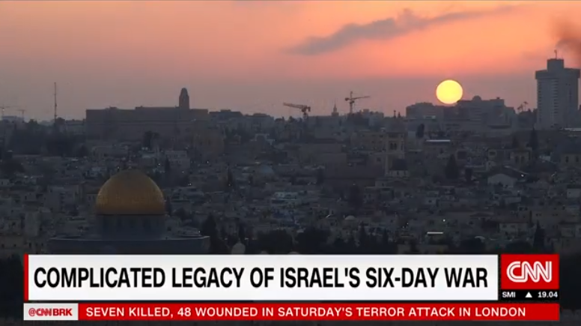
http://www.cnn.com/videos/world/2017/06/05/six-days-war-50th-anniversary-israel-palestine-liebermann-pkg.cnn/video/playlists/israeli-palestinian-conflict/

Slide 8
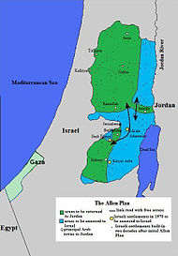
The Allon Plan –June, 1967
1. Partition West Bank
2. Druze State on Golan
3. Return the Sinai
- Israel declined Palestinian option
- Jordan declined Jordanian Option

Slide 9
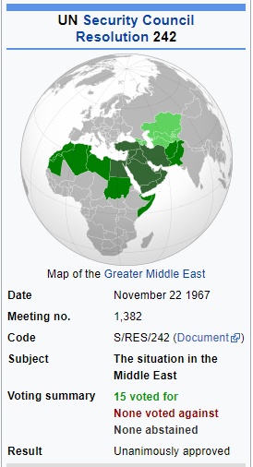
UN Resolution 242
“Withdrawal of Israeli armed forces from territories occupied in the recent conflict””
“Termination of all claims or states of belligerency and respect for and acknowledgment of the sovereignty, territorial integrity and political independence of every State in the area and their right to live in peace within secure and recognized boundaries free from threats or acts of force.“
Direct Negotiation
https://www.youtube.com/watch?v=SpkkdTFC5ek

Slide 10
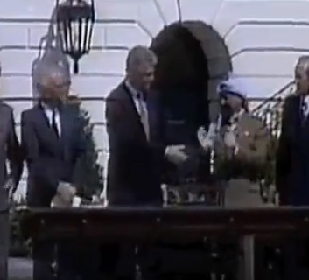
The Oslo Accords
Palestinian Authority
Rabin Assassination
The Rise of the Right
Camp David II
Courage of Leadership?
Vision of Peace
Israeli Consensus
Palestinian Unity
The Old Guard
https://www.youtube.com/watch?v=Jk7JQxTDhdM&t=289s

Slide 11
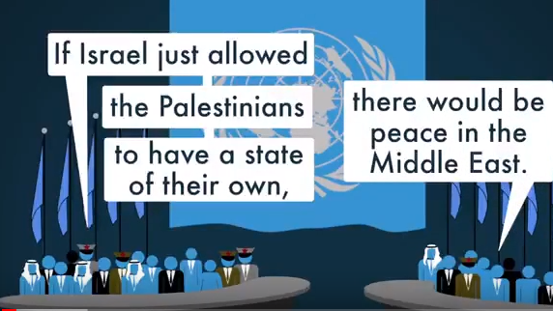
https://www.youtube.com/watch?v=a2cSZ8ro5hk&t=1s

Slide 12
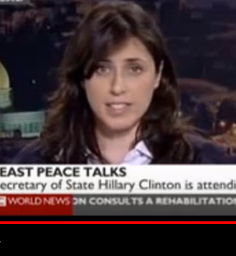
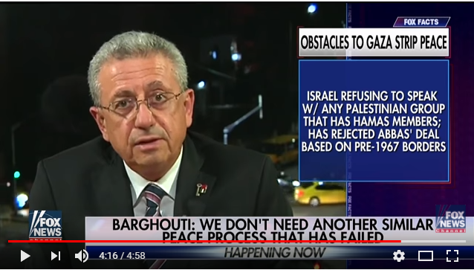
The Extremists
https://www.youtube.com/watch?v=ldZujjKojvo
https://www.youtube.com/watch?v=pTFghpxoUvA

Slide 13
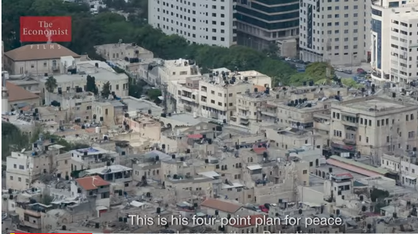
https://www.youtube.com/watch?v=PHFt8mAwl-g

Slide 14
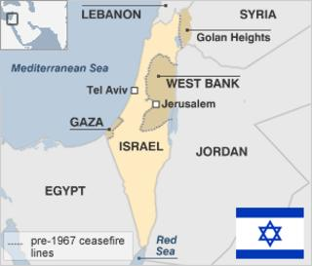
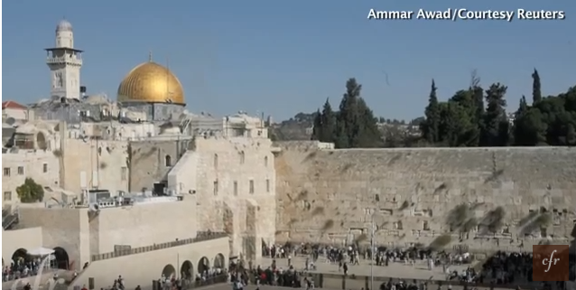
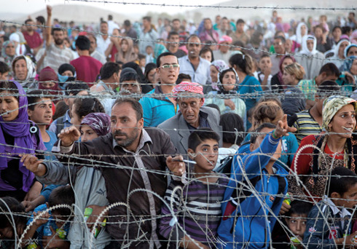
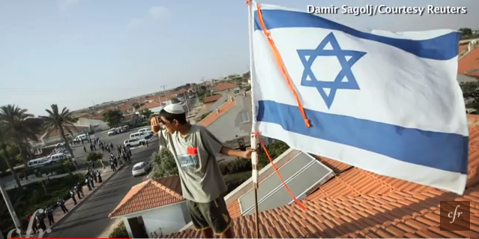
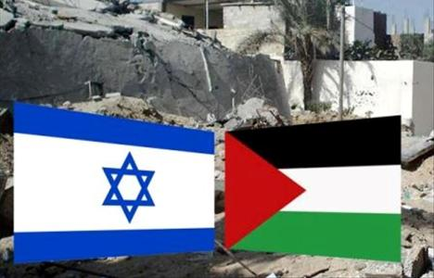

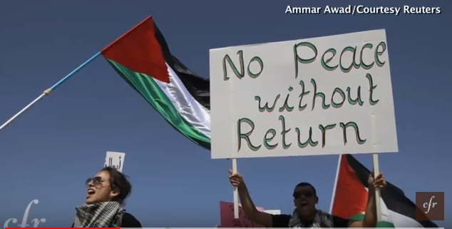
The Thorny Issues
Borders
Refugees
Jerusalem
Settlements
Security/De-militarization
Right of Return
Statehood/Recognition

Slide 15

II

