Slide 1


Slide 2
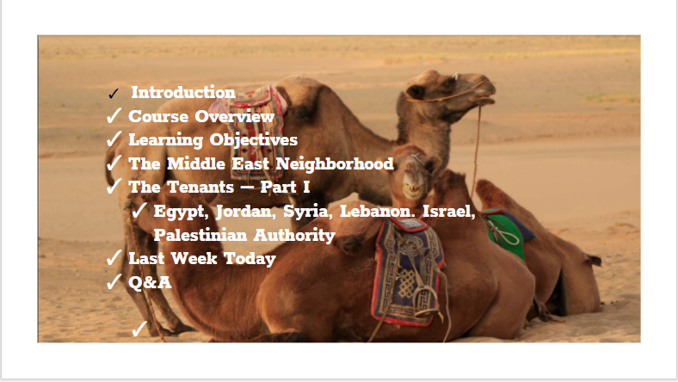

Slide 3


Slide 4


Slide 5


Slide 6
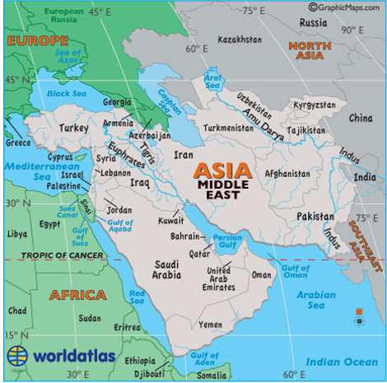

Slide 7

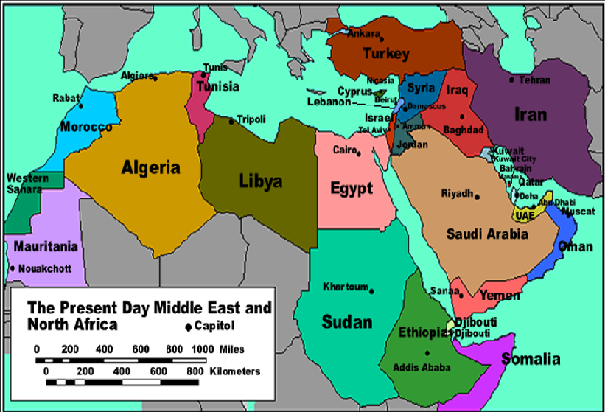
https://www.youtube.com/watch?v=s9xfK92Zv68

Slide 8
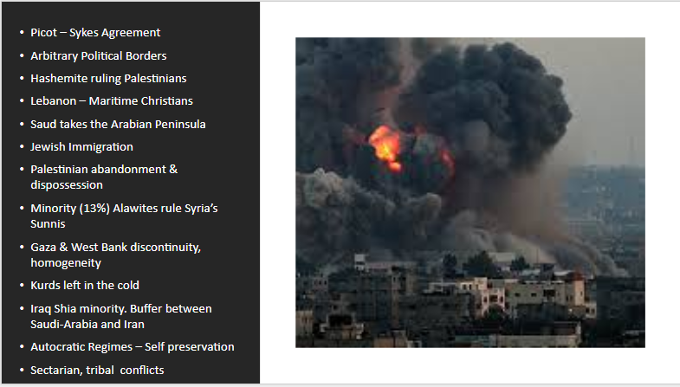

Slide 9


Slide 10
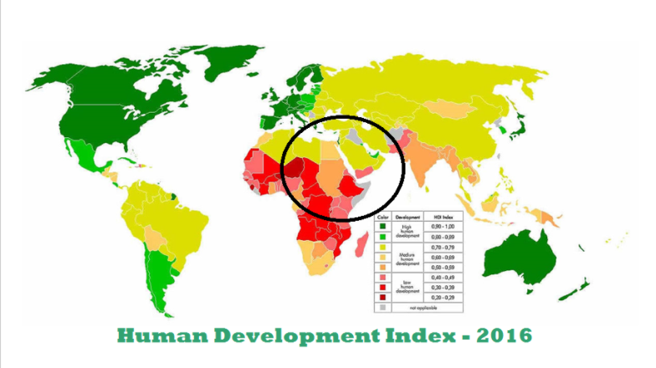

Slide 11
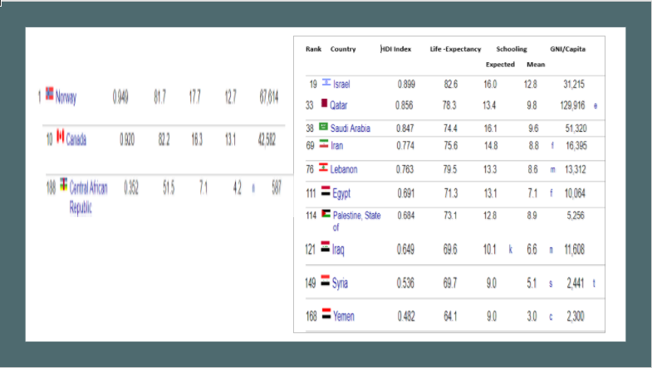

Slide 12


https://www.youtube.com/watch?v=Y5suNtLwbBw&feature=youtu.be

Slide 13


Slide 14

https://www.youtube.com/watch?v=JFpanWNgfQY

Slide 15
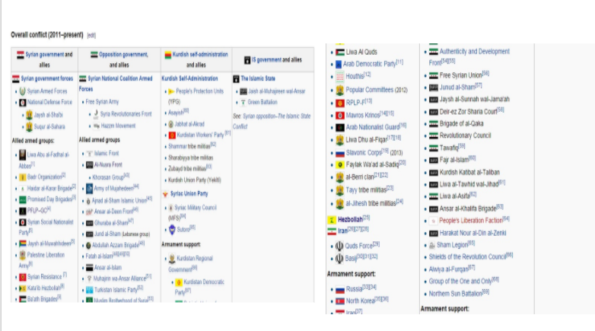

Slide 16

https://www.youtube.com/watch?v=JVnoOCplqyI

Slide 17
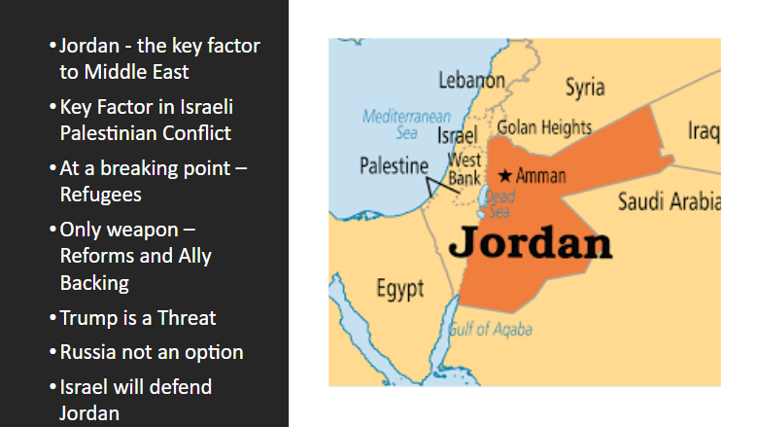

Slide 18

https://www.youtube.com/watch?v=i_w3v6t3rjY

Slide 19


Slide 20

https://www.youtube.com/watch?v=lY6jaUZCLwo

Slide 21


Slide 22


Slide 23
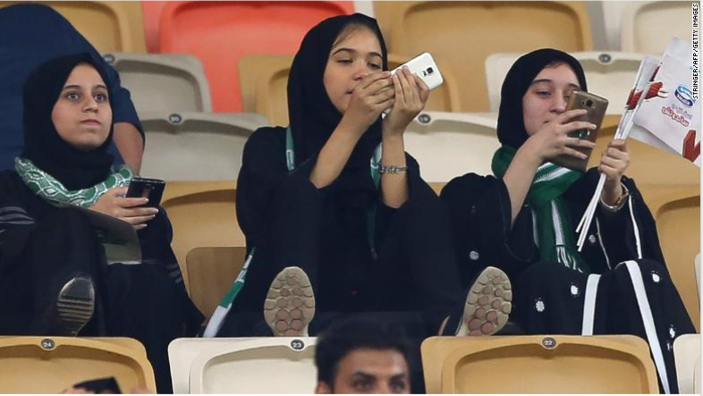



Slide 24


Slide 25


