Slide 1
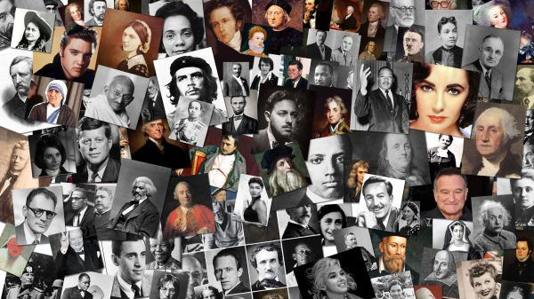
Leaders & Heroes
People who made a difference
Lecture # 3 Human Rights Activists

Slide 2
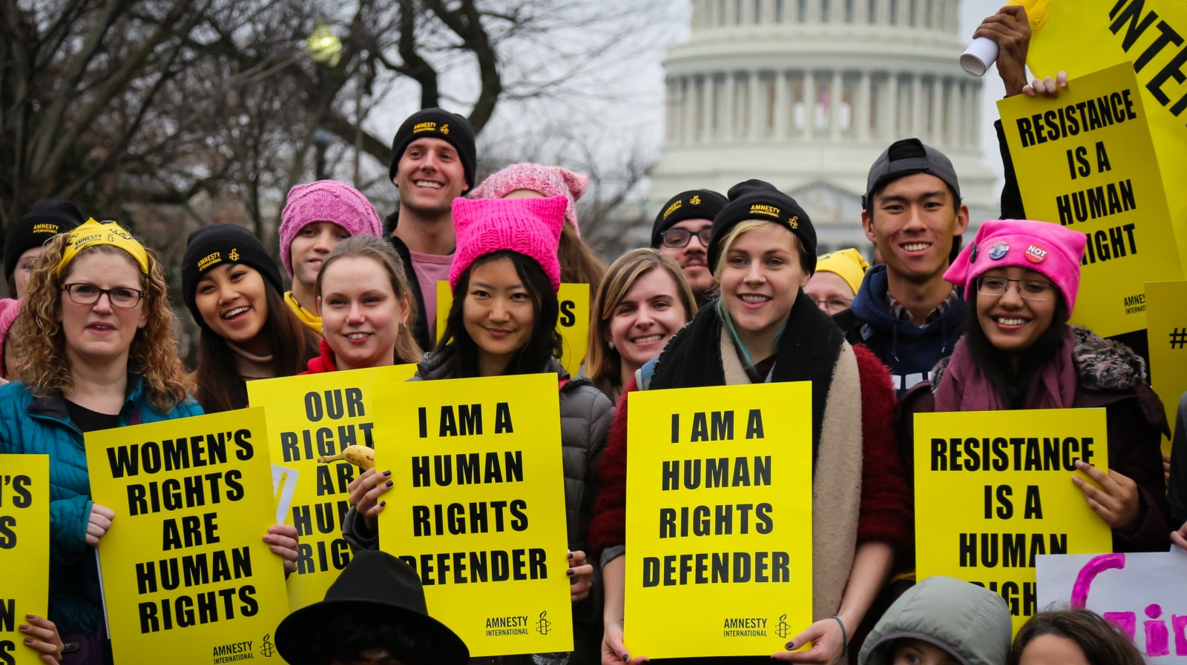

Slide 3
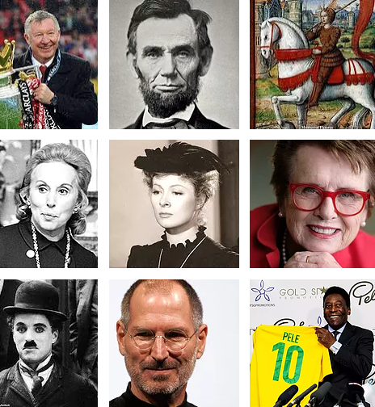
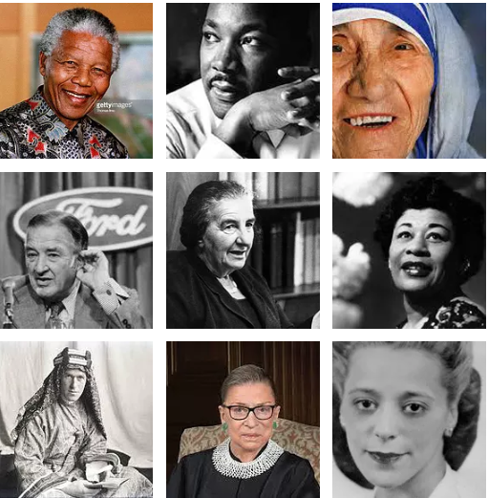
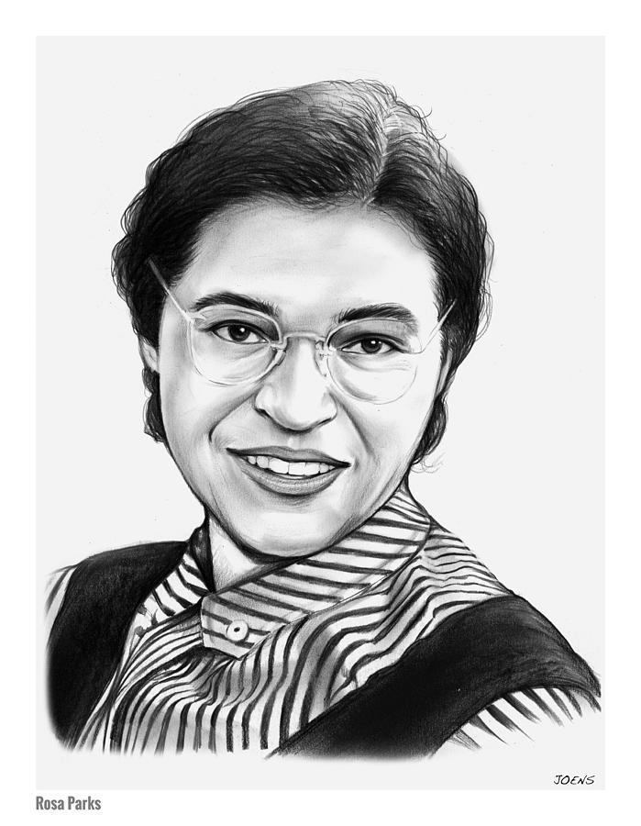


Slide 4
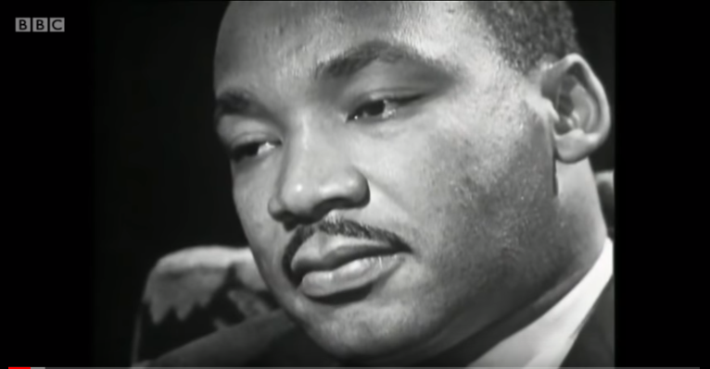

Slide 5
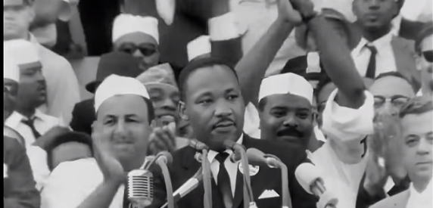
I Have a Dream

Slide 6
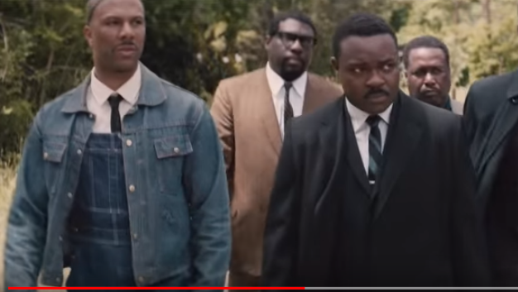
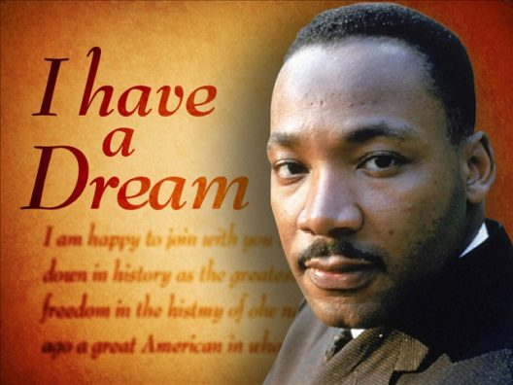
SELMA
https://www.youtube.com/watch?v=x6t7vVTxaic

Slide 7

https://www.youtube.com/watch?v=3_RBi8xaXjA

Slide 8
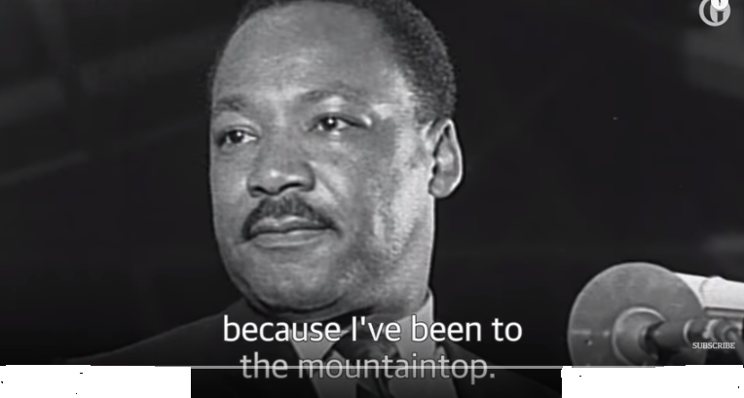
https://www.youtube.com/watch?v=e49VEpWg61M

Slide 9
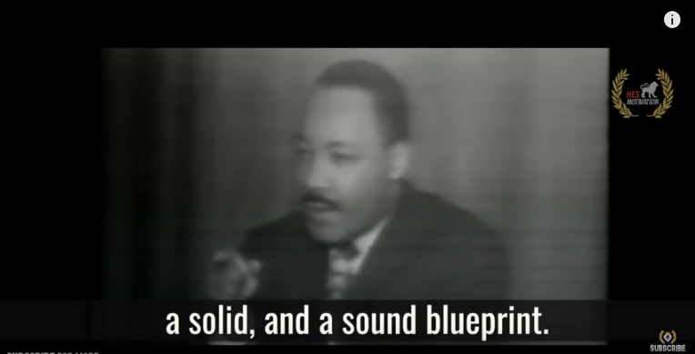
https://www.youtube.com/watch?v=zGt1zbNt2TI

Slide 10
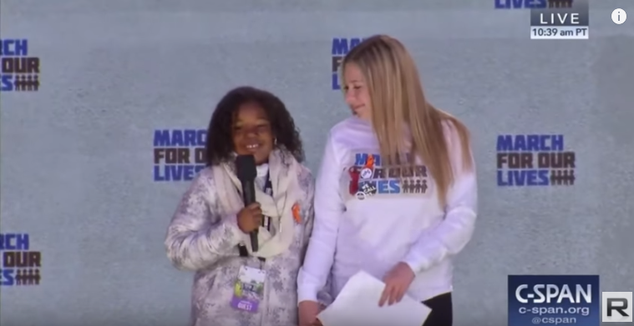
Like Grandfather Like Granddaughter
https://www.youtube.com/watch?v=toNMgn3Tj2Q

Slide 11
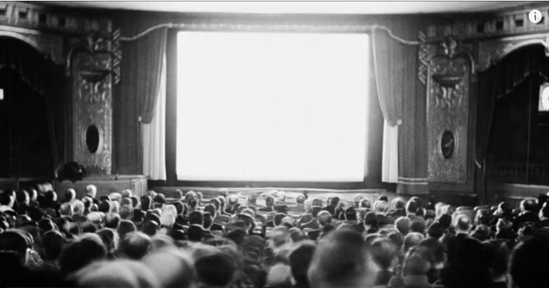
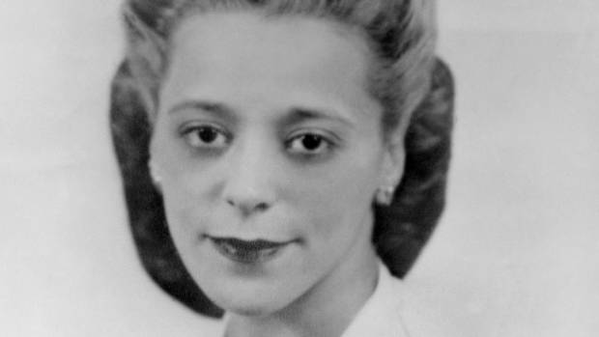
https://www.youtube.com/watch?v=MxU84Pb2HAo

Slide 12
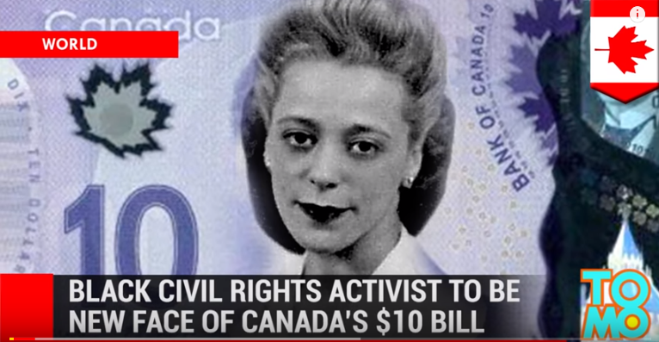
https://www.youtube.com/watch?v=xnjDgorj1Tw

Slide 13
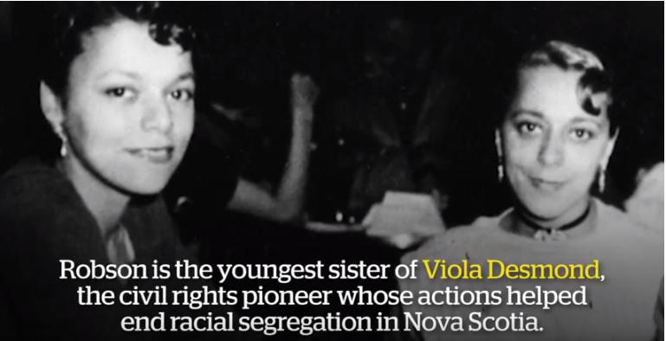
https://www.youtube.com/watch?v=i3XPVlJyocg

Slide 14
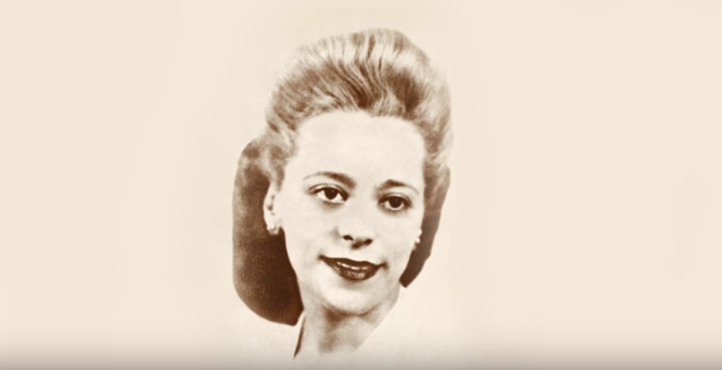
https://www.youtube.com/watch?v=a9zQ5bNyn8s

Slide 15
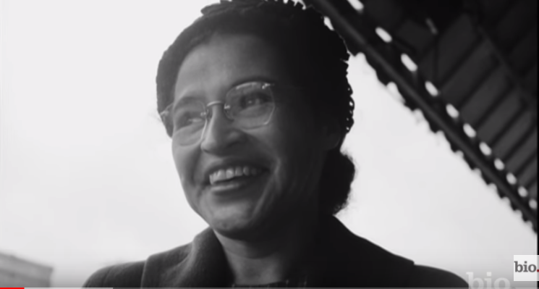
Rosa Parks
https://www.youtube.com/watch?v=v8A9gvb5Fh0

Slide 16
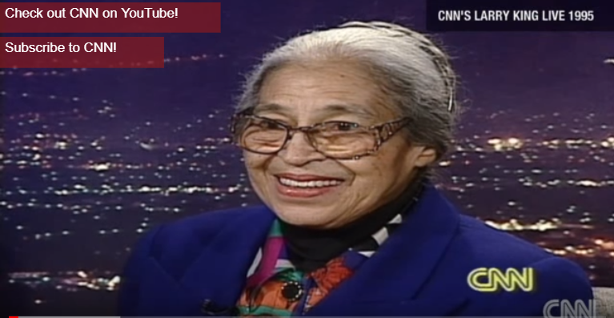
https://www.youtube.com/watch?v=eP1PeR4huuM

Slide 17
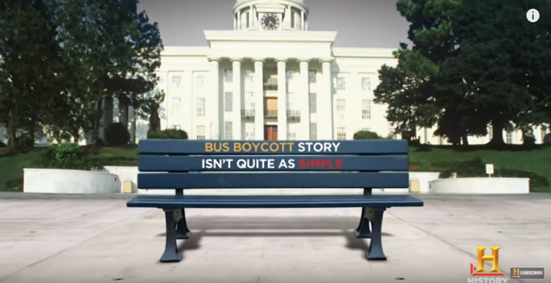
https://www.youtube.com/watch?v=VMACKNh5MuY

Slide 18
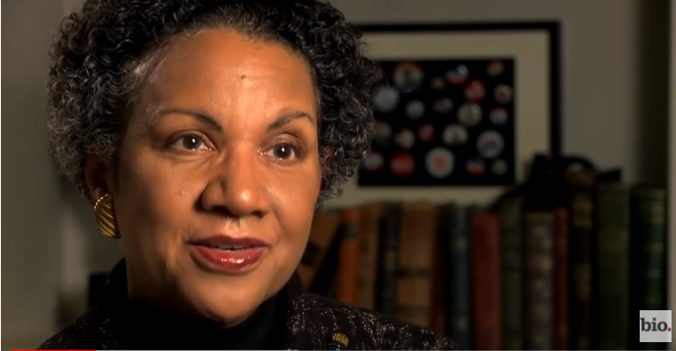
The Influence of Rosa Park
https://www.youtube.com/watch?v=cNzQW_lwOko

Slide 19
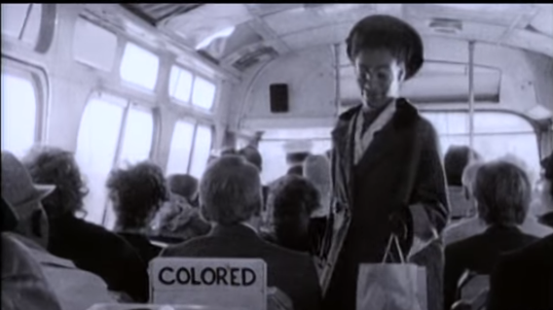
https://www.youtube.com/watch?v=JKCsZc37esU

Slide 20
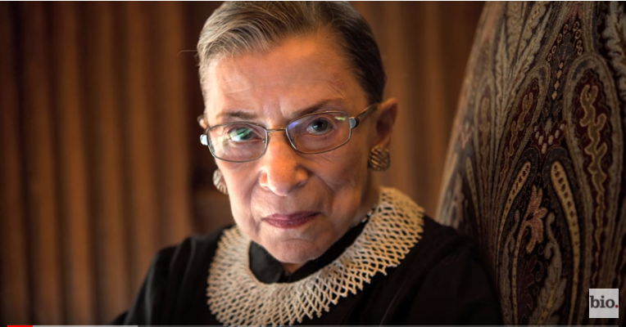
RBG
https://www.youtube.com/watch?v=eY9OE-Eq4TE

Slide 21
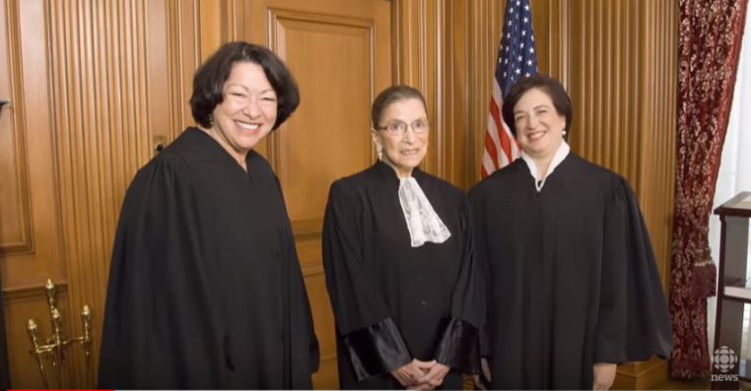
https://www.youtube.com/watch?v=kW6YEZMtIto

Slide 22
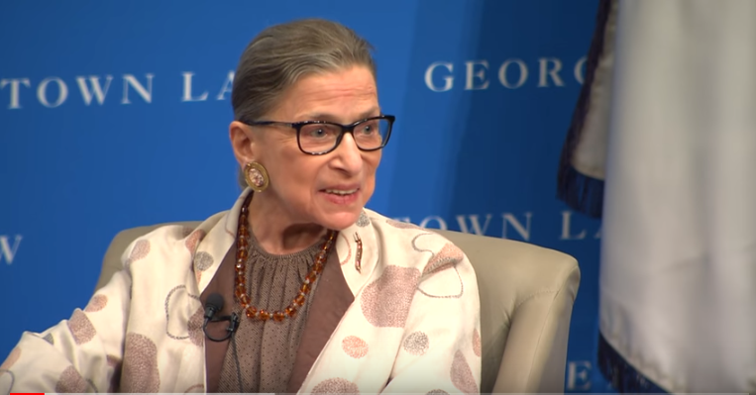
In Her Own Words
https://www.youtube.com/watch?v=AiWYYd1zNJs

Slide 23
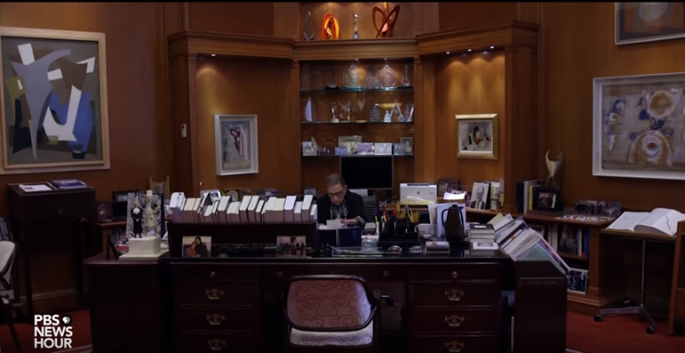
https://www.youtube.com/watch?v=cED0_VEOuRI

