Slide 1
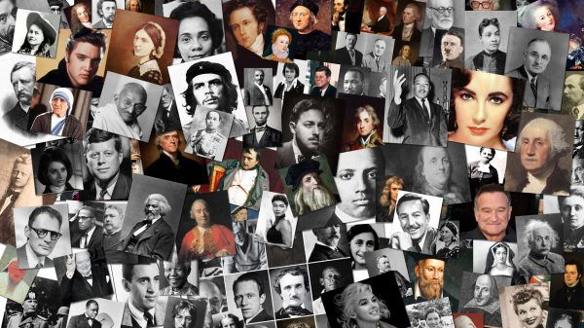
Leaders & Heroes
People who made a difference
Lecture #5 – The Performing Arts

Slide 2


Slide 3
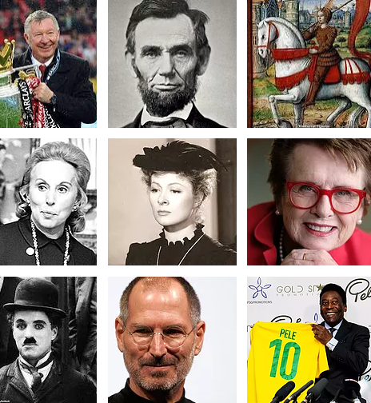
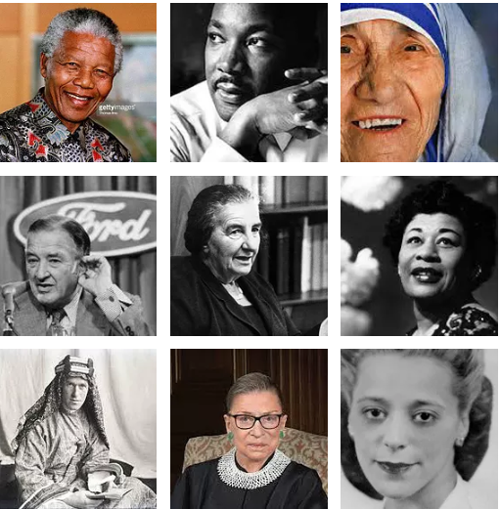
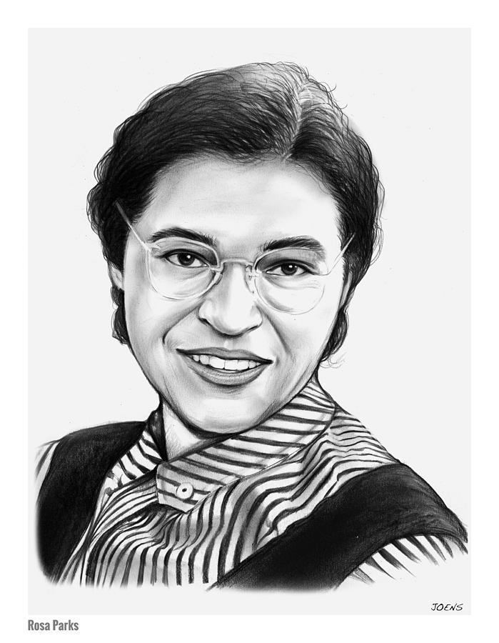


Slide 4
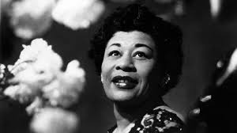
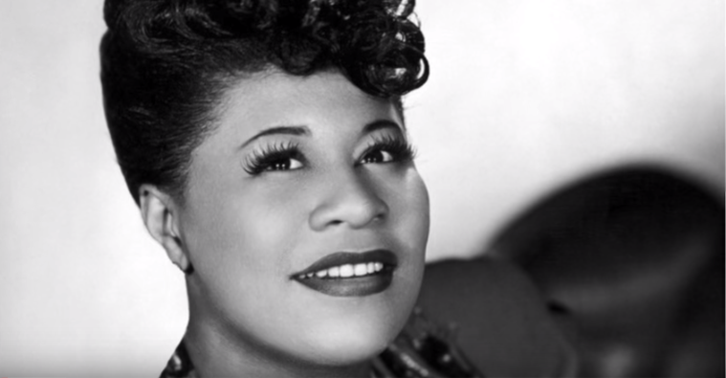
Ella Fitzgerald
https://www.youtube.com/watch?v=79CLMD6yc6I

Slide 5
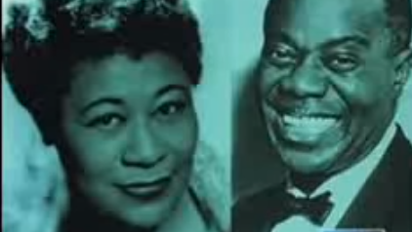
https://www.youtube.com/watch?v=uxotcFALP8k

Slide 6
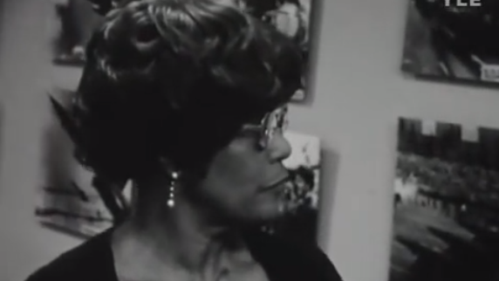
1974 Interview
https://www.youtube.com/watch?v=OnE4qQyle-M

Slide 7
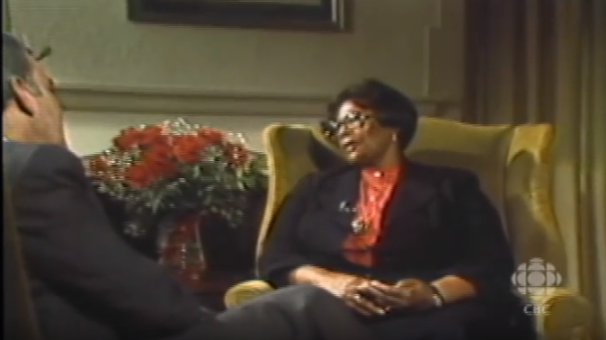
BBC Interview – My Life
https://www.youtube.com/watch?v=OnE4qQyle-M

Slide 8
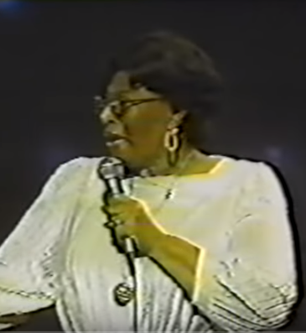
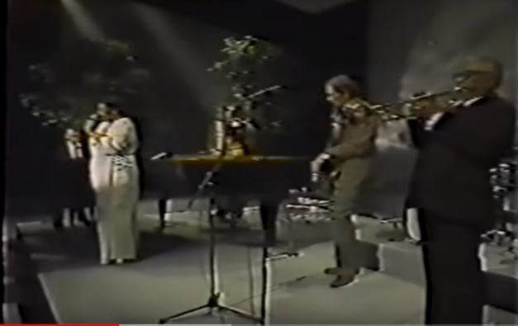
1979 Special
https://www.youtube.com/watch?v=ON8WzMb7-sM

Slide 9
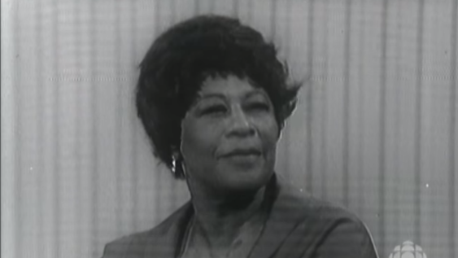
Black Is Black in America even if you’re the Queen of Jazz
https://www.youtube.com/watch?v=R95zXX9oztA

Slide 10
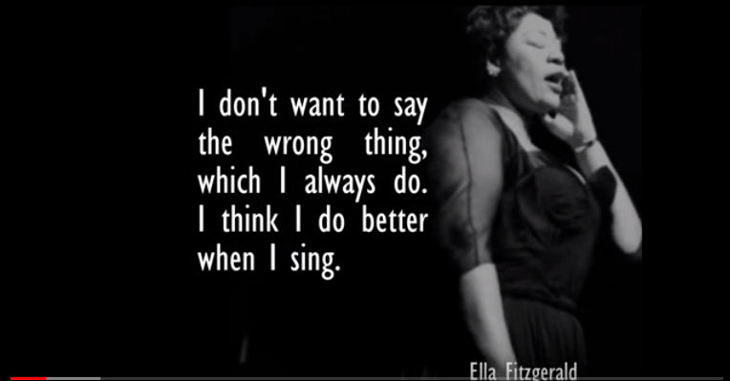
https://www.youtube.com/watch?v=dyMRriAcyl8&t=18s

Slide 11
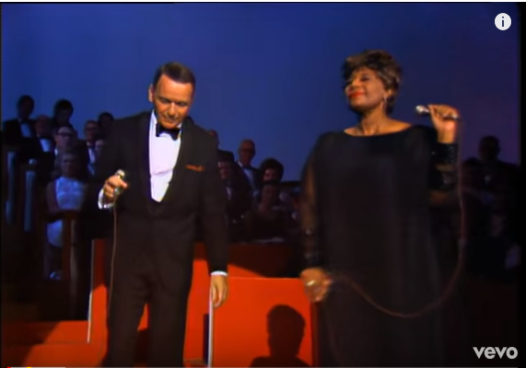
The Greatest
https://www.youtube.com/watch?v=xafBWOxqssg

Slide 12

https://www.youtube.com/watch?v=ywbHMWDFYJo

Slide 13
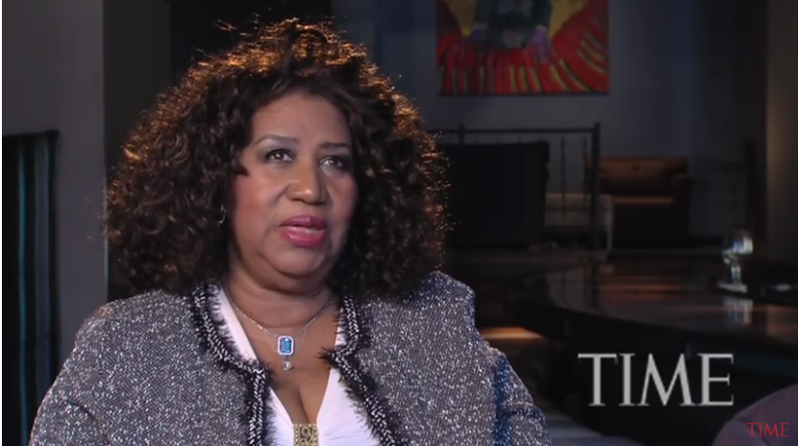
https://www.youtube.com/watch?v=k234-9ftkM8

Slide 14
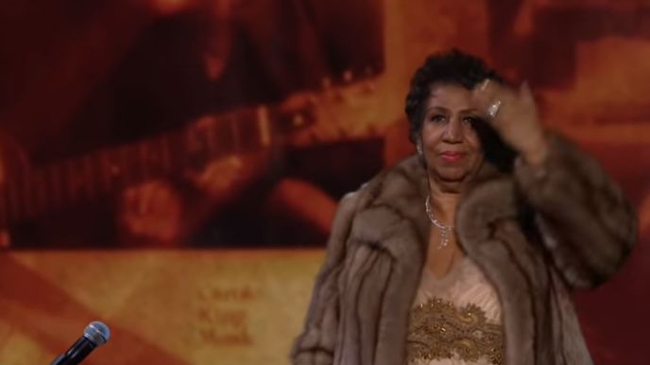
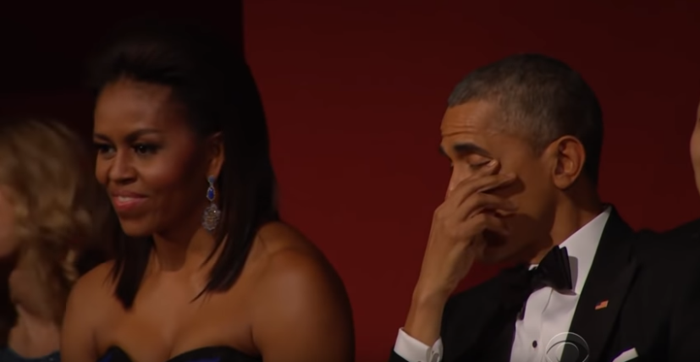
The Queen of Soul
https://www.youtube.com/watch?v=8cF0tf35Mbo

Slide 15
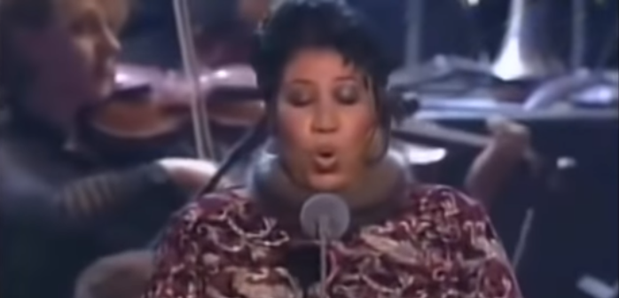
Not Just Soul
https://www.youtube.com/watch?v=_tsYKhGu--U

Slide 16

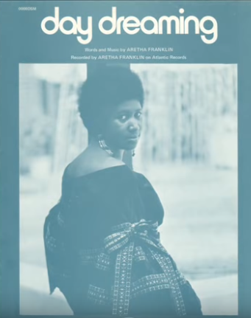
https://www.youtube.com/watch?v=4tMFqa_K7bg&feature=youtu.be

Slide 17
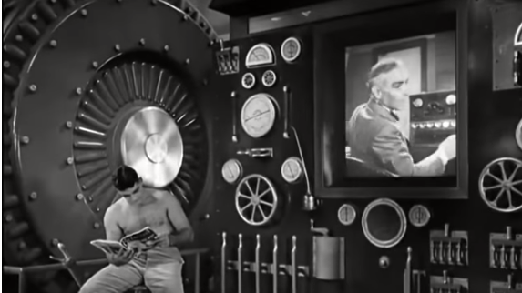
https://www.youtube.com/watch?v=HPSK4zZtzLI

Slide 18
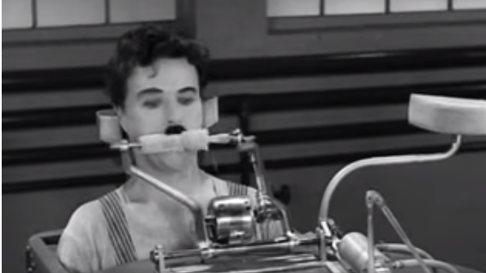
https://www.youtube.com/watch?v=n_1apYo6-Ow&t=105s

Slide 19
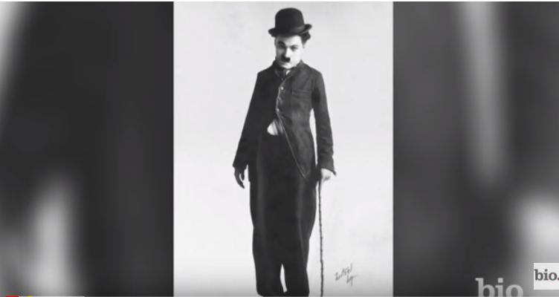
https://www.youtube.com/watch?v=v_ibx52DgoA&t=1s

Slide 20
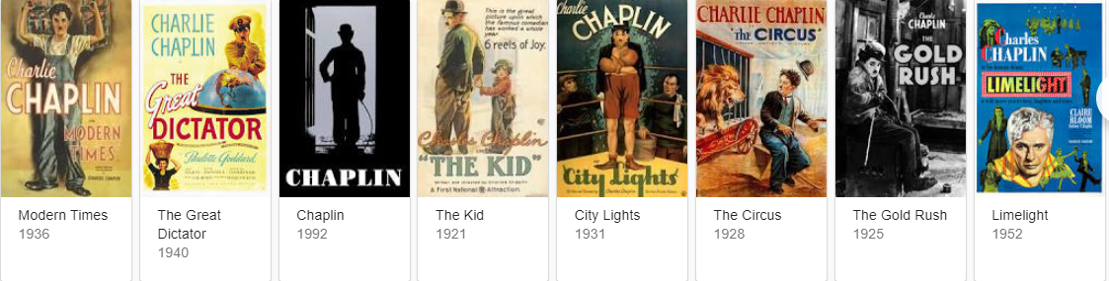
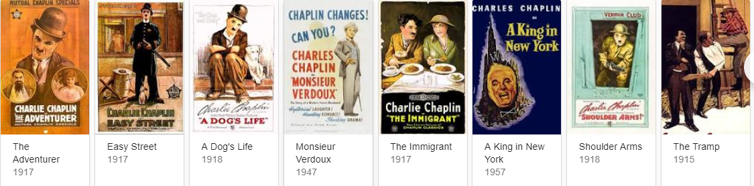
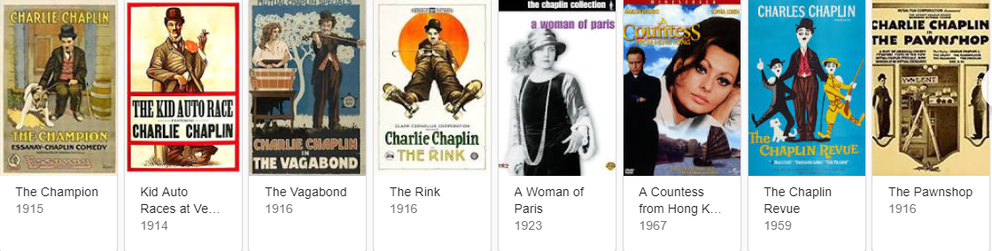

Slide 21
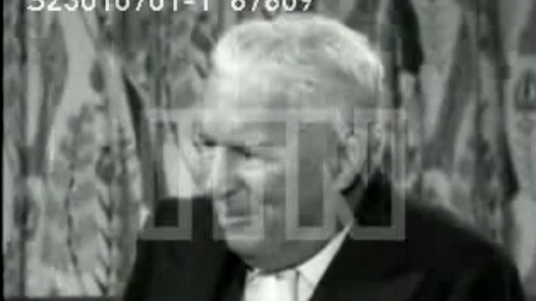
1957 Rare Interview
https://www.youtube.com/watch?v=7j5v0mRFr8U

Slide 22
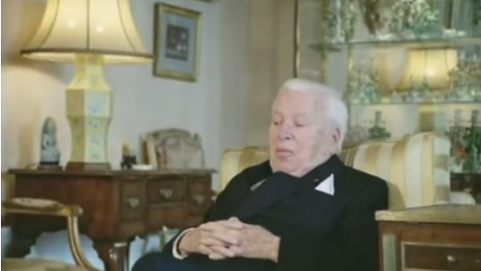
His House in Switzerland
https://www.youtube.com/watch?v=m-e8V40bQYM

Slide 23
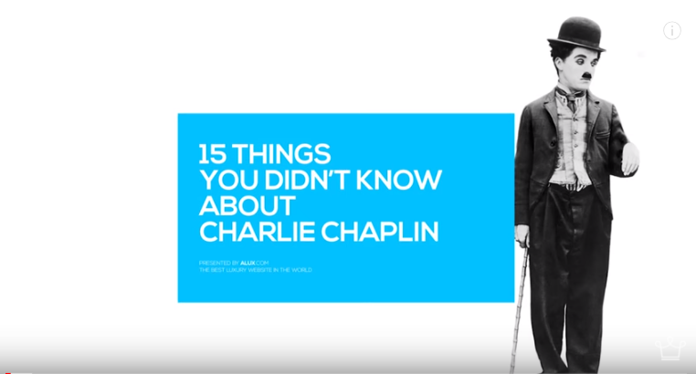
https://www.youtube.com/watch?v=JG0Qwx0ruQs&t=106s

Slide 24
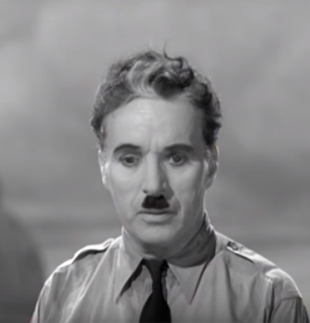
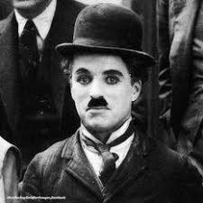
The Great Dictator
The Little Tramp
https://www.youtube.com/watch?v=J7GY1Xg6X20

Slide 25
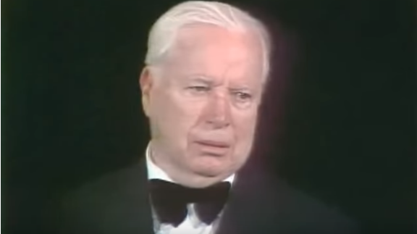
Oscars 1972 – Honorary Award
https://www.youtube.com/watch?v=gVvOtS5i4DU

