Slide 1
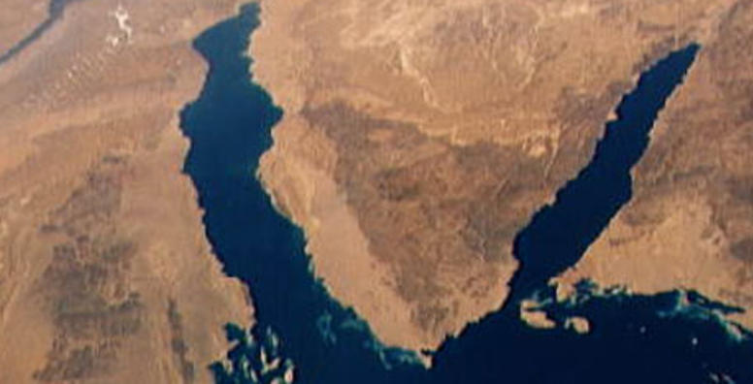
War & Peace
In The Middle East
Lecture #5

Slide 2
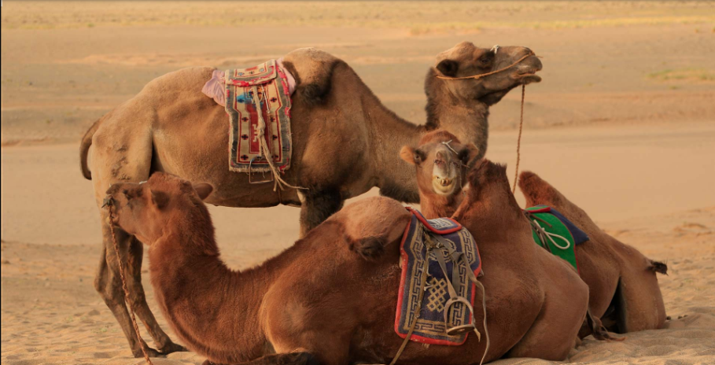
Last week today
The Israeli – Palestinian Conflict – Part II
  Settlements
  Jerusalem
  Borders
  Security
  Statehood
  Right of Return
  Refugees Resettlement
  Discussion Q&A

Slide 3
https://www.youtube.com/watch?v=ECscKICzsJ0

Slide 4
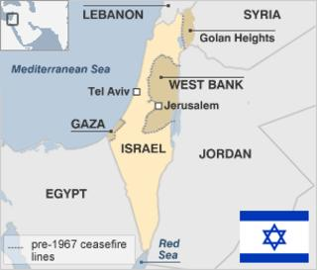
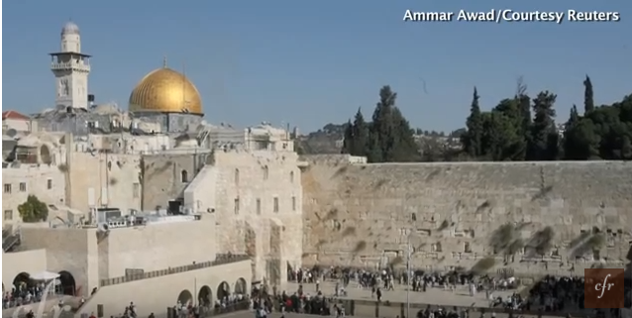
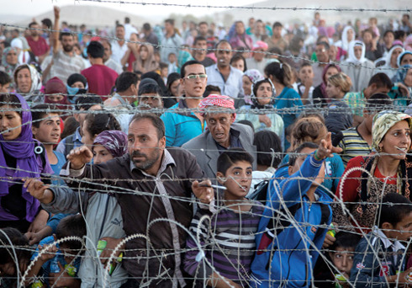
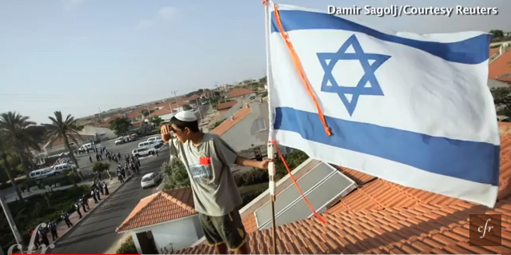
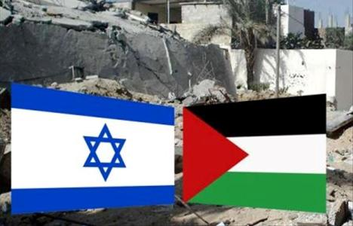

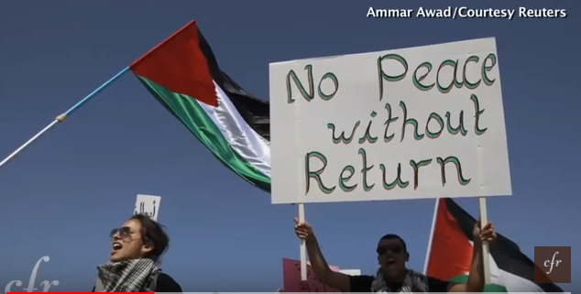
The Thorny Issues
Borders
Refugees
Jerusalem
Settlements
Security/De-militarization
Right of Return
Statehood/Recognition

Slide 5
Borders
https://www.youtube.com/watch?v=0JjpB6sQoVI&t=23s

Slide 6
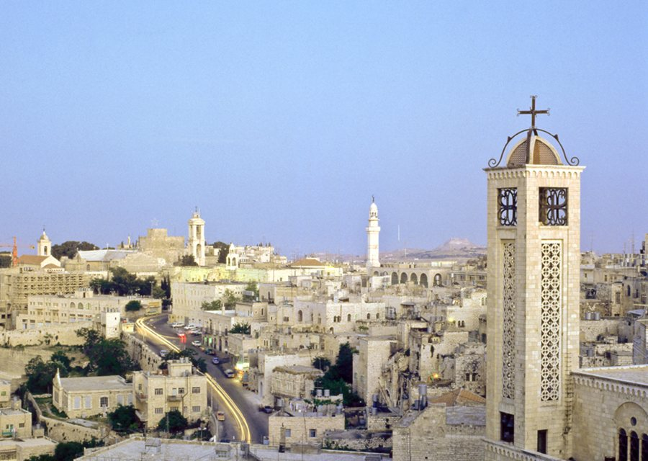
Settlements
https://www.youtube.com/watch?v=E0uLbeQlwjw&t=5s

Slide 7
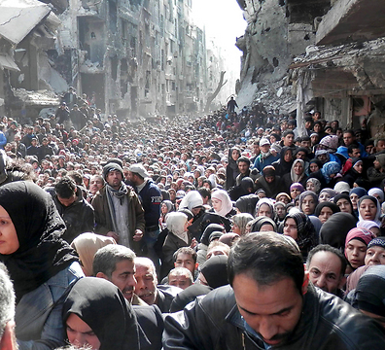
Palestinian Refugees
https://www.youtube.com/watch?v=z2WlJe4mlSY
Palestinians claim the “Right of Return” of all Palestinian refugees to their ancestral homes and lands (U.N Resolution 194 (paragraph 11 out of 15) and assign blame and responsibility to Israel.
Contrary to Palestinian claims Resolution 194 did not guarantee Palestinians the right of return:
  Willing to live in Peace with their neighbors
  Return at “the earliest practicable date” not 63 years later
  It does not refer only or specifically to Palestinian refugees (what about Jews?)
  It offers alternatives to repatriation. e.g. Resettlement and Rehabilitation

Slide 8
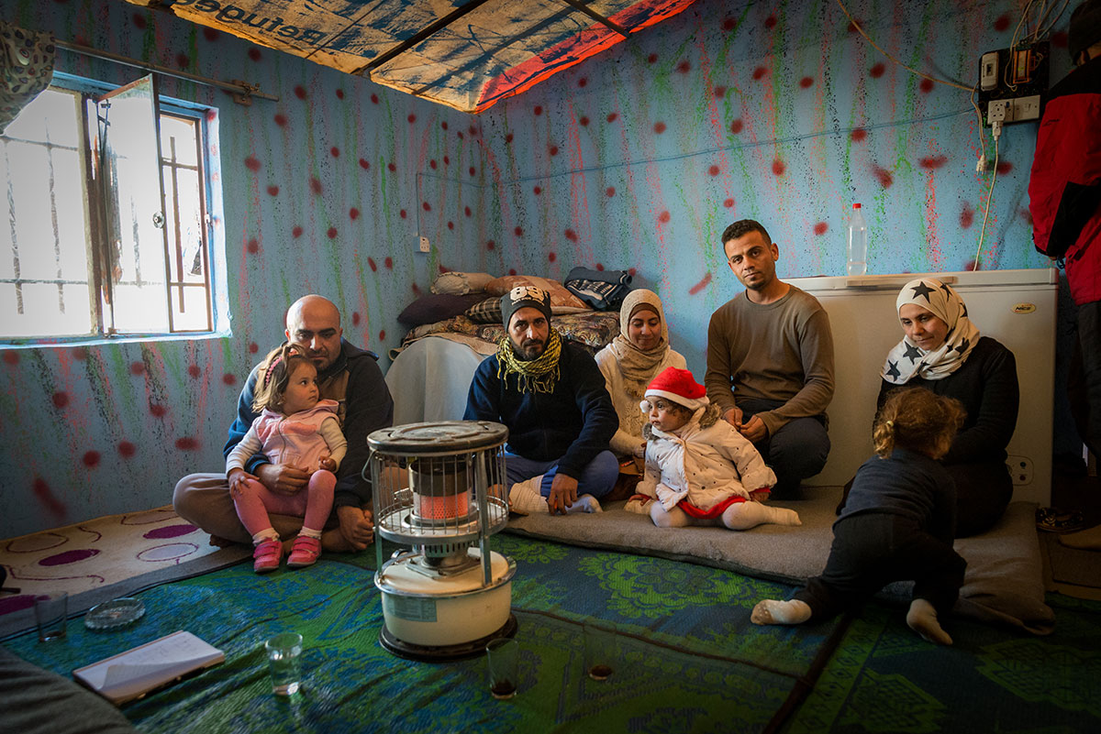
Palestinian Refugees
The return of all Palestinian refugees to Israel proper is not practical, logical and definitely not attainable…
Who says so?
“The return of even 1 million refugees would mean "the end of Israel" and does not seem practical. It would be “illogical” to ask Israel to absorb 5 million refugees as part of a final peace deal.”
Mahmoud Abbas, President, Palestinian Authority November 2008 (source Al Jazeera)

Slide 9
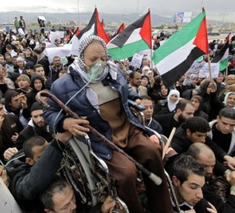
Palestinian Refugees
The conditions of the refugees in the camps are appalling, and their resettlement is a human right obligation of the international community.
Resettling the Palestinians Refugees in the Palestinian State as part of a comprehensive peace in the Middle East is the only solution.
A joint responsibility of all countries of the Middle East including Israel.

Slide 10
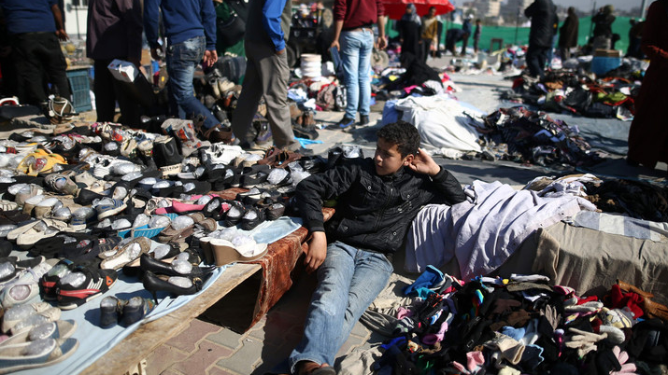
Refugee Camps
https://www.youtube.com/watch?v=g-XHn6bFRRA&t=135s

Slide 11
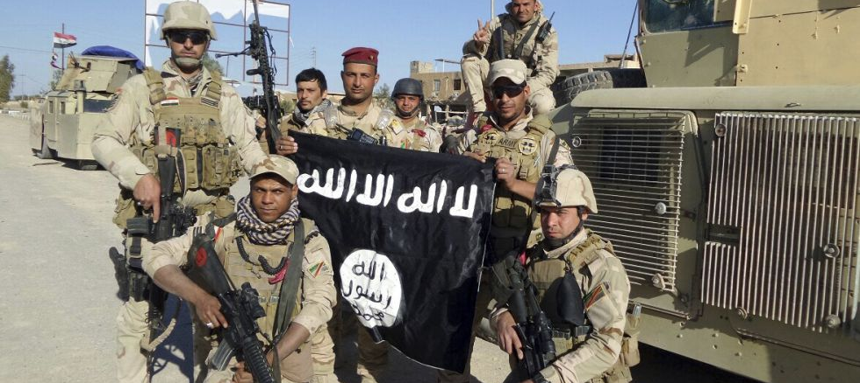

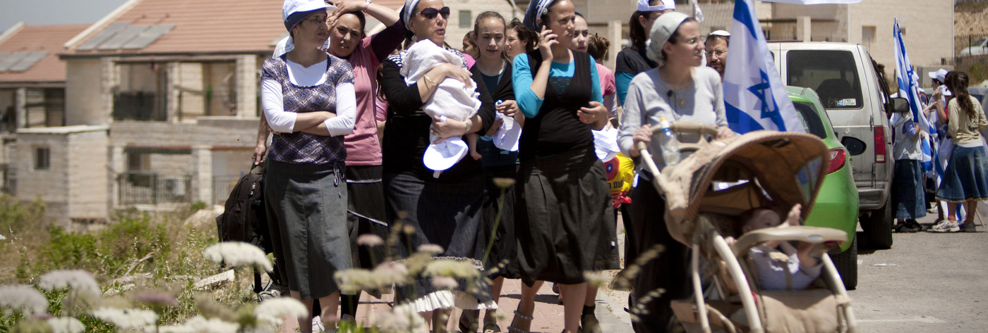
Security
https://www.youtube.com/watch?v=kkIIxXfGKAU
Defensible Borders, de-militarization, Security Co-operation, Time limited presence

Slide 12
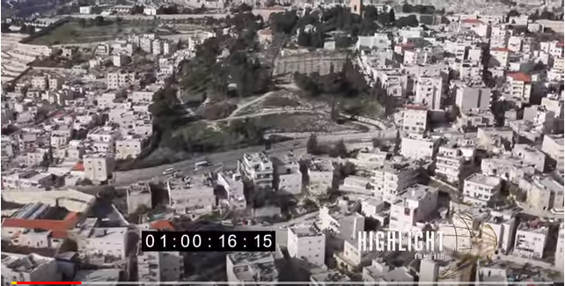
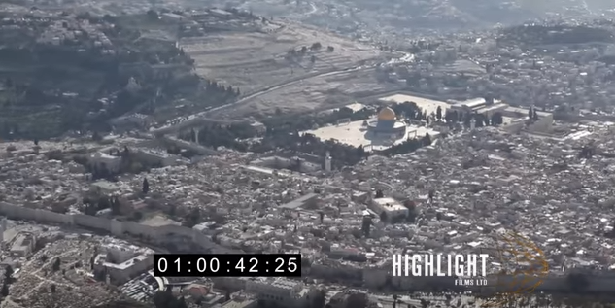
Jerusalem
https://www.youtube.com/watch?v=0evyqo0yS34

Slide 13
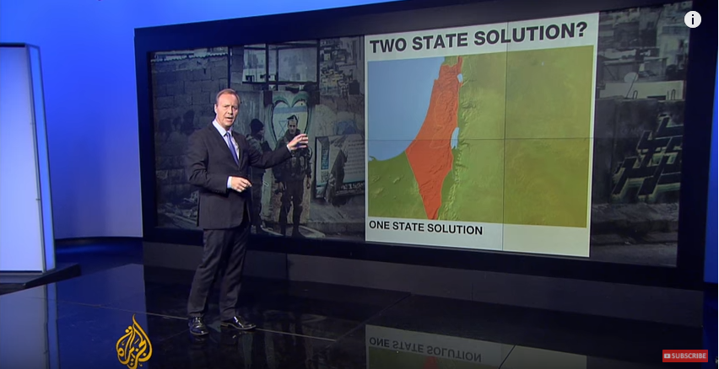
https://www.youtube.com/watch?v=S3NV5taFoWc&t=7s

Slide 14

The World and the Middle East
USA, RUSSIA,CHINA, EUROPEAN UNION, TURKEY, IRAN, SAUDI

